Slide 1
MICHAEL’S Game
Intervention for Delusional Thoughts in a Long Term Forensic Settting

Slide 2
Presenters
Katie Thumann, MSW, LCSW
Katie is the Program Director for the Cognitive Behavior Program at Saint Louis Psychiatric Rehabilitation Center. She received her BSW and MSW from Saint Louis University, and has been a Licensed Social Worker in Missouri since 2013. Katie is learning new things everyday about behavior management, as she parents two children under the age of four; those two present to be more challenging than any client!
Mark Felchlia, PhD
Mark is a licensed Psychologist who works with Deaf Services and the Cognitive-Behavioral Program, and is the site Internship Training Coordinator for St. Louis Psychiatric Rehabilitation Center. He completed his PhD in clinical psychology from St. Louis University in 1992. Clinical interests include individual therapy in long-term treatment settings, the impact of involuntary treatment on the change process, and the psychologist’s role while working with a multidisciplinary team.
Kaelee Newton
KaeLee Newton is a Quality Assurance Specialist for the state of Missouri working at Saint Louis Psychiatric Rehabilitation Center (SLPRC) in St. Louis, MO. She has worked at the facility for nearly 15 years (A fact she can hardly believe when she thinks about it!) starting as a Psychiatric Technician during graduate school. In her role as Quality Assurance Specialist, Ms. Newton enjoys playing with data and making pretty charts and graphs to help translate sometimes overwhelming information into more easily understandable representations. When not at work, she continues creating pretty things by making jewelry or crocheting. She is also trying to see just how many books her bookshelves can hold before collapsing under their own weight as well as working on filling her digital bookshelves with an equal number of undiscovered favorites. She is equally happy talking about research design and data collection as she is about the last great book she read so feel free to start a conversation if you see her wandering between presentations!

Slide 3
Michael’s Game
This presentation will focus on the implementation of “Michael’s Game” in a Forensic setting, specifically the Cognitive Behavior Program at St. Louis Psychiatric Rehabilitation Center. The presenters will review pre and post testing scores using the Peters Et Al Delusion Inventory (PDI 21), implications of this group in an inpatient setting versus a traditional outpatient setting, and additional qualitative benefits of the group in the Cognitive Behavior Program setting where it was implemented.
Objectives:
Describe Michael’s Game and its intended use/benefits
Identify alternative benefits to implementing Michael’s Game in an inpatient setting
Identify opportunities to measure pre and post group symptoms using the PDI 21

Slide 4
Overview
What is Michael’s Game?
Considerations for Inpatient vs Outpatient Use
What We’ve Seen at SLPRC
Data

Slide 5
Back to Basics: CBT
Thoughts influence feelings, feelings influence actions, actions influence our results or life circumstances.
Things and people don’t MAKE us feel certain ways. How we interpret situations or things influence how we feel.
Notes:
Since Michael’s Game is grounded in CBT, best to review basics of the EBP. Cognitions --→ Behaviors -→ consequences
Sometimes we put ourselves in situations that make us vulnerable to certain triggers. For example, we choose who we date, marry, going to certain parties, stay at a job, leave a job, using substances, etc. But, we do not choose our parents, our siblings, the situations our caretakers put us in when we were young, who is driving on the road when we are, natural disasters, etc.

Slide 6
Back to Basics: CBT
What is the difference between thoughts and feelings?
  Thoughts are not feelings
  “If it’s a full sentence, it’s a thought.”
  Feelings are one word and an expression of an emotion
Notes:
“I feel like the treatment team is playing me” --→ Not a feeling, this is a thought. Perception/interpretation
Feelings: Angry, sad, mad, happy, ashamed, fearful, anxious, panicked, overwhelmed.
As you’ll see when we get to card examples, Michael’s Game really works on distinguishing thought from feeling and how those impact actions and consequences.

Slide 7
Back to Basics: CBT
Core Beliefs: a mental filter that guides how people interpret events.
  Failure
  Unlovable/Unlikeable
  Helplessness
  Worthlessness
  Abandonment
  Mistrust
  Vulnerability
  Emotional Inhibition
  Emotional Deprivation
  Subjugation
  Entitlement
  Punishment
  Insufficient self control
Notes:
When someone experiences something that is contradictory or inconsistent with his or her core beliefs, the person may come up with a reason why those experiences don’t count -→ maintaining low self esteem

Slide 8
Okay, but what about…
If CBT works for thought distortions or negative core beliefs, what happens when you throw in delusional beliefs?
Michael’s Game!

Slide 9
What is Michael’s Game?
A group intervention
  Can also be used individually
Written card game
Works on “hypothetical reasoning”
Uses a Cognitive Behavior Therapy (CBT) approach

Slide 10
Michael’s Game
Ideal group size is 2 -8; closed
Schizophrenia, Schizoaffective, or Delusional Disorder diagnosis
2 facilitators
Group make up and considerations
Notes:
Our group attendance ranges from 3-5 regular attendees; facilitators should have at least some grounding in CBT practice/training. Our group is facilitated by a PhD, an LCSW, with PhD students assisting.

Slide 11
Michael’s Game
A card game, with each card describing different scenarios.
Socratic Questioning
Progressive difficulty
Group make up and considerations
Notes:
Literally, there are cards.
Patients, guided by the therapist’s Socratic questioning, are led (by those situations)
to become more familiar with the cognitive approach to psychoses.
Group interactions and the patient’s recognition of some of the situations as having been experienced by himself, or by others, could bring the patient to a more personal questioning of his own experiences.
Examples of Socratic Questioning to encourage client participation:
Questions for Clarification:
Why do you say that?
How does this relate to Michael’s experience? To your own experience?
Questions that probe assumptions
What could we assume instead?
How can you verify or disprove that assumption?
Questions that probe for reason and evidence:
What would be an example?
How did you come to that conclusion?
What do you think causes this to happen?
Why?
Questions about viewpoints and perspectives:
What would be an alternative?
What is another way to look at it?
Questions that probe implications and consequences:
What generalizations can you make?
What are the consequences of that assumption?
How does x affect y?
How does this tie in with what we learned before?
Difficulty progress from non-psychotic, non emotional scenarios, to emotional, non psychotic, to psychotic.

Slide 12
Michael’s Game
The game is intended to stimulate curiosity
Each patient chooses his own degree of participation.
The game leader is not all knowing.
Group make up and considerations
Notes:
This game’s goal is help our clients to develop an individual cognitive approach to their own psychotic symptoms. This game should help them to think differently about situations they find themselves in, and how to act differently based on these different ways of thinking about their lives.

Slide 13
Group structure
Introducing Michael!
  Explain that the group will work through various scenarios for Michael
The players take their turn to read the different situations presented on the cards, in numerical order.
Then, helped by the rest of the group, they answer the questions asked by the leader.

Slide 14
Group Structure
The players have to define, without interpretation, the situation described.
Clients have to give answers to Michael’s questions
During the game, all hypotheses are allowed.
Identify Michael’s hypotheses and propose a way to verify the hypotheses*
Notes:
RE: answering Michael’s questions, point is to relieve him of his anxiety in order for him to regain a sense of self-control.
Not all cards have same make up, some prompt different lines of questioning.

Slide 15
Card Examples
Michael has filled in his bathtub almost to the brim. When he slips into it, the water overflows. Michael wonders what made the bathtub overflow.
Aims of the card :
Situation – What happened? No interpretation, just have clients restate in their own words what the situation is, i.e. “His bathtub overflowed when he got into it.”
Hypotheses – Why did this happen? What could be an alternative?
The group chooses one of its hypothesis
Method for validating the hypothesis – How can we prove our hypothesis? If we are assuming that this (X) is what happened, how does that impact Y? Are there other things we should consider?
Card 3; Non emotional, non psychotic
Notes:
Discuss examples of responses, prompt audience

Slide 16
Card Examples
Michael has lost two pounds this month.He wonders whether he has lung cancer.
Aims of the card :
Situation - What happened? No interpretation, just restate in their own words
Michael’s hypothesis – What does Michael think is happening?
Other hypotheses – What are other things to consider? What could be happening? What could we assume instead?
Likelihood of the validity of the different hypotheses
Method for validating the hypotheses - How can we prove our hypothesis? If we are assuming that this (X) is what happened, how does that impact Y? Are there other things we should consider?
Card 13; emotional, non-psychotic

Slide 17
Card Examples
Michael takes the bus. It is 5 pm and it is crowded. Michael is sitting down, while most of the passengers are standing. Several times, Michael’s eyes catch some passengers glancing at him for a few seconds before looking away. He feels threatened, watched by everybody.
Aims of the card:
Situation – What happened? No interpretation, just restate in their own words
Michael’s hypothesis – What does Michael think is happening?
Other hypotheses – What are other things to consider? What could be happening? What could we assume instead?
Emotional and behavioral consequences of each hypothesis – If we use Michael’s hypothesis, how might he act? How might he feel? If we use one of our hypothesis, what would Michael feel? Would he act differently?
Arguments for and against each hypothesis – Is X more likely than Y? Why? What could explain X instead of our hypothesis? How can we verify x? How can we verify y?
Card 35; Psychotic
Notes:
Note differences in prompts between two cards – this card asks for clients to think about the consequences, pros and cons to evaluate hypotheses.

Slide 18
Considerations for Inpatient Settings
Keep in mind:
  All research specific to Michael’s Game has been conducted in an outpatient setting
  All European
    Belgium, France, Switzerland
    Main developer(s) based out of Switzerland
Notes:
When creating “cards”, may need to translate to more Western phrasing or spelling (colour vs color) “My joy is catching them vs My joy is contagious”

Slide 19
Considerations for Inpatient Settings
Nature of hospitalization
Perceived benefit not always therapeutic
Nature of population
  Chronically symptomatic
  Personality disordered
Notes:
Acute vs long term - More time for learned behaviors that may influence thoughts
Only attend/participate for credit
There is a reason why they’re hospitalized this long, how might those impact barriers to group participation.
Example of incorporative group INTO delusions

Slide 20
Consideration for Inpatient Forensic Settings
Long lengths of stay
Closed vs Open groups
Learned behaviors (Institutionalization)
Notes:
How do we keep things fresh? At SLPRC, Michael’s Game is a relatively new group, so we struggle with getting interest/buy in. Most success has been with clients coming to us from other facilities that have used this intervention.
We want groups to be closed, but also want to allow access to the most clients for active treatment
Some clients have been hospitalized for decades and the examples in cards may be out of context for the lives they have lived.

Slide 21
Consideration for Inpatient Forensic Settings
Variety in group options
Involuntary treatment
Notes:
Ideally, enough population turnover to make the group sustainable (if maintaining closed groups) but once need is met, then what?
Motivating group attendance for someone unhappy about commitment status is not easy!

Slide 22
Consideration for Inpatient Forensic Settings on an ASPD Unit
CBP (TruThought) Unit at SLPRC
42 Beds
All Male
Anti Social Personality Disorder and SMI diagnosis
Notes:
The qualitative and quantitative data we’ll discuss for the remainder of today comes from group intervention done within CBP at SLPRC.

Slide 23
Pop Quiz!
Psychosis or Anti-Social?
Aggression
Lack of Restraint
Hostility
Notes:
Both! Think back to Core beliefs/CBT grounding of Michael’s game. If ASP is layered in with psychotic symptoms, makes it doubly hard to address.

Slide 24
Consideration for Inpatient Forensic Settings on an ASPD Unit
Psychosis
Anti-Social Personality Disorder
Aggression
Agitation
Hostility
Restlessness
Social isolation
Lack of restraint
Anger
Apathy
excitement
feeling detached from self
general discontent
limited range of emotions,
deceitfulness
hostility
irresponsibility
manipulativeness
risk taking behaviors
aggression
impulsivity
irritability
lack of restraint
Notes:
More than 15 years ago, findings from the Epidemiological Catchment Area Study indicated that antisocial personality disorder (APD) is more prevalent among persons with schizophrenia than in the general population. (2004)
Just an example of the overlap in symptomology of our clients, and the need for continued work on these areas.

Slide 25
The Empathy Effect
Learning to consider a different perspective
Thinking about how someone else might think, feel, behave and how that impacts their choices and consequences
“I think like that sometimes.”
Notes:
A qualitative benefit we’ve seen in group is that by using an external character, clients also learn to think of things from someone else’s perspective.
“The progressive difficulty of the cards, group interactions and the patient’s recognition of some of the situations as having been experienced by himself, or by others, could bring the patient to a more personal questioning of his own experiences.”
Bruce example

Slide 26
The numbers

Slide 27
Group measures
PDI 21 scoring
  Pre
  Midway
  Post
PCL-R scores, where applicable

Slide 28
PDI 21
Peters Delusion Inventory 21
Modification of original PDI with 40 questions, reduced to 21
Scored in 4 components
  Yes/No
  Distress
  Preoccupation
  Conviction
Notes:
Some emerging evidence suggestive that best used with unidimensional scoring
Unidimensional scoring of affirmative response vs scoring of persecution, thought disturbances,
grandiosity, religiosity, paranormal beliefs, reference guilt, and apocalypse specific questions

Slide 29
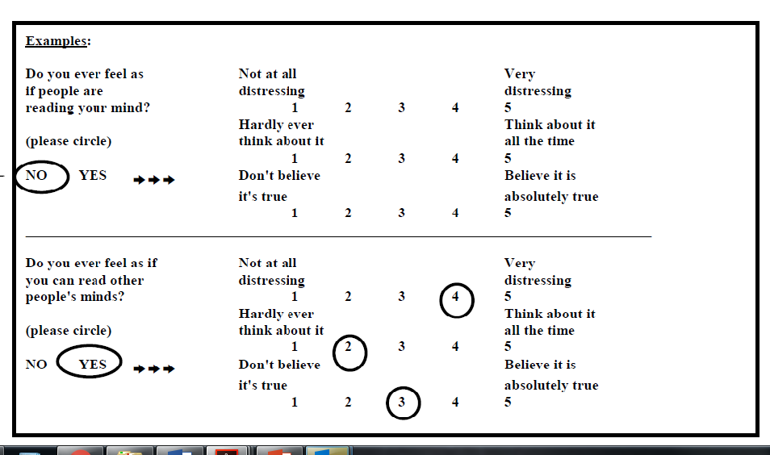
Notes:
Point assigned for affirmative answer initially
5 point Likert Scale for Distress, Preoccupation, Conviction

Slide 30
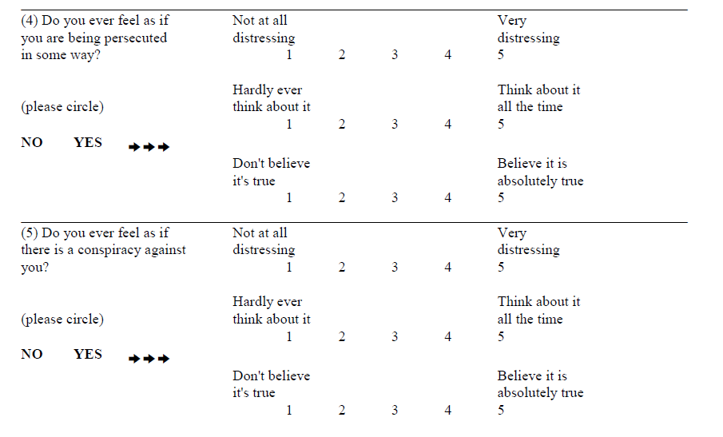

Slide 31
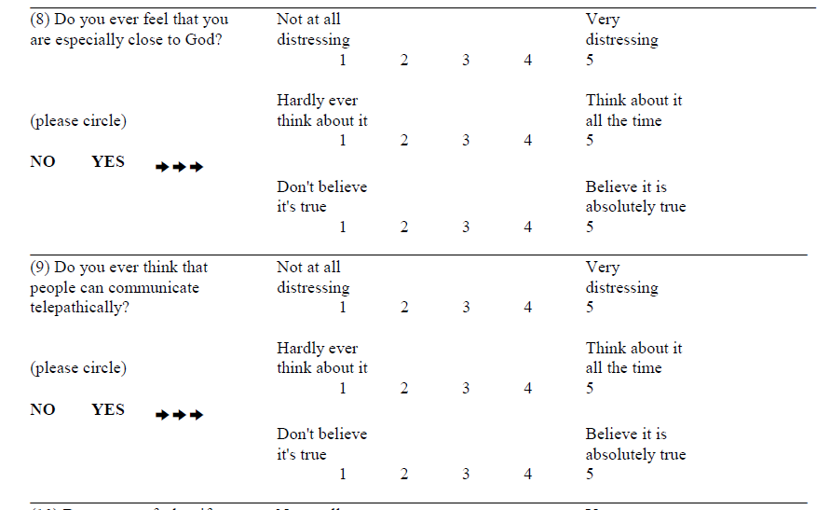

Slide 32
SLPRC Group Measures
PDI 21 scoring will be added as we get closer to the presentation date so we have the most up to date information.

Slide 33
Internal measures
Serious Incident Counts
Restraint Events
Privilege Levels

Slide 34
Other Qualitative Observations
Client quotes of perceived benefits
Staff observations
Notes:
Group anecdotes

Slide 35
References
Jones, S. R., & Fernyhough, C. (2007). Reliability of factorial structure of the Peters et al. delusions inventory (PDI-21). Personality and Individual Differences, 43(4), 647-656.
Khazaal, Y., Favrod, J., Libbrecht, J., Finot, S., Azoulay, S., Benzakin, L., Oury-Delamotte, M., Follack, C., & Pomini, V. (2006). A card game for the treatment of delusional ideas: A naturalistic pilot trial. BMC Psychiatry, 6(48).
Khazaal, Y., Chatton, A., Dieben, K., Huguelet, P., Boucherie, M., Monney, G., Lecardeur, L., Salamin, V., Bretel, F., Azoulay, S., Pesenti, E., Krychowski, R., Prata, A., Bartolomei, J., Brazo, P., Traian, A., Charpeaud, T., Murys, E., Poupart, F., Rouviere, S., Zullion, D., Parabiaghi, A., Saoud, M., & Favrod, J. (2015). Reducing delusional conviction through a cognitive-based group training game: A multicenter randomized controlled trial. Frontiers in Psychiatry, (6).
Khazaal, Y., Favrod, J., Azoulay, S., Finot, S., Bernabotto, M., Raffard, S., Libbrecht, J., Dieben, K., Levoyer, D., & Pomini, V. (2011). “Michael’s Game,” a card game for the treatment of psychotic symptoms. Patient Education and Counseling, (83), 210-216.
Peters, E., Joseph, S., Day, S., & Garety, P. (2004). Measuring Delusional Ideation: The 21-Item Peters et al. Delusions Inventory (PDI). Schizophrenia Bulletin, 30(4), 1005-1022.

Slide 36
Contact Information
Kathryn.Thumann@dmh.mo.gov
Kaelee.Newton@dmh.mo.gov

