Slide 1
TEAMwork Makes the Dream Work
Building a High Performing Leadership Team

Slide 2

Mission Statement
  BHR ensures compassionate and immediate barrier free access to behavioral healthcare

Slide 3
Solution Focused Organization
24/7 Crisis Intervention
Multiple Platforms
Behavioral Health Assessments
Critical Incident Response
Extensive Follow-Up

Slide 4
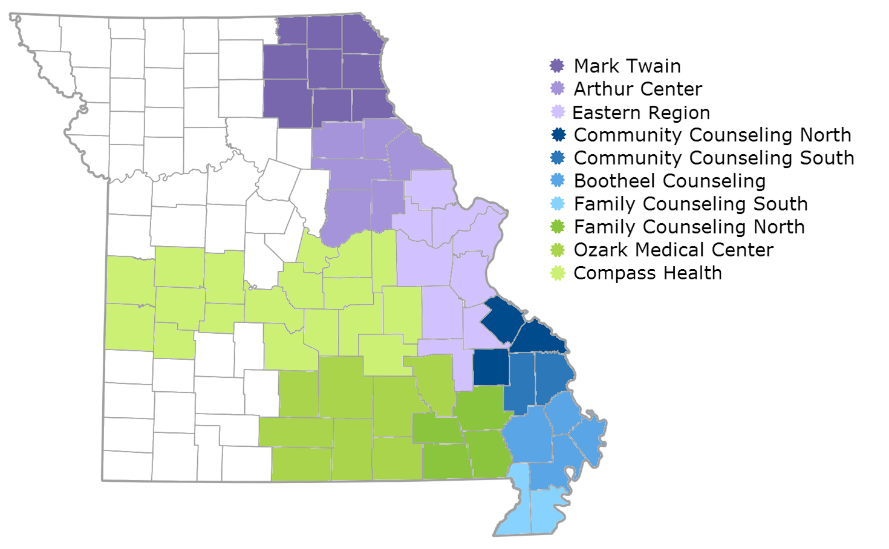

Slide 5
BHR
Accessibility
Integrity
Respect
Excellence

Slide 6
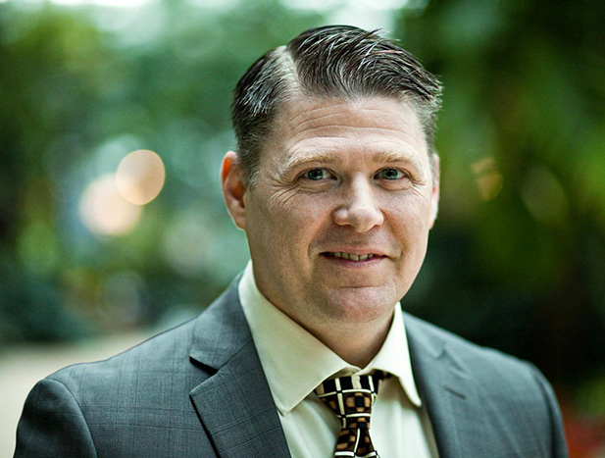

Our Team

Slide 7


Slide 8
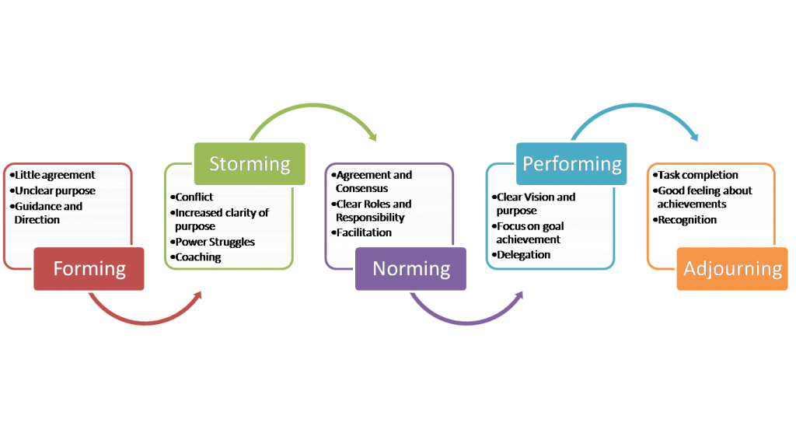
Stages of Team Conflict

Slide 9


Slide 10


Slide 11

NORMING
DEVELOP WAYS OF DOING THINGS

Slide 12


Slide 13
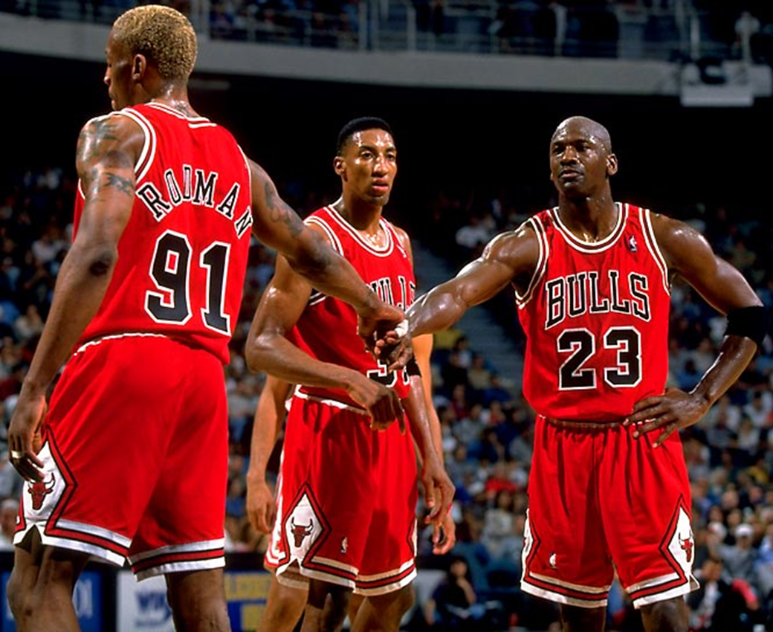
ADJOURNING
CELEBRATE SUCCESS
SUCCESS ACHIEVED! CELEBRATE!

Slide 14
Key Elements of Effective Management
GOOD COMMUNICATION
INDUSTRY KNOWLEDGE
ORGANIZATIONAL SKILLS
TEAM BUILDING SKILLS
CUSTOMER SERVICE SKILLS
SELF-MOTIVATION
TRUSTWORTHY
CONFLICT RESOLUTION
ACCEPT & PROMOTE CHANGE
DEDICATION

Slide 15


Ask the Experts

