Slide 1


Understanding Family Trauma
Escaping the Drama Triangle
Rev. Roxanne Pendleton, MDiv
Dena Sneed, OTR/L
Notes:
Minute to arrive
Introductions
(If time) Class-brief intros-name and role

Slide 2
Objectives
  Participants will define and explore the impact of cultural, historical, and intergenerational trauma
  Participants will consider the varying experiences of trauma within the family system
  Participants will identify re-enactment (also called the “drama triangle”) including reasons, roles, and re-scripting strategies
Notes:
Thank Lesa Chandler (Cornerstones of Care) who gave us information that inspired us and informs a good deal of this presentation.

Slide 3
Definitions…
Historical trauma is most easily described as multigenerational trauma experienced by a specific cultural group
Historical trauma is cumulative and collective
Notes:
Historical trauma can be experienced by “anyone living in families at one time marked by severe levels of trauma, poverty, dislocation, war, etc. and who are still suffering as a result.” (Cutler, n.d.)

Slide 4
Historical Trauma
Dominant culture perpetrates mass trauma on a specific population (colonialism, slavery, war, or genocide)
Affected population shows physical and psychological symptoms in response to the trauma
Initial population passes these trauma responses on to subsequent generations, who in turn display similar symptoms
Notes:
In the initial phase, the dominant culture perpetrates mass trauma on a population in the form of colonialism, slavery, war, or genocide.
In the second phase the affected population shows physical and psychological symptoms in response to the trauma.
In the final phase, the initial population passes these responses to trauma to subsequent generations, who in turn display similar symptoms EVEN THOUGH THEY DID NOT EXPERIENCE THE TRAUMA
From: Trauma May be Woven Into DNA of Native Americans, by Mary Annette Pember 05/28/15
“Recent developments in the fields of cellular biology, neurobiology, epigenetics, and developmental psychology underscore the importance of exploring at least three generations of family history in order to understand the mechanism behind patterns of trauma and suffering that repeat.” Mark Wolynn

Slide 5
What is the Impact?
Unresolved Grief | Isolation | Anxiety
Shame | Depression | Insomnia
Anger | Suicide | Nightmares
Fear | Hopelessness | Paranoia
Distrust | Isolation | Self-hatred
Violence | Substance Abuse | Isolation
Micro aggressions | Guilt | Gastric Complaints

Slide 6
“Trauma experienced by earlier generations can influence the structure of our genes, making them more likely to ‘switch on’ negative responses to stress and trauma.”
- Mary Annette Pember

Slide 7
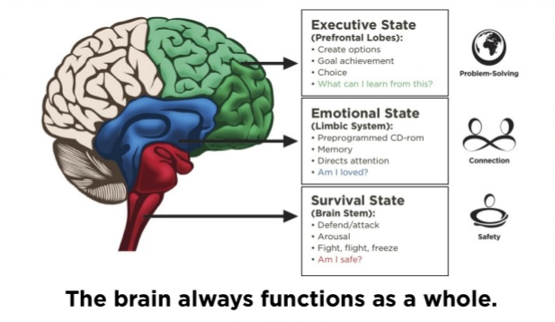




Conscious Discipline® Brain State Model
Executive State (Prefrontal Lobes):
Create options
Goal achievement
Choice
What can I learn from this?
Emotional State
(Limbic System):
Preprogrammed CD-rom
Memory
Directs attention
Am I loved?
Survival State
(Brain Stem):
Defend/attack
Arousal
Fight, flight, freeze
Am I safe?
The brain always functions as a whole.
Notes:
We are beings of experience and nostalgia. So when we are faced with something, we often react (or respond) based on the strength of those pathways.
From the Conscious Discipline Brain State Model:
All of our memories are stored in the limbic system (good and bad). Traumatic events trigger the survival state (fight, flight, or freeze), which creates memories, again in the limbic system. When we encounter a trigger, or reminder of that event, the pathway to the survival state is strong. When we receive treatment or an early intervention for the trauma, different pathways are formed to our pre-frontal lobes (executive state), which help us to respond versus react to situations. Without those interventions, the pathways from the stored memory to the brain stem become strengthened, which creates a state of chronic hyperarousal—what we often see as a trauma response. This can keep someone in the midst of conflict without the ability to do problem-solving in order to manage the conflict.
The only way to soothe the survival state is through the creation of safety.
The only way to soothe an upset emotional state is through the creation of connection.
The executive state is the optimal state of problem-solving and learning.

Slide 8
Removed
https://www.youtube.com/watch?v=lOeQUwdAjE0

Slide 9
5
4
3
2
1
things you can see
things you can touch
things you can hear
things you can smell
thing you can taste
Notes:
A mindfulness exercise, which we will walk through together right now.
The process is to describe to oneself in vivid detail…
This is also helpful for anxiety, especially when you are so stressed that you cannot control your breathing enough to DO a breathing exercise!

Slide 10
“Traumatic re-enactment is an attempt of the unconscious to replay what’s unresolved, so we can “get it right”
- Mark Wolynn
Notes:
This unconscious drive to relive past events could be one of the mechanisms at work when families repeat unresolved traumas in future generations

Slide 11
What is the drama triangle?
https://www.youtube.com/watch?v=ovrVv_RlCMw
Notes:
Film starts automatically on next slide (it is 3:20 long)

Slide 12
What is the drama triangle?
Three dramatic roles: Victim, Persecutor, Rescuer
Common, unsatisfactory, repetitive, largely unconscious behavior that is often rooted in trauma
It is possible to play all three roles even in the same encounter
When we are stuck in the drama triangle, instead of resolving problems, we endlessly repeat them
Notes:
Karpman, 1973
Define trauma: Trauma occurs when internal and external resources are inadequate to cope with an external threat, either real or perceived (Van der Kolk). Trauma is prevalent (see: ACEs).

Slide 13
Signs of Re-Enactment
Strong Emotions
Hopeless, helpless
Furious, irritated, angry
Sad, protective, uncomfortable
Extreme Thoughts
All, always, every time
Never, no way
Disaster, kill, it’s all over
Physical Response
Hot or flushed face
Racing heart
Muscle tension
Notes:
The first critical skill in using the traumatic re-enactment triangle to help solve a problem is to identify when one is occurring. When the amygdala, our warning system, goes off, it creates changes in our body, our feeling, and our thinking. Here are some signals:
(Click) Here are some examples of strong emotions. We may bounce between them or feel several of them swirling through us at the same time.
(Click) Here are some examples of extreme thinking. When we go into exaggeration mode, that is a strong signal that the amygdala has hijacked the brain and disengaged the prefrontal cortex.
(Click) Here are some examples of physical response. These are generally related to our bodies preparing to fight, flee, or freeze.

Slide 14
VICTIM
There’s nothing I can do.
Poor me!
Denies power
Lets the experience define him or her
Looks to others for rescue
Relinquishes responsibility
Feels hopeless
They have no idea how bad they are making this for me…
Notes:
Handout: Escaping the Triangle
In the Victim role, we are helpless, incompetent, oppressed, and hopeless. (Karpman)
The victim is the FREEZE response of fight, flight, or freeze.
Sometimes the freeze is obvious – deer in the headlights look or complaining about how unfair things are....
Sometimes the freeze is somewhat hidden – shut down or disassociation . . .
POWER: In the victim role, a person refuses to use their power, either believing they have none or wanting someone else to come rescue them.

Slide 15
PERSECUTOR
You will do what I say or else.
Misuses power
Uses passive aggression
Demands or coerces
Threatens/Bullies
Uses physical force
Finds fault
Blames/shames
You are stupid.
This is all your fault.
Notes:
When playing the Persecutor role we are operating from a position of some kind of power, tend to bully, find fault, accuse others, lead by threats, and are often blaming and shaming. (Karpman)
The persecutor is the FIGHT response of fight, flight, or freeze.
Sometimes the fight is obvious – anger, negative language, argumentation, put downs, hitting….
Sometimes the fight is somewhat hidden – sarcasm, irritation in the voice, irritation. . .
POWER: In the persecutor role, individuals tend to use power to coerce or punish others.

Slide 16
RESCUER
No need to worry. I’ll take care of it
Helps no matter the cost
Takes the place of
Fixes
Meddles
Encourages dependence
Feels martyred
If I don’t fix this, it won’t get done.
Oh, here. Let me do that.
Notes:
When in the Rescuer role, we are working hard to “help” someone else but are often feeling martyred, guilty, angry under the surface, and may be considered meddler by others. (Karpman)
The rescuer is the FLIGHT response of fight, flight, or freeze.
Sometimes the flight is obvious – avoiding conflict at all costs, or simply leaving the situation
Sometimes the flight is less obvious – rushing in to save the day, volunteering to fix things
POWER: The rescuer tends to use power to make uncomfortable things go away, overriding others in a way that on the surface may seem helpful but diminishes the power of others to learn to do what is needed.

Slide 17
Thinking About Removed
What re-enactment role(s) did Zoe play?
What has Zoe learned to believe about the world, about adults, who to trust, how things work, about herself?
How were her beliefs about the world reinforced?
What survival skills has she learned?
What are her triggers?

Slide 18
Scientific developments offer exciting insights not only into how we react to trauma but also how we manage to survive and thrive.
Notes:
Inherited Resilience: Native peoples ability to maintain culture and sense of who they are in the face of traumatic history suggests an inherited resilience.

Slide 19

Escaping the Triangle
Graphic used with permission from Cornerstones of Care
DRIVER
GUIDE
VICTIM
PERSECUTOR
CONFLICT
to
CREATIVITY
RESCUER
COACH
Notes:
Once we have identified the triangle, the next step is to figure out how to escape the triangle, to manage emotions, and to re-engage our prefrontal cortex. Doing that allows us to move from conflict to creative problem-solving.
So let’s look more in depth at each role to understand the interactions of power, emotions, and reactivity.

Slide 20
DRIVER
VICTIM
Denies power
Lets the experience define him or her
Looks to others for rescue
Relinquishes responsibility
Feels hopeless
Uses power wisely
Remains true to self
Seeks help responsibly, appropriately, & clearly
Seeks to learn
Focuses on the future
Notes:
Handout: Escaping the Triangle
The Victim is the FREEZE response of fight, flight, or freeze.
POWER: In the Driver role, a person uses their personal power

Slide 21
PERSECUTOR
GUIDE
Misuses power
Uses passive aggression
Demands or coerces
Threatens/Bullies
Uses physical force
Finds fault
Blames/shames
Empowers others
Communicates directly
Respects boundaries
Models behavior
Provides expectations
Offers alternatives
Commends strengths
Encourages others to link cause & effect
Notes:
The Persecutor is the FIGHT response of fight, flight, or freeze.
POWER: In the Guide role, the person uses power to compassionately lead others.

Slide 22
RESCUER
COACH
Helps no matter the cost
Takes the place of
Fixes
Meddles
Encourages dependence
Feels martyred
Assists only as necessary
Stands beside
Encourages action of others
Empowers
Expresses confidence
Asks permission
Checks back
Notes:
The Rescuer is the FLIGHT response of fight, flight, or freeze.
POWER: The Coach role helps others discover their own power.

Slide 23
What do I need to move myself or others from…
Victim to Driver
Responsibility
Empowerment
Persecutor to Guide
Rescuer to Coach
Boundaries
Emotional Presence
Facilitation Skills
Compassionate Leadership
Notes:
To move from Victim to Driver, a person needs knowledge and skills to act and to take responsibility for their actions.
To move from Persecutor to Guide, a person needs to facilitate change rather than force change.
To move from Rescuer to Coach, a person needs clear boundaries that allow other people to take responsibility for themselves and the ability to be emotionally present even in uncomfortable situations without having to fix it.

Slide 24
Visual Re-Scripting Tool
Graphic used with permission from Cornerstones of Care
Notes:
This visual tool can help an individual or group think through traumatic re-enactment and re-script the situation. The triangle shrinks when we use responses outside of the three roles of victim, persecutor, and rescuer.

Slide 25
Graphic used with permission from Cornerstones of Care
I already have too much to do.
I don’t have any help.
I’m being set up to fail.
I can’t ask my busy co-
workers for help. I’ll just do it.
I have to get this done because
I’m the only one who can do it.
If I don’t do this, it will lead to disaster.
What screwball
decided this is critical?
My boss is being unreasonable.
The agency doesn’t care about us.
Notes:
Here is an example. Let’s say you or a co-worker are suddenly and without explanation assigned additional work. Here are some typical trauma responses.
(Click & allow time for participants to read the 3 bullet points) What role is this? (Victim)
(Click & allow time for participants to read the 3 bullet points) What role is this? (Persecutor)
(Click & allow time for participants to read the 3 bullet points) What role is this? (Rescuer)

Slide 26
Graphic used with permission from Cornerstones of Care
I’m in charge of my time and energy.
I can prioritize my to do list.
What do I need to make this happen?
I need to let my boss know when I’m feeling overwhelmed.
I can make suggestions regarding ways we can be more efficient and tools that would help.
Am I doing more than I should?
I’ll ask Sue for help.
That can wait until tomorrow.
Notes:
Let’s look at some different responses.
Driver: (Click) How are these responses different that those coming from the role of victim?
The person is identifying what they have control over.
The person is taking charge of their schedule.
The person is not giving up their power.
Guide: (Click) How are these responses different that those coming from the role of persecutor?
The person is acknowledging their challenge in a responsible way.
The person is using their power constructively.
The person is being proactive and thinking about the situation in a creative way.
Coach: (Click) How are these responses different that those coming from the role of rescuer?
The person is acknowledging their desire to fix it and thinking about what others should do.
The person is asking for help and not playing the martyr.
The person is setting boundaries and including self-care.

Slide 27
Graphic used with permission from Cornerstones of Care
I’m missing
important information.
She’s keeping me from learning.
Why doesn’t the trainer call her out?
That is so disrespectful to
the trainer.
Everyone in my class
shouldn’t have to put up with
this! I’ve got to get her to stop.
What a jerk!
I hate all this noise.
She’s so distracting.
I’m going to let her have a piece of my mind.
Notes:
Here is another example. Let’s say you are really interested in this training today (don’t tell me if it’s not true!). Someone comes in late, engages in side conversations, takes a phone call, taps their fingernails on the table.
(Click) Which response is this?
Victim – freeze response, giving up power, seeking rescuer
(Click) Which response is this?
Persecutor – fight response, abusing power
(Click) Which response is this?
Rescuer – flight response, using power to make problem go away

Slide 28
Graphic used with permission from Cornerstones of Care
I can learn what’s going on with her.
I can ask for the volume level to be lowered.
I wondered if you are aware of the volume level and how it is distracting …
How do you think we can resolve this?
Notes:
Here are some responses OUTSIDE the triangle. They are collaborative and solution focused, demonstrating that the complex thinking brain is being used.

Slide 29
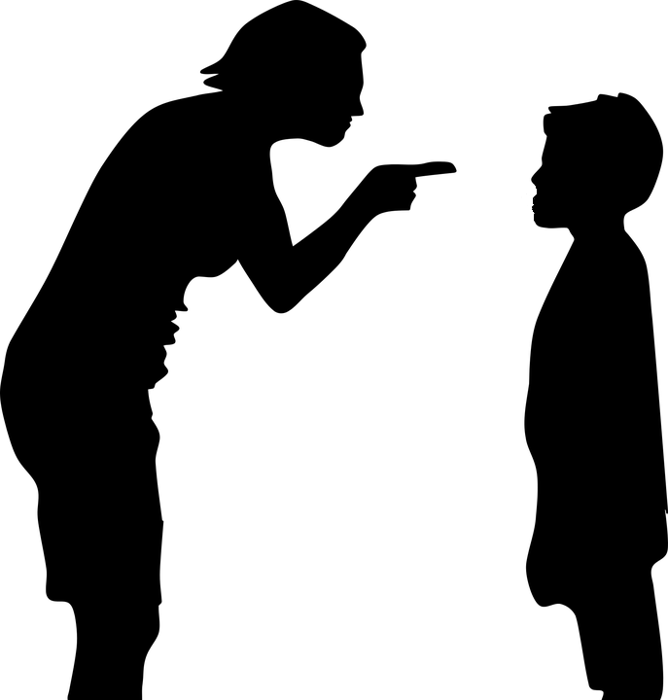
Helping Others
Notes:
Identifying when we are in the triangle is very helpful in avoiding drama. We can also use the triangle to help others. Let’s look at Removed again.

Slide 30
MOM
ZOE
FOSTER MOM
VICTIM
RESCUER
PERSECUTOR
Notes:
The triangle can get very messy. Any one person may play various roles.
If we were going to diagram this, what role did Mom play?
Victim –
Persecutor –
Rescuer –
What role did Zoe play?
Victim –
Persecutor –
Rescuer –
What role did foster mom play?
Victim –
Persecutor –
Rescuer –

Slide 31
Graphic used with permission from Cornerstones of Care
Why am I feeling this way?
What are others feeling?
How can we manage triggered emotions?
How can I avoid getting pulled into the triangle?
How can I encourage them to resolve this themselves?
Notes:
Brainstorming solutions can come from identifying responses outside the triangle.
Here are some thoughts and questions that each role could consider before responding.

Slide 32
Steps for Escaping the Drama Triangle
Remain curious and nonjudgmental
Evaluate where the power is
Own your feelings and actions; allow others to own theirs
Practice alternative behaviors (Driver, Guide, Helper)
Notes:
This process takes time and practice. Take good care of yourself as you learn these new skills. It is important to seek accountability, as well as to celebrate your successes.
Plug other trainings for more information/practices.

Slide 33
Exposure to stress makes
us ALL vulnerable
to re-enactment

Slide 34
Self-Reflection
Which role in the re-enactment triangle do you think you are most likely to fall into at work?
What are some of the qualities you have that make you vulnerable to falling into this role?
What behaviors are most likely to trigger you or push you into one of these roles?
What behaviors in the people that you serve, your co-workers, or your family members are most likely to trigger you or push you into one of these roles?
How might a co-worker or family member best intervene with you if he/she feels you are engaged in a re-enactment?
Notes:
Take about 2 minutes for each question
After self-reflection time, partner up and share anything that came up that you are comfortable sharing.

Slide 35
Self-Reflection
Think of a conflict situation you have been in recently.
Identify the roles each person is/was playing in the drama triangle.
Consider how you can shift your power to change your role and begin to escape the triangle.
Consider how you could support the others in that situation to move from Victim to Driver, Persecutor to Guide, and Rescuer to Coach.
Notes:
The conflict situation can be with a coworker, client, family member, etc.
Take 10 minutes to do this exercise. If time, partner up to share anything they would like to or ask for feedback.

Slide 36
Thank you! ctii@tmcmed.org
Additional Trainings: http://ctii.eventbrite.com

