Slide 1
Self-Care and Resiliency Room
Stations for Renewal, Earn CEU Credit
Open Thursday 8 to 8, Friday 8 to 3
7th Floor, Parasol I

Slide 2

Self-Care and Resiliency Room
Created by Mental Health Professionals for Mental Health Professionals

Slide 3

Self-Care and Resiliency Room
Taking good care of yourself is the foundation for providing good care to others.

Slide 4

Self-Care and Resiliency Room
Resilience is strengthened by healthy self-care practices.

Slide 5
Self-Care and Resiliency Room
CEU Credits 7th Floor, Parasol I, Thursday, 8 a.m. to 8 p.m. Friday, 8 a.m. to 3 p.m.

Slide 6

Aromatherapy Station: Create your own combination of healing plant fragrances.
Self-Care and Resiliency Room

Slide 7

Wellness and Nutrition Station: Resource sheet of books, websites, and videos on wellness.
Self-Care and Resiliency Room

Slide 8
Nature Station: Experience a connection with nature.
Self-Care and Resiliency Room

Slide 9
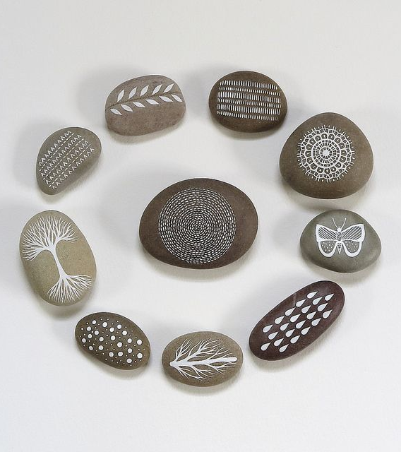
Grounding Stone Station: Practice relaxation while decorating your own mindfulness stone.
Self-Care and Resiliency Room

Slide 10

Small Accomplishments Station: Check out mind-building puzzles and games.
Self-Care and Resiliency Room

Slide 11

Self-Massage Station: Massage away stress.
Self-Care and Resiliency Room

Slide 12

Relaxation Station: Stretch out on a yoga mat and relax with a weighted blanket.
Self-Care and Resiliency Room

Slide 13

Book Browse Station: Resources for resilience.
Self-Care and Resiliency Room

Slide 14

Mindfulness Station: Enjoy Zen Gardens.
Self-Care and Resiliency Room

Slide 15

Creativity Station: Let your inner spark out through creativity.
Self-Care and Resiliency Room

Slide 16

Gratitude Station: Gratitude is a skill.
Self-Care and Resiliency Room

Slide 17
Sound Healing Station: Explore soothing sounds.
Self-Care and Resiliency Room

Slide 18
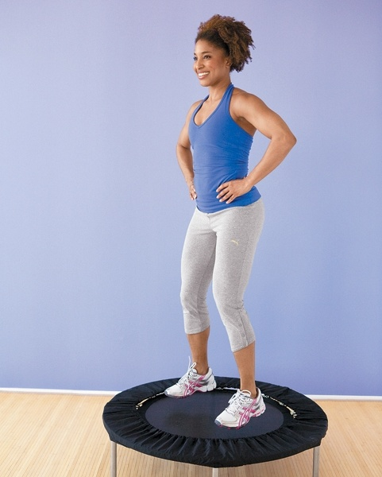
Movement Station: Rebounding improves lymphatic circulation.
Self-Care and Resiliency Room

Slide 19
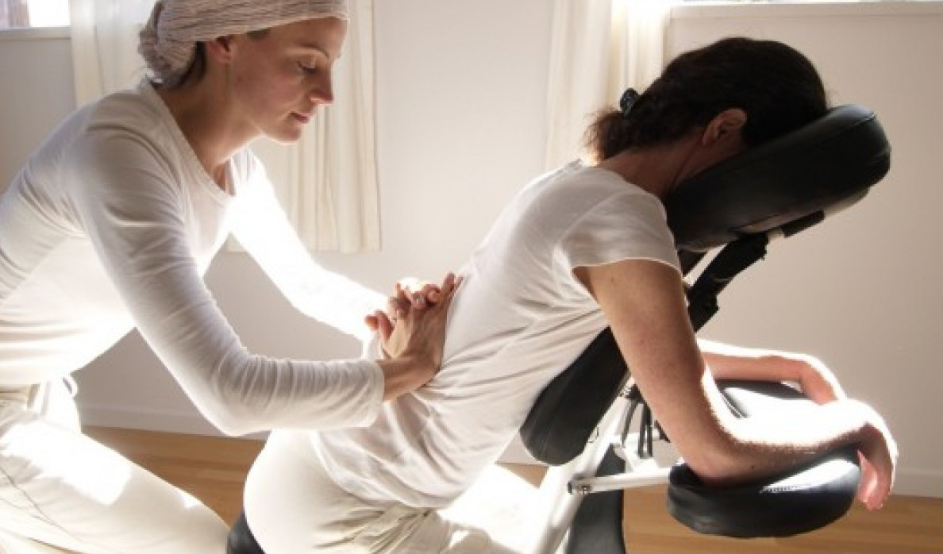
Chair or Table Massage: Sign up for a healing massage at a reasonable fee.
Self-Care and Resiliency Room

Slide 20
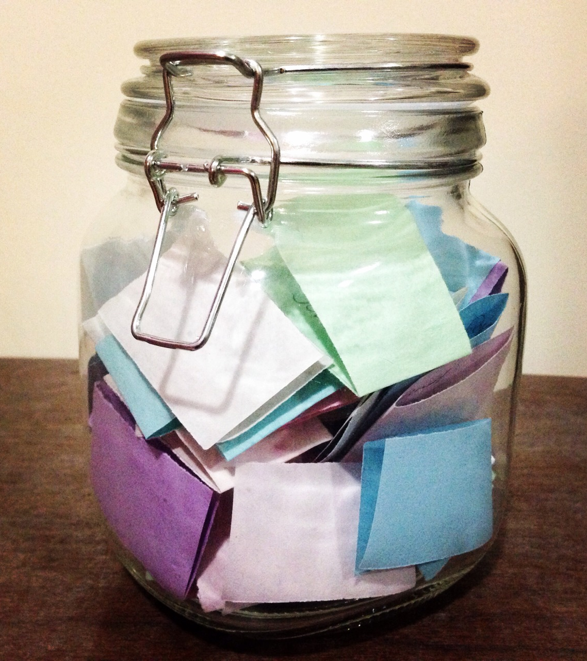
Door Prizes: Add your name to win a prize. Names will be drawn throughout the conference. If you win, you will receive a text message. Many different prizes to choose from.
Self-Care and Resiliency Room

Slide 21

Self-Care and Resiliency Room
7th Floor, Parasol I, Open Thurs 8 a.m. to 8 p.m. Friday 8 a.m. to 3 p.m.

