Slide 1
Special Considerations for Working with Children of Adoption
Sara Schmitz, M.Ed, lpc, CPT

Slide 2
Objectives
Identify unique challenges faced by children who have been adopted
Describe the challenges that children adopted from other cultures can face
Identify how trauma symptoms can mimic those of other psychiatric diagnoses

Slide 3
What do you know about adoption?
https://youtu.be/DDLBrv934pY

Slide 4
Types of adoption
Planned adoption
Adoption from Foster care
International adoption

Slide 6
Identity development: Case Study
Case study: Jane
  Adopted from foster care at 3 months old, with older brother and sister
  Spent 4 weeks in PICU, born addicted to opiates
  Currently 12 years old, lives with biological brother and sister, as well as another adopted brother who is not biologically related to them
  Biological parents have been addicted, involved in gangs and incarcerated
  Adoptive parents have not told client the negative aspects of her biological family

Slide 7
The Six Stuck Spots(by Debbie Riley,
Beneath the Mask)
1. Reason for adoption (Why was I adopted?)
2. Missing/Difficult Information (What is the truth about my birth parents?)
3. Difference (Why do I feel different from everyone else?)
4. Identity (Who am I?)
5. Loyalty (Is it okay if I think about my birth parents?)
6. Permanence (What will happen when I leave home?)

Slide 8
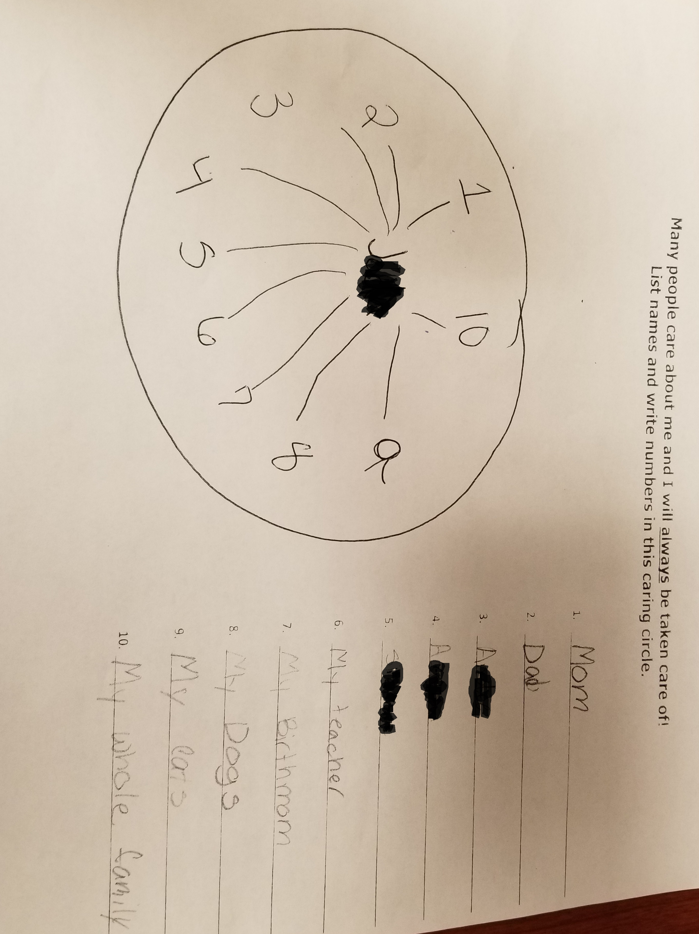

Slide 9
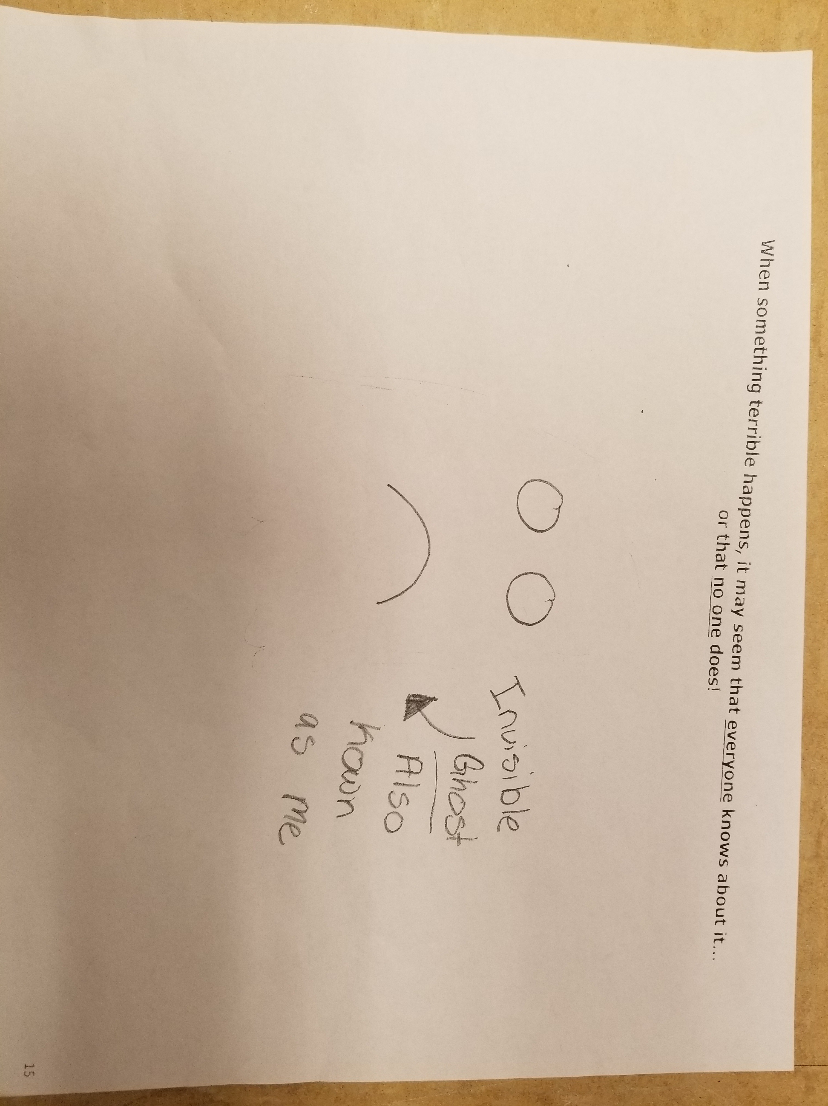

Slide 10
Intercultural Adoption: Case Study
Monica and Rachel
  Adopted at approximately ages 9-11 (Monica) and 6-8 (Rachel)
  Biological father died of unknown causes and Monica and Rachel were accused of being witches.
  Abandoned in the bush, taken to two orphanages
  Two foster homes and then moved to America
  Primary language was French, also spoke Swahili

Slide 11

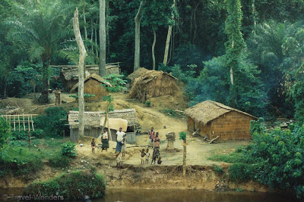
Old vs. New
Congo
St. Louis

Slide 12
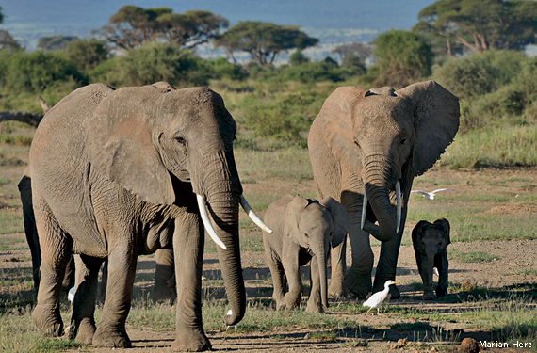
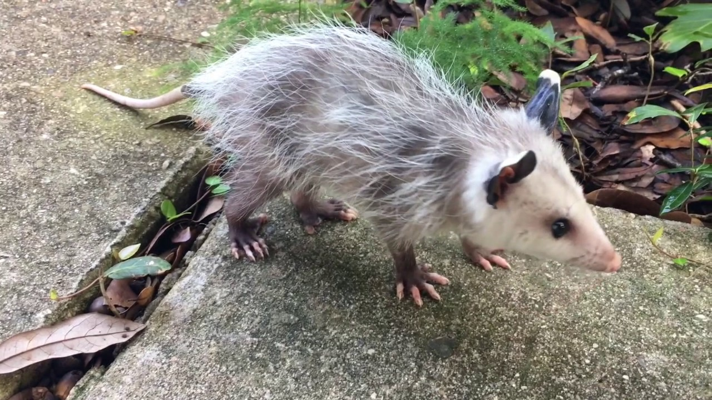
Old vs. New
Congo
St. Louis

Slide 13
What did they lose?
Language
Culture
Environment
Time
History
Names

Slide 14
“I was sad because I have no friends.”

Slide 16
Intercultural adoption
Loss of culture by appropriation
M & R: did not like going to the African festival
E & A: were expected to be able to speak their Eastern language due to looks
Russian names for different medical issues that are not the same as US
Case study: M& R

Slide 17
Trauma symptoms: Case Study
Greg
  Removed from home due to abuse and neglect
  Placed in several foster homes, some inappropriate
  Adopted at age 5

Slide 18
Trauma vs ADHD
Case study: G
  High energy, can often be aggressive
  Very smart, but lack of attention at school leading to classroom disruption
  Has been called “very sweet and attentive to others” (actually hypervigilant)
  Mood swings toward aggression
  Cannot maintain sitting still in a classroom setting for long periods of time

Slide 19
ADHD or Trauma?
ADHD
Trauma
Often “on the go”, acting as if “driven by a motor”
Often does not seem to listen when spoken to directly (e.g. mind seems elsewhere, even in the absence of obvious distraction)
Is often easily distracted by extraneous stimuli
High state of physical arousal due to fight or flight instinct
Dissociative tendencies
Hypervigilance

Slide 20
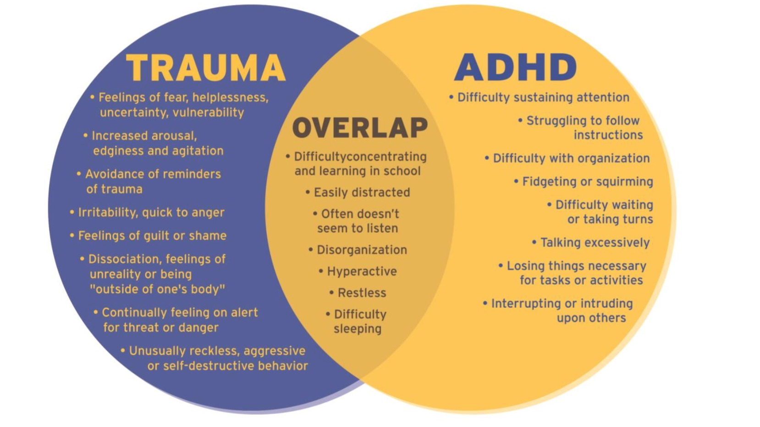
Trauma vs ADHD

Slide 21
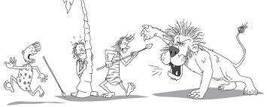
Fight, Flight or Freeze

Slide 22
What do I do now?
Encourage age appropriate honesty for parents
Recognize that adoption is about loss
Children’s lives do not begin the day they are adopted
Remember when working with adopted children that they have a past, present and future

Slide 23
Where are they now: Jane
Jane
  Continuing to work in individual therapy to meet goals
  Working on affect identification and expression
  Parent are meeting with therapists regularly to discuss how to handle behaviors and receive education regarding trauma
  Also working with parents to provide support in honesty with their children
  Doing well in school, involved in sports

Slide 24
Where are they now: Monica and Rachel
Rachel
  Highly bonded and attached to nanny and younger brother
  Working on attachment with adopted parents
  Doing well in school, increasing her interactions with other students
  Increase in paralell play with therapist and others
Monica
  Unable to attach to anyone in the home
  Retraumatizing and acting out previous aggression
  Residential placement and adoption has been rescinded

Slide 25
Where are they now: Greg
Greg
  Doing well in school
  Teachers, social worker and principal are understanding of trauma and how his behaviors
  Continuing to work with telling his story on his terms
  Working with self regulation and coping skills as well as affect expression

Slide 26
Sources
American Psychiatric Association: Diagnostic and Statistical Manual of Mental Disorders, 5th Edition. Arlington, VA., American Psychiatric Association, 2013.
Riley, D. B., & Meeks, J. E. (2006). Beneath the mask: Understanding adopted teens: Case studies & treatment considerations for therapists & parents. Silver Spring, MD: C.A.S.E.

