Slide 1
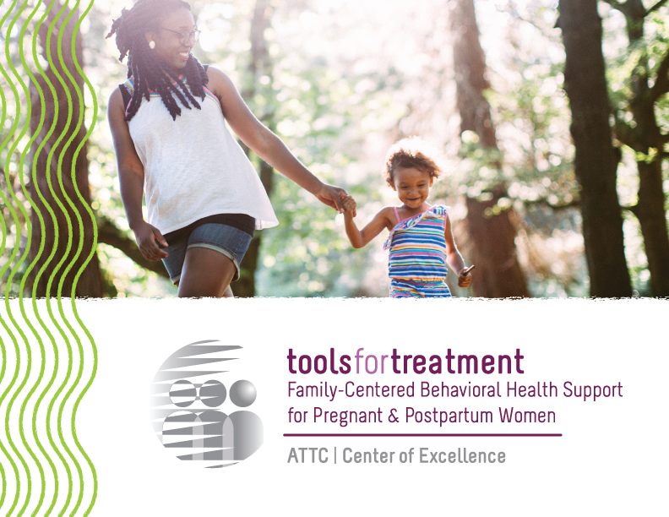

Easier Together:
Providing Family-Centered Care for Pregnant and Postpartum Women with Substance Use Disorders
Pat Stilen, LCSW and Sarah Knopf-Amelung, MA-R

Slide 2
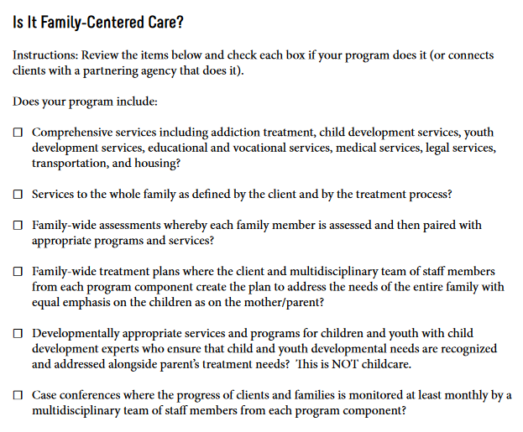
Please Complete “Is It Family-Centered Care?” Checklist
Notes:
Before we get started, please complete the “Is It Family-Centered Care?” checklist. We will use this later in the workshop.

Slide 3
Overview of “Easier Together” Curriculum
Comprised of 6 Modules:
  Module 1 — Introduction (45 min)
  Module 2 — Family-Centered Care (45 min)
  Module 3 — Building Programs for Fathers (45 min)
  Module 4 — Implementing Family-Centered Programming (45 min)
  Module 5 — Family-Centered Clinical Interventions (45 min)
  Module 6 — Case-Based Application (45 min)
Notes:
We wanted to note that the content from today’s workshop is part of a larger curriculum package that contains 6 modules. We strongly encourage you to take this curriculum back to your agencies. All content is provided in an in-service format that is perfect for staff development trainings and can be downloaded from our website.

Slide 4
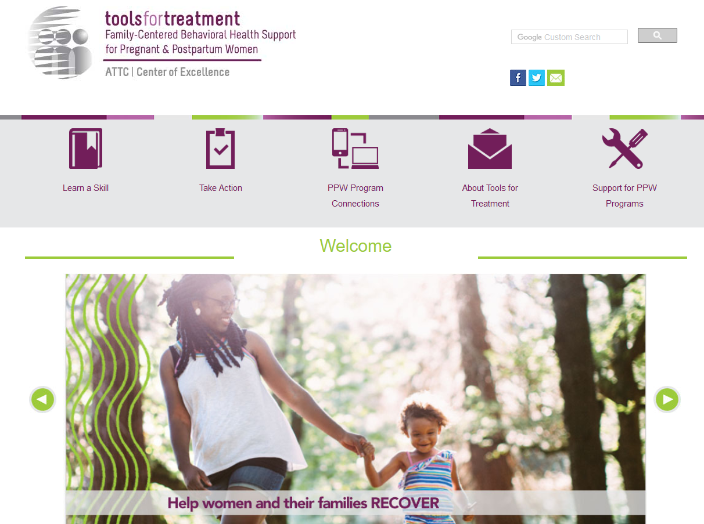
Visit www.attcppwtools.org for More Resources
Training Curriculum
Online Courses
300+ Program Resources Library
Recorded Presentations
Videos
Notes:
For additional resources, visit www.attcppwtools.org. Here you can download the “Easier Together” curriculum and access other resources such as:
Training curriculum
Online courses
300+ resources in the Program Resources library
Recorded presentations
Videos

Slide 5
Learning Objectives
Define family-centered care and explain why it matters.
Evaluate the impact of language, myths, and stigma on care for pregnant and postpartum women with substance use disorders and their families.
Analyze how the principles of family-centered care were applied to a program in California.
Examine application of family-centered care principles in your own work.

Slide 6
Key Question
Why does this topic matter?
Notes:
So why does family-centered care matter? We’re all at different levels of experience with it, and some of you may feel like you’re doing much of this already. However, if we’re still talking about it, we could always do it more effectively and enhance our services to be more family-centered. We’re hoping this curriculum will provide new insights for even those of you who have worked in this area for a number of years.

Slide 7
Why Does This Matter?
____ % of U.S. treatment facilities offer at least one special program or group for pregnant/postpartum women.
    a ) 10% b) 21% c) 45% d) 60%
(SAMHSA N-SSATS, 2016)
Notes:
Does anyone know what percentage of U.S. treatment facilities offer at least one special program or group for pregnant/postpartum women?
Answer: b – 21%
Treatment services tailored for pregnant/postpartum women are surprisingly limited, despite the importance of addressing substance use during this time period.

Slide 8
Why Does This Matter?
____ % of U.S. treatment facilities offer childcare services.
    a ) 6% b) 18% c) 35% d) 50%
(SAMHSA N-SSATS, 2016)
Notes:
Does anyone know what percentage of U.S. treatment facilities offer childcare services?
Answer: b – 6%
So few programs offer childcare services, making it extremely challenging for women to participate in treatment. And this number only includes childcare services; therapeutic and child development services for clients’ children are even scarcer.

Slide 9
Why Does This Matter?
____ % of U.S. treatment facilities offer residential beds for clients’ children.
    a ) 3% b) 18% c) 35% d) 50%
(SAMHSA N-SSATS, 2016)
Notes:
Does anyone know what percentage of U.S. treatment facilities offer residential beds for clients’ children?
Answer: b – 3%
Not letting women bring their children to treatment is a huge barrier. Again, a lot of us think family-centered care is widespread and what we’ve always been doing. However, the data tells a different story. This approach is actually very uncommon.

Slide 10
Why Does This Matter?
Stigma and discrimination toward pregnant women with SUDs is a barrier to accessing care.
Laws criminalizing prenatal substance use
Stigmatizing and sensationalized media portrayals
Healthcare providers’ negative attitudes
Programs not accommodating the needs of women with children and making them choose between their family and treatment
Notes:
Family-centered care is also important given the current climate of stigma and discrimination toward PPW with SUD. Providing family-centered, compassionate, inclusive care reduces barriers to accessing care.

Slide 11
Why Does This Matter?
Family-centered care results in:
Improved treatment and retention outcomes for individual women
Improved outcomes for children and other family members
(Werner, Young, Dennis & Amatetti, 2007)
Notes:
Family-centered care has impressive outcomes. Current data has shown:
It results in improved treatment and retention outcomes for individual women.
Children and other family members also have improved outcomes.

Slide 12
What is Family-Centered Care for Pregnant/Postpartum Women with Substance Use Disorders?
Notes:
So let’s discuss what family-centered care is all about and where this concept came from.

Slide 13
Definition
Family-Centered Care:
Providing services for the whole family to make recovery possible; although the mother is the entry point, the family becomes the client
Notes:
There are many definitions and philosophies about family-centered care as it applies to different fields. In the context of pregnant and postpartum women’s addiction treatment, it is providing services for the whole family to make recovery possible. Although the mother is the entry point, the family becomes the client. This includes the father and/or partner, children of all ages, and other extended family members or friends who are an integral part of the woman’s family.

Slide 14
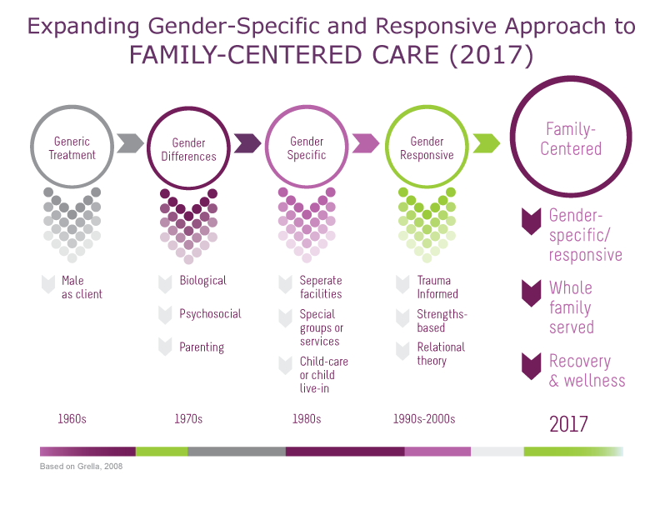
Expanding Gender-Specific & Responsive Approach to FAMILY-CENTERED CARE (2017)
Expanding Gender-Specific & Responsive Approach to FAMILY-CENTERED CARE (2017)
p. 25 of participant manual
Notes:
Family-centered care in the context of pregnant/postpartum women’s addiction treatment is a natural expansion from gender-specific and responsive approaches. It builds on those principles by providing wraparound services for the entire family and uses a recovery approach to support long-term wellness.
Graphic based on: Grella, C. E. (2008). From generic to gender-responsive treatment: Changes in social policies, treatment services, and outcomes of women in substance abuse treatment. Journal of Psychoactive Drugs, SARC Supplement 5, 327-343.
Note to trainer: This handout is available on page 25 of the participant manual.

Slide 15
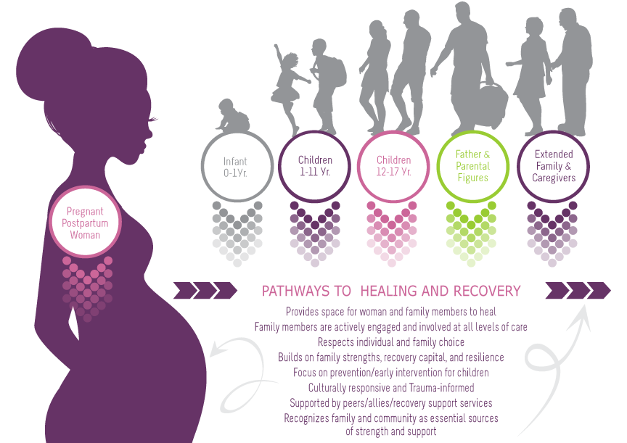
Family-Centered, Recovery & Wellness Principles
Page 69 in participant manual
Notes:
This is a graphic that was developed to embody family-centered care in pregnant/postpartum women’s treatment. In this graphic, you can see that the woman is the vehicle of entry for all family members. She is the initial client that comes into the program to receive services, but through her, our view expands to include all family members. The family becomes the client and we wrap services around all family members to support family strengthening and healing.
Additionally, this graphic outlines “family-centered, recovery and wellness principles.” It is imperative to view family-centered care through the lens of recovery and wellness, not just as a treatment episode. Family-centered care sets families up for sustainable recovery and wellness long after treatment ends.
Note to trainer: This is available as a handout on page 69 of the participant manual.

Slide 16
Core Principles
of Family-Centered Care, Recovery, and Wellness
Provides space for family healing
Family members are actively engaged
Respects individual and family choice
Builds on family strengths
Focus on prevention/early intervention for children
Culturally responsive and trauma-informed
Supported by peers/allies/recovery support services
Recognizes family and community are essential sources of strength and support
Notes:
Let’s dive deeper into the principles of a family-centered, recovery and wellness approach:
Provides space for the woman and her family members to heal
Family members are actively engaged and involved at all levels of care
Respects individual and family choice
Builds on family strengths, recovery capital, and resilience
Focus on prevention/early intervention for children
Culturally responsive and trauma-informed
Supported by peers/allies/recovery support services (e.g., housing, employment, medical care)
Recognizes family and community are essential sources of strength and support
Do any of these resonate with you?

Slide 17
Outcomes
of Family-Centered Care, Recovery, and Wellness
Family Outcomes
  Focus on (re)building a life in the community
  Improve client and family engagement
  Promote recovery, health and well-being
  Address psychosocial and developmental needs of children
  Increase client and family satisfaction
  Build family and community strength
  Activated clients
Notes:
A family-centered, recovery and wellness approach to addiction treatment can result in:
Focus on (re) building a life in the community
Improve client and family engagement (partnership with program staff)
Promote recovery, health and well-being of all family members
Address psychosocial and developmental needs of infant/children
Increase client and family satisfaction
Build family and community strengths (recovery capital)
Activated clients (clients are empowered to take responsibility for and guide their recovery)

Slide 18
Outcomes
of Family-Centered Care, Recovery, and Wellness
Staff Outcomes
  Stronger partnership with client/family
  Increased understanding of families’ and communities’ recovery capital
  Improved care planning
  Improved communication with clients, coworkers, and partner organizations
  Reduced burnout
  Stronger linkages/partnerships with the natural supports in the community
Notes:
This approach also produces a number of benefits for staff:
Stronger partnership with client and commitment to the client and family choice.
Increased understanding of families’ and communities’ recovery capital.
Uses a strengths-based approach and supports sustainable recovery after treatment episode.
Improved care planning when developed in collaboration with family/peer support (team is expanded to include family).
Improved communication with families, coworkers, and partner organizations.
Family-centered approach requires multidisciplinary team to work together to wrap services around family members and meet their different needs (e.g., early childhood, fathering/parenting programs, etc.).
Increased professional self-efficacy; reduced burnout.
Reduced burden on staff when families are experts in their own lives.
Stronger linkages/partnerships with the natural supports in the community.
Build good relationships with community partners so your program doesn’t have to do everything itself. Partnerships allow you to provide families with all the different services they need. Also, building strong partnerships with child welfare, justice system, education system, and others allows you to help families navigate potential challenges.

Slide 19
What Do You Think?
Family-centered care decreases focus on the woman.
  Agree?
  Disagree?
  Not sure?
Notes:
I want to stop and get your thoughts on making this shift. What do you think? Does family-centered care decrease focus on the woman?
Raise your hand if you agree
Raise your hand if you disagree
Raise your hand if you’re not sure
Those of you who agree, would you talk about some of your concerns? *Note to trainer: Ask, “Those of you with your hands up, would you be willing to tell us why you responded this way?”
Those of you who are unsure, would you describe why? *Note to trainer: Ask, “Those of you with your hands up, would you be willing to tell us why you responded this way?”
Those of you who disagree, would you share your thoughts? *Note to trainer: Ask, “Those of you with your hands up, would you be willing to tell us why you responded this way?”
I appreciate the group for responding to this question. There aren’t clear answers to this statement. We hope you get some clarity as we further explore family-centered care throughout this training.

Slide 20
How is a Family-Centered Program Built? A Real Life Example
Notes:
A lot of this feels abstract until you learn more about an example of a family-centered program. We’re going to watch a short documentary we produced about a program in Compton, CA.
Note to trainer: Questions may arise about SHIELDS for Families, the program featured in the documentary. Here is a description of the agency: Established in 1991, the organization has grown to serve more than 10,000 families each year, employing more than 350 full-time staff, with an annual budget of more than $30 million from federal, state, and local funding sources. SHIELDS operates 38 programs and serves as the lead agency with four collaborative networks. Programs are collaborative and comprehensive, spanning across three main divisions including community and family, behavioral health, and supportive services. More information is available on their website at www.shieldsforfamilies.org. Additionally, a brief vignette on “How They Did It” is available at www.BringThemAll.org.

Slide 21
www.BringThemAll.org
Link to Video
Notes:
This brief documentary shows what family-centered care is like from the perspectives of clients and staff at SHIELDS for Families in Compton, CA. Let’s watch this 17-minute documentary, then afterwards we’ll discuss its content.
Link to documentary: https://vimeo.com/233560293/bc3c8dd057

Slide 22
Tying it all Together:
Family-Centered Care Principles at
SHIELDS for Families and in Your Agency
Notes:
Let’s debrief about what we just watched, keeping in mind the family-centered care principles we discussed earlier.
Note to trainer: Questions may arise about SHIELDS for Families, the program featured in the documentary. Here is a description of the agency: Established in 1991, the organization has grown to serve more than 10,000 families each year, employing more than 350 full-time staff, with an annual budget of more than $30 million from federal, state, and local funding sources. SHIELDS operates 38 programs and serves as the lead agency with four collaborative networks. Programs are collaborative and comprehensive, spanning across three main divisions including community and family, behavioral health, and supportive services. More information is available on their website at www.shieldsforfamilies.org. Additionally, a brief vignette on “How They Did It” is available at www.BringThemAll.org.

Slide 23
Discussion
What are your first impressions after watching that?
What did you learn about family-centered care that surprised you?
Notes:
What are your first impressions after watching that? What did you learn about family-centered care that surprised you?

Slide 24
Discussion
Family-Centered Principle: Family members are actively engaged and involved at all levels of care
What are some examples from the documentary of this principle in action?
Notes:
Let’s revisit one of the most important family-centered principles: family members are actively engaged and involved at all levels of care.
What are some examples from the documentary of this principle in action?
Trainer note: These are some points you can reference if needed:
CEO Kathryn Icenhower discussed the Exodus program, where a mother can bring her whole family to live and receive services on-site.
Staff member Colette talked about how it is different working with all family members, not just one client. It was an adjustment for her at first since she had previously worked with individual clients. Now she works as part of a multidisciplinary team to serve all the different needs of families.
Staff member Danielle talked about how staff value the opinions of the families because the program is for them.
Staff member Danielle talked about how staff are “on demand” for families.
Male client talks about how much it means to have staff care about him and his kids.
Client talks about what it was like to find a program that let her bring her kids.
CEO Kathryn Icenhower talks about how “it’s much easier to let people in than keep people out” in reference to accepting families where they’re at.
CEO Kathryn Icenhower talks about the importance of designing a program that meets the needs of the families in your community.

Slide 25
Activity
Please refer to your “Is It Family-Centered Care?” checklist. Please finish completing it if you haven’t already.
Notes:
Now that we’ve seen how one agency provides family-centered programming, let’s explore what your agency is currently doing.
Please turn to your “Is It Family-Centered Care” checklist. Please finish completing it if you haven’t already.

Slide 26
Discussion
How does your agency compare to the family-centered items on the checklist?
How are your current program approaches similar and/or different to what you saw in the documentary?
What changes would you be interested in implementing to improve family-centered culture and services?
Notes:
How does your agency compare to the family-centered items on the checklist?
How are your current program approaches similar and/or different to what you saw in the documentary?
What changes would you be interested in implementing to improve family-centered culture and services?

Slide 27
Discussion
The documentary showed an approach that works for families in Compton, CA.
In a perfect world, what adaptations would you make in your program or community to better serve the needs of its families?
Notes:
The documentary showed an approach that works for families in Compton, CA. But we also know that every community is very different.
In a perfect world, what adaptations would you make in your program or community to better serve the needs of its families?

Slide 28
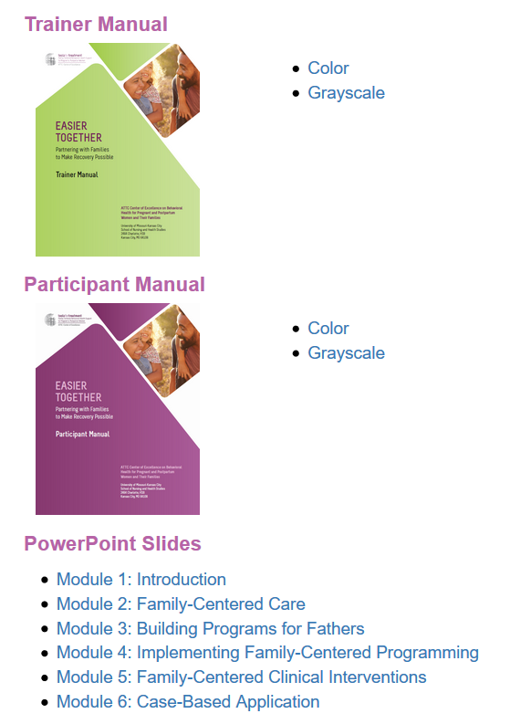
Wrap-Up
www.attcppwtools.org
Notes:
After processing all of this information, how has your impression of family-centered care changed?
As we said, this workshop is just a sample of the full training series. You can learn more about the content by exploring the curriculum, documentary and other resources on our website.

Slide 29
References
Child Welfare Information Gateway. (2014). Parental substance use and the child welfare system. Washington, DC: U.S. Department of Health and Human Services, Children’s Bureau.
Grella, C. E. (2008). From generic to gender-responsive treatment: Changes in social policies, treatment services, and outcomes of women in substance abuse treatment. Journal of Psychoactive Drugs, SARC Supplement 5, 327-343.
Substance Abuse and Mental Health Services Administration. (2017). National Survey of Substance Abuse Treatment Facilities (N-SSATS): 2016, Data on substance abuse treatment facilities. Retrieved from https://www.samhsa.gov/data/substance-abuse-facilities-data-nssats
Substance Abuse and Mental Health Services Administration. (2014). Results from the 2013 National Survey on Drug Use and Health: Summary of national findings (NSDUH Series H-48, HHS Publication No. (SMA) 14-4863). Rockville, MD: Substance Abuse and Mental Health Services Administration, 2014.
Werner, D., Young, N. K., Dennis, K, & Amatetti, S. (2007). Family-Centered Treatment for Women with Substance Use Disorders – History, Key Elements and Challenges. Department of Health and Human Services, Substance Abuse and Mental Health Services Administration.

