Slide 1
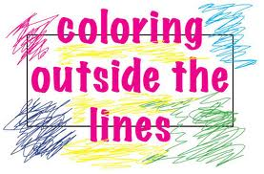
Using Creative Therapies with Difficult Clients
Nena L. Kircher, PsyD
Licensed Clinical Psychologist
nenaleann@gmail.com

Slide 2
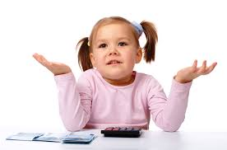
Why would I use creative therapies in a forensic setting?
In forensic settings the therapists’ task of lowering the client’s defensives to help him rebuild a healthier self is often MUCH more difficult.
Patients need for diversion and escape from boredom
(Gussak & Virshup, 1-2)

Slide 3
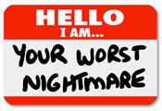
Difficult Clients
Who are we referring to?
Clients who have a history of responding poorly to traditional “talk therapy”
Clients with diagnoses that are chronic and difficult to treat with traditional therapies
  Incarcerated Offenders
  Personalities Disorders
  SPMI

Slide 4
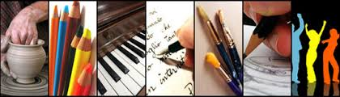
How it Works
Creative therapies offer a “safer” or more comfortable way of expressing things that patients are not able to share through words.
This non-verbal expression can be essential for working through issues of anger or resentment that could be perceived as threatening and result in other problems if expressed verbally in the institutional setting.
(Gussak & Virshup, 1-2)

Slide 5

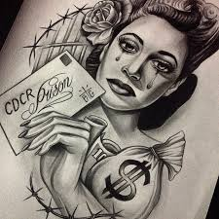
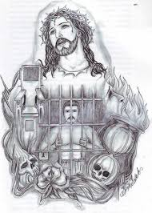
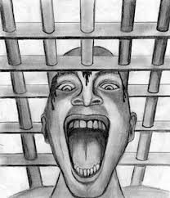
Art Therapy
The ability to create good art can be a status symbol.
Art is a form of expression that is acceptable both to staff and other patients.
Art making may reduce depression and conduct violations (Gussak 444-45).

Slide 6

Who can benefit from Art Therapy?
Case Examples:
Offender who “acts out” by drawing staff – naked?
Mandalas for Mindfulness
An Offender who is severely depressed and unable to express emotions.

Slide 7

Cinema Therapy
“No form of art goes beyond ordinary consciousness as film does, straight to our emotions, deep into the twilight room of the soul.”
– Ingmar Bergman

Slide 8

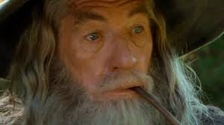


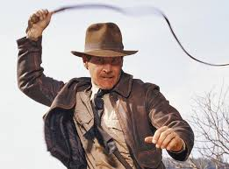
Is Cinema Therapy Something New?
Could be considered a form of Bibliotherapy.
  Storytelling
  Ancient Greek Dramas
  Power of Metaphor, Symbols, and Myth

Slide 9
How is Cinema Therapy Used?
Evocative Way
  Clients are encouraged to talk about movies that they have strong reactions to.
  Therapist does not recommend specific movies.
Prescriptive Way
  Therapist recommends a movie.
  Discusses movie with client(s) focusing on lessons learned by the characters.
Cathartic Way
  Therapist recommends a specific movie with an emotional theme that client is having difficulty connecting to.
  Encourages client to pay attention to and discuss how the characters processed the events/emotions.

Slide 10
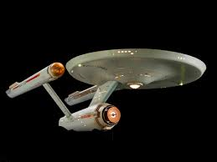
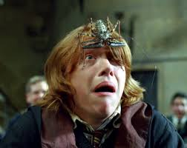

The Power of Film
Movies
  allow us to move beyond our own experience to the perspective of the observer.
  tap into basic human instincts and desires.

Slide 11
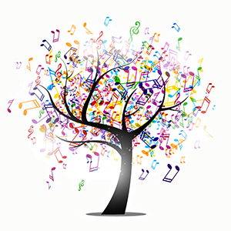
What is Music Therapy?
Music Therapy is the clinical and evidence based use o music interventions to accomplish individualized goals within a therapeutic relationship by a credential professional who has completed an approved music therapy program.
Music therapy also provides avenues for communication that can be helpful to those who find it difficult to express themselves in words.
Research in music therapy supports its effectiveness in many areas such as: overall physical rehabilitation and facilitating movement, increasing people's motivation to become engaged in their treatment, providing emotional support for clients and their families, and providing an outlet for expression of feelings.
– American Music Therapy Association

Slide 12
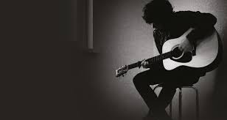
Music Therapy
Music has been demonstrated as an effective low-cost, non-invasive treatment for many mental disorders (Lin et. al. 2011).
Participation in music can be an effective method for personal growth including enhanced confidence, skills building and educational developments (Cathro & Devine 2012).

Slide 13

Music Therapy vs.
Therapeutic Music
Music Therapy as a Licensed Music Therapist vs. Therapeutic Music as an augmented technique to other modalities.
Music Therapists are specialized clinicians, with a particular highly trained skill set.
However, there are other examples of Therapeutic Music that can be incorporated into nearly any clinical setting:
      Asking a client to share the lyrics of a favorite song.
      Listening to music in session.
      Discussion based on song lyrics and emotional responses to music.

Slide 14
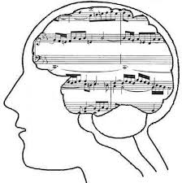
Mood Regulation
When used in conjunction with other techniques listening to soft music has been found to reduce anxiety in inpatient psychiatric clients (Silverman 2006).
Music alone can also significantly reduce stress related arousal symptoms (Pellitier 2004).
Listening to music with a sad theme may assist patients with depression in identifying their emotions (Bodner et. al. 2007).

Slide 15


Access to Music
Simply having access to music can be an issue for some due to safety issues and property restrictions in maximum security settings.
How can the clinician become an advocate for access to items (e.g. CD player) that might improve an offender or patient’s behavior and decrease symptoms of mental illness?

Slide 16
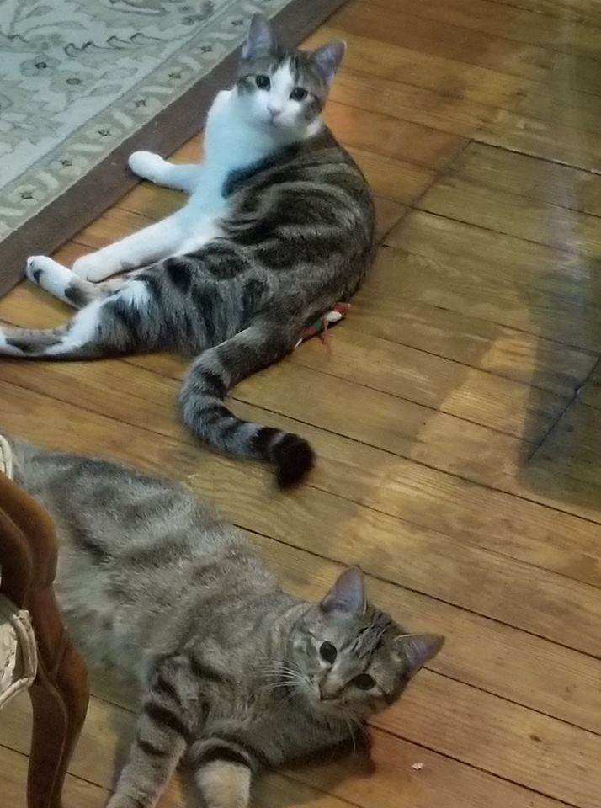
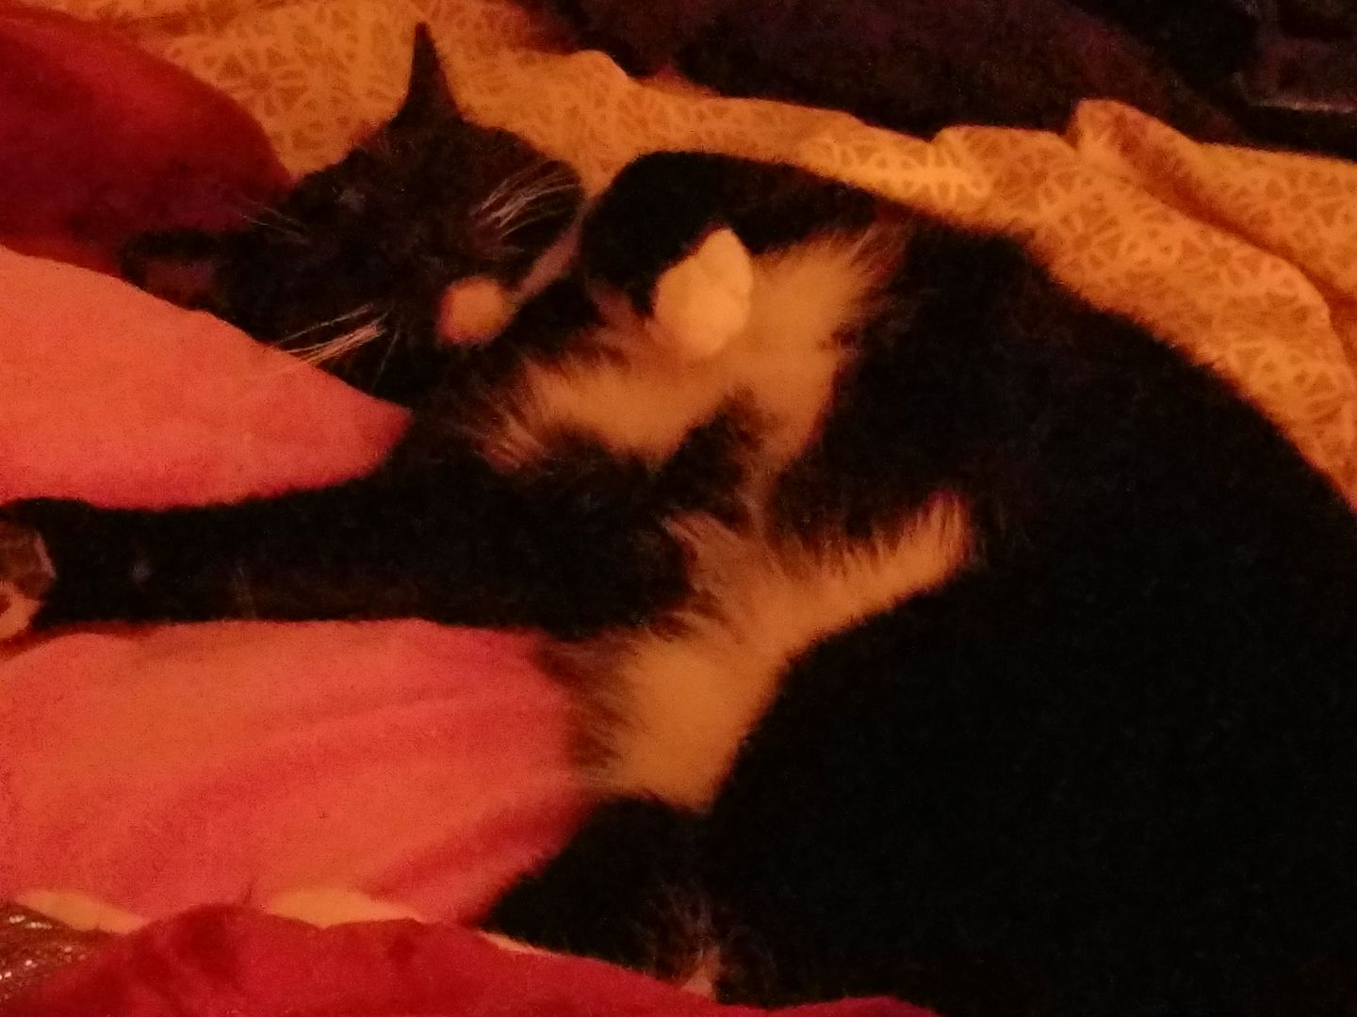
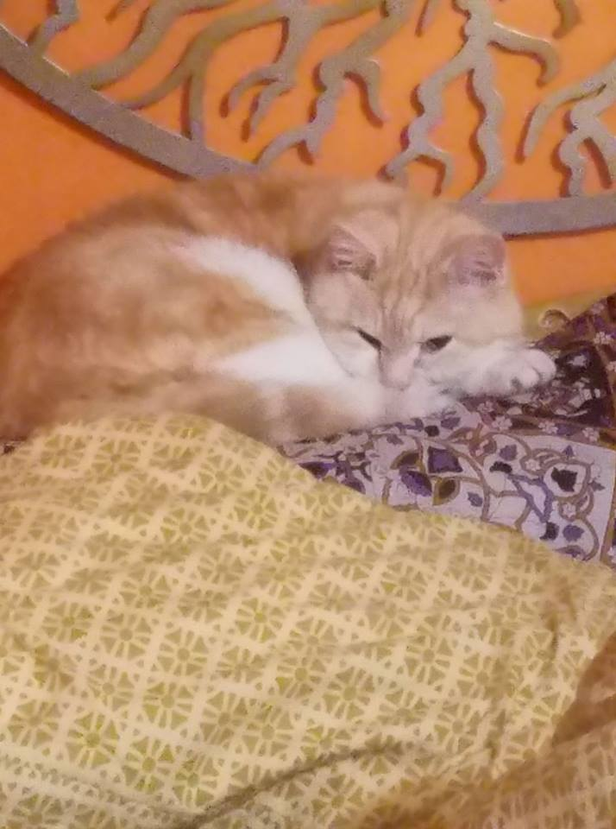
Pet Therapy
Animals provide opportunity for positive interaction and a lowering of barriers that difficult patients may be unwilling or unable to allow themselves with other people (Ormerod 2008).

Slide 17
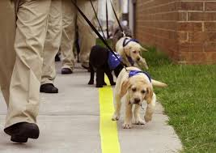
Pets in Unusual Places
Puppies for Parole
  Offenders Train Shelter Dogs that were previously labled “unadoptable” and would have otherwise been euthanized.
  4000th Dog adopted in February 2016.
  Partnership with COMTREA’s Bridle Ridge for Training Therapy Dogs
    Advanced Dogs placed in therapeutic settings: Autism, PTSD, Nursing homes, etc. to match the unique needs of the adopter.
    Dog Handlers are Supervised by Certified Therapy Dog Trainers
    Facebook.com/Missouri PuppiesforParole
DMH Pet Therapy Options
  CLS/Groups Homes has Slim living in cottage with forensic clients for more than 6 years
  Pet Therapy with Rehab Staff

Slide 18

Summary
As long as you’re being therapeutically appropriate there is no wrong way to use creative therapies.
The goal is to use these interventions to break through barriers and better meet your clients’ needs.

Slide 19
References
Art Therapy
Gussak, D. (2007). The effectiveness of art therapy in reducing depression in prison populations. International Journal of Offender Therapy and Comparative Criminology, 51(4), 444-59.
Gussak, D. & Virshup, E. Eds. (1997). Drawing time: Art therapy in prisons and other correctional settings. Chicago: Magnolia Street Publishers.
Liebmann, M. (1994). Art therapy with offenders. London: Jessica Kingsley Publishers.
Liebmann, M. (2004). Art therapy for groups: A handbook of themes and exercises. New York: Routeledge.
Lin, S., Yang, P., Lai, C., Su, Y. Yeh, Y., Huang, M. & Chen, C. (2011). Mental health implications of music: Insight from neuroscientific and clinical studies. Harvard Review of Psychiatry, 19 (1). 34-46.
Malchiodi, C.A. (2007). The art therapy sourcebook. New York: McGraw-Hill.

Slide 20
References
Cinema Therapy
Ramis, H. (1993). Groundhog’s Day [Film]. Columbia Pictures: Los Angeles.
Wright, J. Director. (2009). The Soloist [Film] . StudioCanal: Paris.
Wolz. B. (2013). Cinema therapy – using the power of imagery in films for the therapeutic process [Online Course]. Sonoma: Zur Institute.
Wolz. B. (2013). Positive psychology & the movies: Transformational effects of movies through positive cinema therapy – Part I & II. [Online Course]. Sonoma, California: Zur Institute.
Wolz, B. (2005). E-Motion Picture Magic: A Movie Lover’s Guide to Healing and Transformation. Centennial, Colorado: Glenbridge.

Slide 21
References
Music Therapy
American Music Therapy Association http://www.musictherapy.org/
Bodner, E., Iancu, J., Gilboa, A., Sarel, A., Mazor, A., & Amir, D. (2007). Finding words for emotions: The reactions of patients with major depressive disorder towards various musical excerpts. Arts in Psychotherapy, 34(2):142-50.
Bradt, J., Magee, W.L., Dileo, C., Wheeler, B.L., & McGilloway, E. (2010). Music therapy for acquired brain injury. Cochrane Database of Systematic Reviews, 2010(7), doi: 10.1002/14651858.CD006787.pub2
Cathro, M. & Devine, A. (2012). Music therapy and social inclusion. Mental Health Practice, 16 (1). 33-36.
Clair, A. A., Lyons, K., & Hamburg, J. (2012). A feasibility study of the effects of music and movement on physical function, quality of life, depression, and anxiety in patients with Parkinson disease. Music and Medicine, 4 (1), 49-55.
Pellitier, C. L. ( 2004). The effect of music on decreasing arousal due to stress: A meta-analysis. Journal of Music Therapy, 42, 192-214.
Silverman, M.J. (2006). Psychiatric patients' perception of music therapy and other psychoeducational programming. Journal of Music Therapy, 43(2):111-22.

Slide 22
References
Pet Therapy
Berget, B. & Braastad, B. O. (2008). Theoretical framework for animal assisted interventions in clinical practice. Therapeutic Communities, 29 (3). 323-337.
Missouri Department of Corrections. Division of Adult Institutions. Puppies for parole. http://doc.mo.gov/DAI/P4P.php
Ormerod, E. (2008). Companion animals and offender rehabilitation – experiences from a prison therapeutic community in Scotland. Therapeutic Communities, 29 (3). 285-296.

Slide 23


