Slide 1

Wellness: Our Ethical Responsibility
Lia Willis Ph.D., MSW, LCSW
Mike Perkins, MSW, LCSW
Columbia College
Notes:
520,000,000 results when I googled “wellness” wellness is certainly a trendy topic, but it is a very important aspect of our work and personal lives

Slide 2
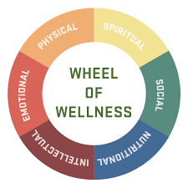
Wellness defined
"...a state of complete physical, mental, and social well-being, and not merely the absence of disease or infirmity."
The World Health Organization
Notes:
39.5 million results on google! There are many wellness cmponents but we are focusing mainly on psychological wellness in our presentation today.
Our message today is that, for most of us, wellness doesn’t just happen. We have to practice wellness. We have to pursue wellness. We have to make choices to contribute to our own wellness. We have to understand how to achieve or increase wellness in our own lives. We believe, and research supports, that the pursuit of wellness will make us healthier in many aspects of our lives.
We believe that our code of ethics requires us to practice wellness. Our goal today is show you some interesting ways to practice wellness and help you incorporate the practice o wellness into your lives.

Slide 3

Social workers’ ethical responsibilities as professionals: standard 4.5 “impairment”
Social workers should not allow their own personal problems, psychosocial distress, legal issues, substance abuse or mental health difficulties to interfere with their personal judgment and performance or to jeopardize the best interests of people for whom they have a professional responsibility.

Slide 4

National Board for Certified Counselors
Ethical policy #23
“NCCs shall seek professional assistance or withdraw from the practice of counseling if their mental or physical condition makes it unlikely that the counselor will be able to provide appropriate services.”

Slide 5
MCB Professional competence and integrity: competence and self knowledge
“The professional shall seek appropriate professional assistance for their personal problems or conflicts that may impair work performance or clinical judgment”
MCB Code of Ethics

Slide 6

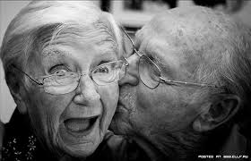

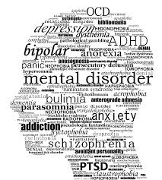


Helper’s role
To assist people who are vulnerable.
Notes:
One thing we forget sometimes is to care for ourselves. Caring for others is noble and it is what we do. Our jobs make us particularly susceptible to secondary traumatic stress, which means we really need to take care of ourselves. In our work with others, We can’t forget ourselves.

Slide 7
Evidence of impairment
Depression
Anxiety
Use of substances
Other mental health issues
Problems with physical health
Poor job performance
Notes:
Lack of self care can lead to
impairment, leading to poor professional performance

Slide 8
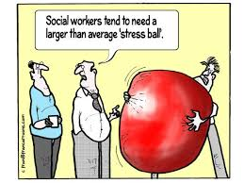
Stress busters for the workplace
http://zoo.sandiegozoo.org/cams/panda-cam

Slide 9


Stress busters at work
http://livepuppycam.com/cam-2/
Mantras
Stretching at your desk
Talking with a coworker

Slide 10
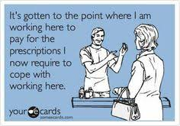
Notes:
It is really important that we take care of ourselves so we can help prevent burnout, personal difficulties, and poor job performance. That is why we are saying it is our ethical responsibility to practice wellness.

Slide 11

wellness strategies
Mindfulness meditation
Exercise
Nutrition
Supervisor support
Social support
Notes:
Supervisor can help with caseload assignments, recognizing warning signs of secondary traumatic stress, comp time usage, discussion/support groups

Slide 12

Mindfulness is good for our bodies
A seminal study found that, after just eight weeks of training, practicing mindfulness meditation boosted the immune system’s ability to fight off illness.

Slide 13

Mindfulness is good for our minds
Several studies have found that mindfulness increases
positive emotions while reducing negative emotions and stress.
Indeed, at least one study suggests it may be as good as antidepressants in fighting depression and preventing relapse.

Slide 14
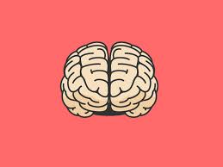
Mindfulness changes our brains
Research has found that it increases density of gray matter in brain regions linked to learning, memory, emotion regulation, and empathy.
Mindfulness helps us focus: Studies suggest that mindfulness helps us
tune out distractions and improves our memory and attention skills

Slide 15

Mindfulness fosters compassion and altruism
Practicing Mindfulness makes us more likely to help someone in need and increases activity in neural networks involved in understanding the suffering of others and regulating emotions.

Slide 16

Mindfulness enhances relationships
Research suggests mindfulness training makes couples more satisfied with their relationship, makes each partner feel more optimistic and relaxed, and makes them feel closer to one another.

Slide 17
Mindfulness is good for parents
Studies suggest it may reduce pregnancy-related anxiety, stress, and depression in expectant parents.
Parents who practice mindfulness report being happier with their parenting skills and their relationship with their kids, and their kids were found to have better social skills.

Slide 18
Mindfulness helps healthcare professionals
cope with stress
connect with their patents
improve their general quality of life
by reducing negative emotions and anxiety, and increasing
their positive emotions and feelings of self-compassion

Slide 19
Mindfulness-Based Stress Reduction (MBSR)
The gold standard of clinical mindfulness practice
developed by Dr. Jon Kabat-Zinn (1979) at the University of
Massachusets Medical Center.
https://palousemindfulness.com/

Slide 20

https://palousemindfulness.com/meditations/mountain.html

Slide 21
Mindfulness-Based Cognitive Therapy (MBCT) is a form of MBSR
that includes information about depression as well as cognitive
therapy-based exercises linking thinking and its resulting impact
on feeling.”
http://www.mindfullivingprograms.com/whatMBSR.php

Slide 22
The Pareto Principle
It commonly takes 20% of the time allotted to complete 80% of
a task.
To complete the last 20% of a task takes 80% of the effort.
Achieving perfection is impossible.
Increasing effort results in diminishing returns as further
activity becomes increasingly inefficient.

Slide 23
“Good Enough” Mindfulness
Don’t aim for perfect. Aim for sustainable. Ruthlessly forgive relapses.
Get a schedule and a routine.
Have things you can do, and some things you might do, and
know the difference.
Utilize the myriad resources that are available at little, or no,
cost. You will learn 80% of what there is to know from those
sources.

Slide 24
More ideas for wellness
Gratitude journal
Doing new things
Do nice things for people for no reason
stop multtasking. Turn off the
radio, turn off your phone, and absolutely no headphones.
Exercise – whatever it is you like to do: walk, bike, run,
swim, dance,....
“Be here now.”

Slide 25
Putting it all together
Meditation and an exercise regime including yoga,
along with a healthy diet is a powerful combination
for improving physiological and psychological health.
It is all connected.

Slide 26

Phone apps
Yoga
Mindfulness
Relaxation
Meditation
Metronomes counting breaths

Slide 27

To Read
1. Hardwiring Happiness by Rick Hanson
2.Meditaton for Beginners by Jack Kornield
3. The Myths of Happiness: What Should Make You Happy, But Doesn’t What Shouldn’t Make You Happy, but Doesn’t by Sonja Lyubomirsky
4.The Science of Yoga: The Risks and the Rewards by William J. Broad
5. The Minimalists: Essental Essays by Joshua Millburn and Ryan Nicodemus

Slide 28
https://www.timeanddate.com/countdown/retirement?iso=20230501T00&p0=5687&msg=retirement&font=cursive

Slide 29
References
Aronsson, Astvik & Gustafsson. (2014). Work Conditions, Recovery and Health: A Study among Workers within Pre-School, Home Care and Social Work. British Journal of Social Work 44(6): 1654-1672.
Butler, Carello, & Maguin. (2017). Trauma, Stress, and Self-Care in Clinical Training: Predictors of Burnout, Decline in Health Status, Secondary Traumatic Stress Symptoms, and Compassion Satisfaction.
Kabat-Zinn. www.palousemindfulness.com
Psychological Trauma: Theory, Research, Practice, and Policy Vol. 9, No. 4, 416–424.
Ting, Jacobson & Sanders, Sara. (2011). Current levels of perceived stress among mental health social workers who work with suicidal clients Social Work, 56(4): 327-336.

