Slide 1

Serving Those Who Serve
Rachael Fields, MSW, LCSW

Slide 2
Serving Those Who Serve
Become familiar with current statistics regarding suicide in the military
Review risk factors and warning signs of suicide
Review protective factors that foster resiliency among service members
Overview of current methods employed by the Army, Air Force, Navy, and Marines to reduce suicide among members
Resources for military members

Slide 3
22 Push-Up Challenge
http://mynews4.com/news/local/22-pushup-challenge-raising-awareness-about-veteran-suicide-rates

Slide 4
Statistics
1455 military personnel committed suicide from 2005 to 2011. From 2006 to 2011, the rates were highest among army personnel (19.13 to 29.44 cases per 100 000). Among suicides with a known cause of death, 62% were attributed to firearms. Among army personnel or marines who committed suicide, those with infantry or special operations job classifications were more likely than those in non-infantry positions to use a firearm.
Suicide Rates and Methods in Active Duty Military Personnel, 2005 to 2011: A Cohort Study.
Anglemyer A, Miller ML, Buttrey S, Whitaker L.
Ann Intern Med. 2016 Aug 2;165(3):167-74. doi: 10.7326/M15-2785. Epub 2016 Jun 7.

Slide 5
Statistics Cont.
In 2012, there were 319 suicides among active duty service members and 203 among reserve service members, compared with 237 combat-related deaths of active duty service members in Afghanistan, according to the Department of Defense.
Service members and veterans who attempted suicide before joining the military were six times more likely to attempt suicide after joining the military than those who had never attempted suicide
Among service members and veterans who attempted suicide, approximately 50% had thought about committing suicide and 25% had attempted suicide before joining the military.
http://www.socialworktoday.com/news/dn_081314.shtml

Slide 6
Risk Factors
MOS (Military Occupational Specialty)
Relationship difficulty
Financial Difficulty
Family history of suicide
Family history of child maltreatment
Previous suicide attempt(s)
History of mental disorders, particularly clinical depression
History of alcohol and substance abuse or increase in current use
Feelings of hopelessness

Slide 7
Risk Factors Cont.
Impulsive or aggressive tendencies
Cultural and religious beliefs (e.g., belief that suicide is noble resolution of a personal dilemma)
Isolation, a feeling of being cut off from other people
Barriers to accessing mental health treatment
Loss
Physical illness
Easy access to lethal methods
Unwillingness to seek help because of the stigma attached to mental health and substance abuse disorders or to suicidal thoughts

Slide 8
Warning Signs of Suicide
Talking about wanting to die or to kill themselves
Looking for a way to kill themselves, like searching online or buying a gun
Talking about feeling hopeless or having no reason to live
Talking about feeling trapped or in unbearable pain
Talking about being a burden to others
Increasing the use of alcohol or drugs
Acting anxious or agitated; behaving recklessly
Sleeping too little or too much
Withdrawing or isolating themselves
Showing rage or talking about seeking revenge
Extreme mood swings

Slide 9
Protective Factors
Effective behavioral health care
Connectedness to individuals, family, community, and social institutions
Life skills (including problem solving skills and coping skills, ability to adapt to change)
Self-esteem and a sense of purpose or meaning in life
Cultural, religious, or personal beliefs that discourage suicide

Slide 10
Jeromy Kelsey's Personal Story
https://www.youtube.com/watch?v=wn3XtRMhXEI

Slide 11
Navy- Every Sailor, Every Day
Launched in 2014
Seeks to empower behavior change by providing sailors & their families with tips to support themselves and each other.
Promotes on-going and active engagement to enable early recognition of risk and proactive intervention

Slide 12
Navy Operational Stress Control (OSC)
Promotes an understanding of stress, awareness of support resources, and practical stress navigation tools to help build resilience of Sailors, families, and commands
Components of program: Training, intervention, response, reporting

Slide 13
ACT
Ask
Care
Treat

Slide 14
Patrick Murphy, former Under Secretary U.S. Army
https://www.youtube.com/watch?v=CwvYwTChnSA&app=desktop

Slide 15
Army- ACE
Ask
Care
Escort

Slide 16
Army- ASIST
2 day workshop
Suicide First Aid
Gatekeeper Philosophy

Slide 17
Marines- RACE
Recognize
Ask
Care
Escort
Social Media Campaign #BeThere_Marine

Slide 18
Air Force- Green Dot
https://vimeo.com/168118402

Slide 19
7 Things to Know about Green Dot:
1. Green Dot is an Air Force strategy to decrease interpersonal violence across the service: It is an interactive training program designed to help Airmen, which includes military and civilians, intervene in and prevent violence.
2. More than sexual assault: Green Dot training aims to prevent suicide, sexual assault, family violence, abuse, stalking and other forms of violence.
3. Green Dot addresses multiple forms of violence simultaneously: Green Dot is designed to help Airmen develop key skills that address the underlying common risks and protective factors for multiple forms of violence.

Slide 20
7 Things Cont.
4. It is mandatory for Airmen, both military and civilians: Green Dot consolidated some of the required and annual briefings for Airmen and shortened the amount of time they spend doing it. Though it is mandatory, only Airmen can choose to internalize what they learn and put it into practice.
5. Obviously, the name came from seeing green and red dots on a map: Red dots represent an incident involving violence, while green dots represent counteractions against or to prevent them.
6. There are two types of classes: Individuals who have not taken Green Dot training before must take the initial class; the refresher class is for Airmen who have completed the training before.
7. Prevention starts with us: Through Green Dot training, everyone is empowered to actively intervene when an issue arises–recognize the warning signs; understand the barriers to intervening; intervene by directing, delegating or distracting; and strengthen the protective factors
Information courtesy of Secretary of the Air Force Public Affairs and 86th Airlift Wing Public Affairs

Slide 21
Air Force
Ask
Call
Escort
Incorporated in Green Dot Training

Slide 22
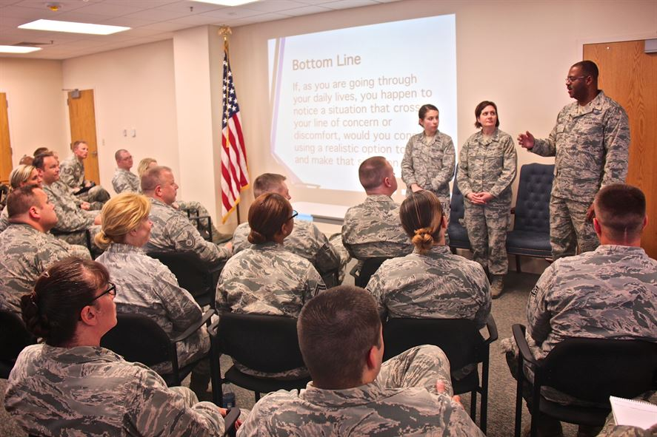
Here’s My Green Dot

Slide 23

What’s Your Green Dot?

Slide 24
Resources on base:
Clinic/hospital
Director of Psychological Health
Chaplain
Commander

Slide 25
Resources
Military One Source http://www.militaryonesource.mil/
National Suicide Prevention Lifeline (800)273-8255
https://www.vets.gov/health-care/health-conditions/mental-health/suicide-prevention/

Slide 26
Summary
Focus on psychoeducation throughout the branches: Identification of risk factors, warning signs, and building protective factors and resilience.
ACE concept adopted throughout
Focus on Wingman concept
Focus on reduction of stigma in seeking mental health services

