Slide 1
Relationship Status:
It's Complicated
Teens, Technology,
and Relationships
Kaleigh Cornelison, MSW
k-cornelison.com

Slide 2
How comfortable are you with…
Texting
Facebook
Twitter
Instagram
Tumblr
Snapchat
Kik
WhatsApp
Telegram
WeChat
AskFM
GroupMe
Musical.ly
Houseparty
Omegle
Live.ly
Live.me
YouNow
Whisper
Monkey
MeetMe
Yubo
Notes:
Do either the walk side to side activity or fist of 5
How many people see at least one item up here that they’re not familiar with?
https://www.commonsensemedia.org/blog/16-apps-and-websites-kids-are-heading-to-after-facebook
https://www.lifewire.com/hottest-social-app-trends-for-teens-3485940
https://www.nytimes.com/2017/09/06/style/teen-apps-bullying.html

Slide 3
Teens & Tech Tip #1
TALK TO YOUR TEENS
Notes:
As adults there’s almost no way to know everything that’s happening online and on their apps. You HAVE TO ASK THEM.

Slide 4
Teens & Tech Tip #2
TRY IT
Notes:
Once you know a little more about what they’re using – try it! Down the app, go to the website and try it for yourself. Everything will seem a lot more scary until you actually see what it is and does. Don’t be like my dad and avoid getting a smart phone for a million years. He doesn’t know any teens so it’s fine for him!

Slide 5
“I’ve come to the conclusion that the way we engage with social media is like fire- you can use them to keep yourself warm and nourished, or you can burn down the barn. It all depends on your intentions, expectations and reality-checking skills.”
Brené Brown
Braving the Wilderness

Slide 6

This workshop is NOT…
Notes:
https://www.youtube.com/watch?v=Z7dLU6fk9QY

Slide 7
What Does “Look Up” Get Wrong?
Tech-negative
Social isolation
Unrealistic
Claims online connections are fake and unemotional

Slide 8
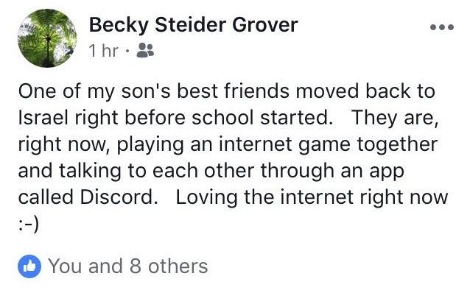
Instead, consider this approach…
Balanced
Tech-neutral (or tech-positive)
Realistic
Responsible
Different/not worse

Slide 9
Teens & Tech Tip #3
KEEP AN OPEN MIND
Notes:
If you go into every convo about tech use assuming that the app or site is dangerous, evil or harmful you won’t get anywhere. Give it a chance. Social media and technology is here to stay – we have to adapt and welcome it to keep up with our teens.

Slide 10
Teen Identity

Slide 11
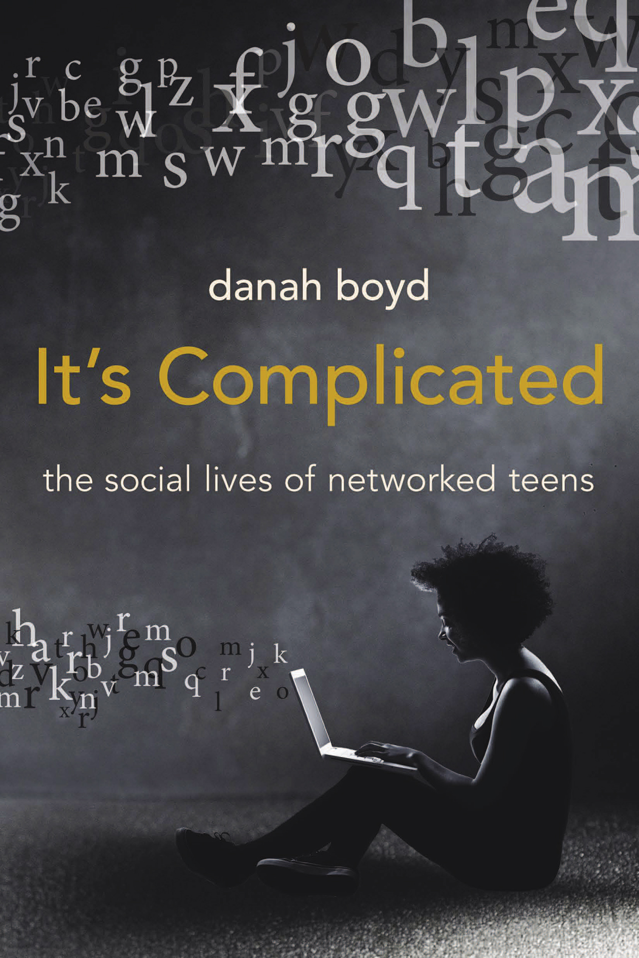

Slide 12
“I think it is important to realize the underlying reasons why young people are engaging with social media are the same reasons that have always encouraged them to gather in physically grounded public spaces. They want to gossip, they want to flirt, they want to hang out, they want to joke around, they want to see and be seen. And all of that is really important because it is how identity is manufactured and understood. It’s how teens figure out who they are.”
dannah boyd
Notes:
What types of youth might especially benefit from online communities?

Slide 13
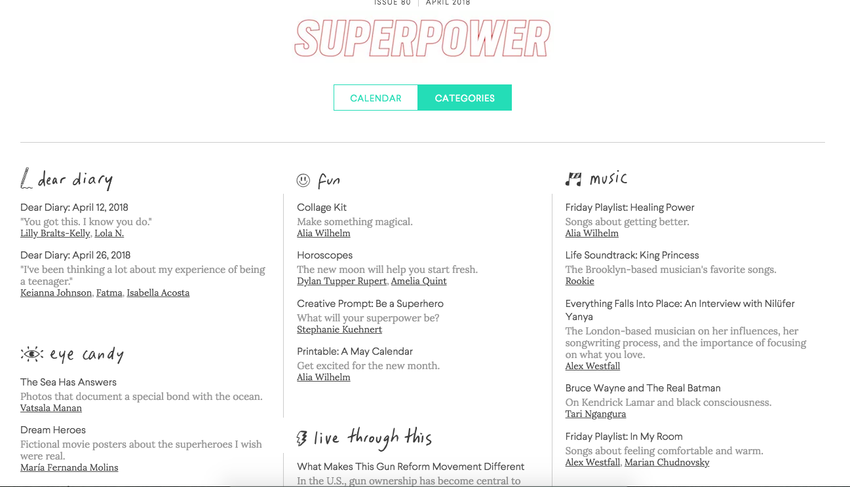
Rookie Magazine
Notes:
Created by Tavi Gevinson when she was a teen
Online magazine by and for teens
Monthly themes – example here (Can see in categories or calendar view)
Teens can submit content
Rooke on Love and Year Books

Slide 14

Youth Are Awesome
Notes:
All the content on Youth Are Awesome is written by youth bloggers who cover everything from film to books to volunteering to sports to issues that affect youth and so much more. These bloggers range in age from 12 – 18 years old, and come from every quadrant of the city, each bringing a unique view and style to the site. Alberta, Canada

Slide 15
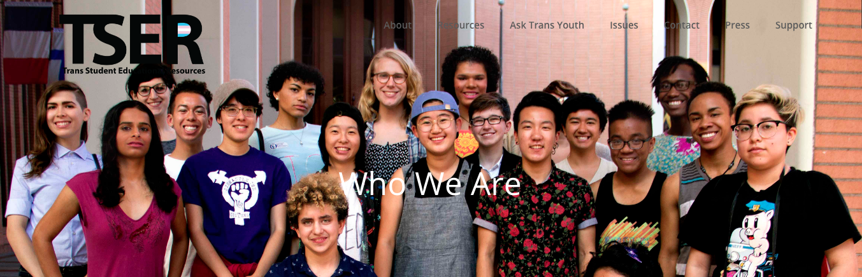
Trans Student Education Resources
Notes:
Trans Student Educational Resources was co-founded in 2011 by Eli Erlick and Alex Sennello, two 16-year-old transgender women, as Trans Student Equality Resources. It was and remains the only national organization run by young transgender people. TSER was originally envisioned as an organization for creating safer schools through youth-led action, much of which focused on policy. Since this time, we have hugely expanded our efforts in scope and scale to encompass many programs and services.

Slide 16
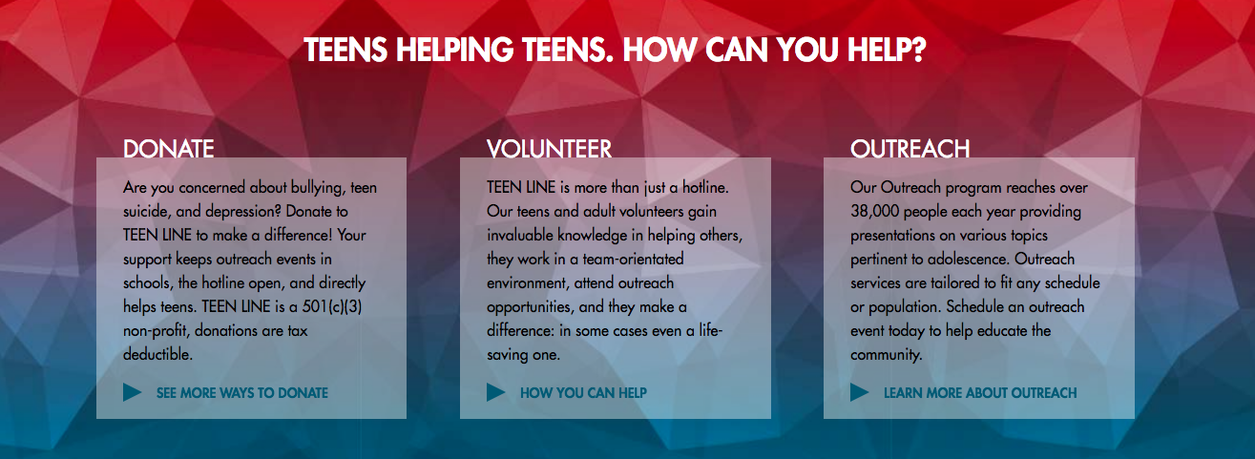
Teen Line
Notes:
Teen Line was created in 1980 by a group of mental health professionals who, through their personal work with teenagers, realized that a more inclusive approach to adolescent mental health was needed. After extensive research and consultation, Teen Line was born.
Teen Line is based on the premise that when a teenager has a problem, they often seek help from their peers. Many teens think their parents can’t possibly understand what’s happening in their lives and that their friends might laugh or abandon them. Teen Line provides a safe, confidential place to talk things out with another teen who can understand and will listen, but not judge.
The hotline receives over 15,000 calls, texts, and emails each year

Slide 17
Teens & Tech Tip #4
SEE THE GOOD
Notes:
Know what research is real and what’s fake.

Slide 18
The Common Sense Census:
Media Use by Tweens & Teens
Common Sense Media
Nationally Representative Survey
2,658 U.S. 8 to 18 years olds
February 6 to March 9, 2015

Slide 19
Media Activities Included:
watching television, movies, and videos
playing video/computer/mobile games
listening to music
using social media
reading
using digital devices for other purposes (such as browsing websites, video-chatting, or creating digital art or music)

Slide 20
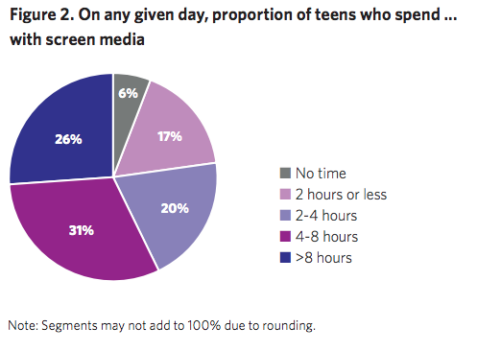
Notes:
On any given day, American teenagers (13- to 18-year-olds) average about nine hours (8:56) of entertainment media use, excluding time spent at school or for homework.

Slide 21
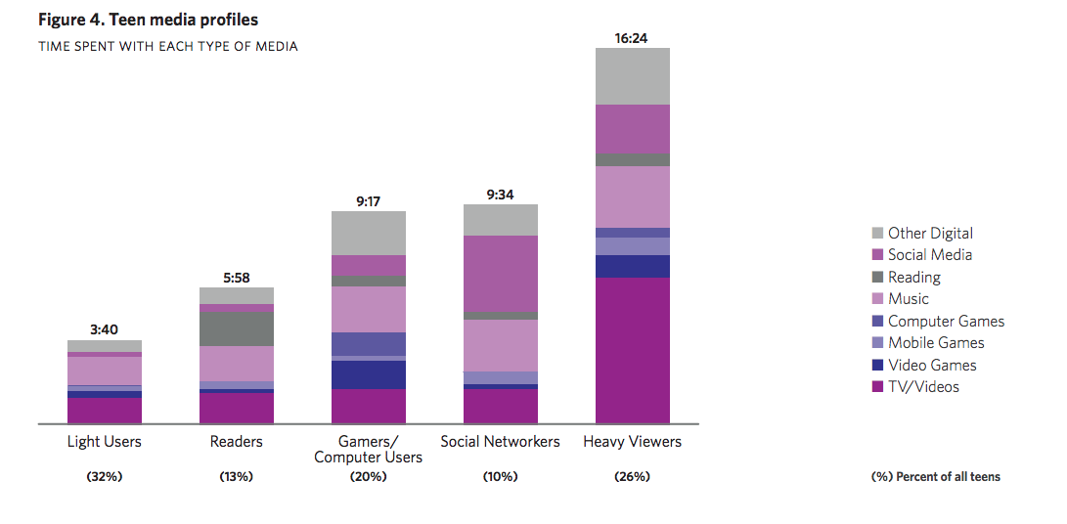
Notes:
There are substantial variations in the types of media-related activities young people engage in and how they use devices.
Almost all teens spend some time watching TV and listening to music on any given day; but beyond that, there are distinct types of media “diets” and users.
Young people who use similar amounts of screen time spend that time doing very different things on their screens.

Slide 22
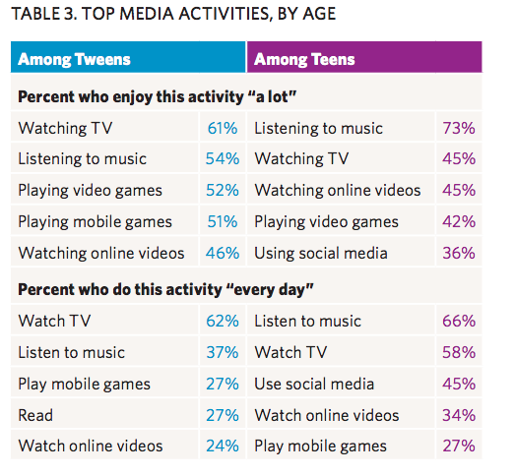
Notes:
Listening to music and watching tv still rank as the top media activities
Enjoy “a lot” and engage in “every day”
There is no question that social media have become an integral part of most teens’ lives; an average of 1:11 a day is devoted to using social media among this age group. But for a generation often defined by its use of social media, it is interesting that it doesn’t get the same devotion that listening to music or watching TV do. A significant number of teens say they use social media “every day” (45 percent), but that’s far less than the proportion that listens to music (66 percent) or watches TV (58 percent) that often. A third of teens (36 percent) say they enjoy using social media “a lot,” but that is substantially less than those who say the same about listening to music (73 percent) or watching TV (45 percent). Only 10 percent of teens choose using social media as their “favorite” media-related activity, compared with 30 percent who choose listening to music.

Slide 23
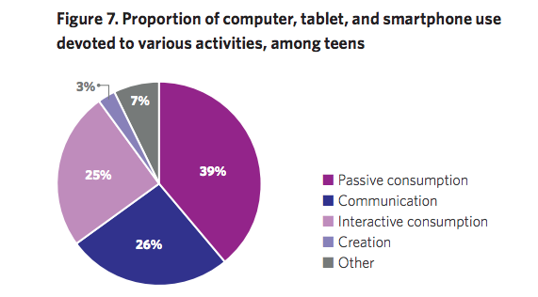
Notes:
Teens are consuming a lot more media than creating it

Slide 24
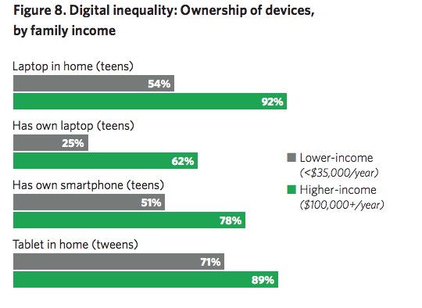
Notes:
Low income youth spend an average of more than 2:45 more time using digital media that higher-income peers.
The number of teens who use digital media is about the same the difference is between those who report they use it
Black youth report spending more time with media that white or Hispanic youth

Slide 25
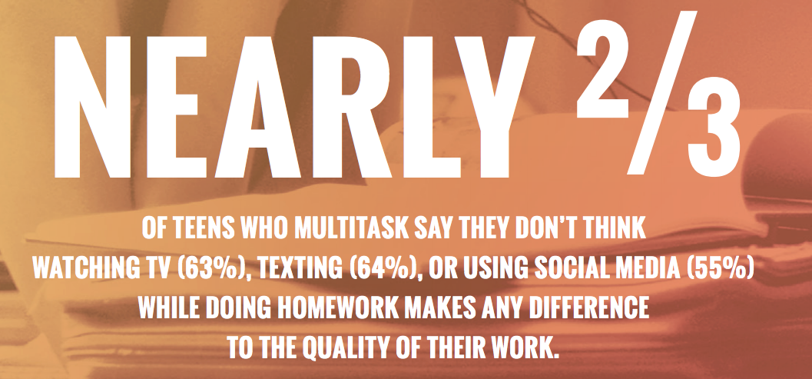
Notes:
Half of teens say they “often” or “sometimes” watch TV (51 percent) or use social media (50 percent) while doing homework, and more say the same about texting (60 percent) and listening to music (76 percent).

Slide 26
Teens & Tech Tip #5
EDUCATE YOURSELF
Notes:
Know what research is real and what’s fake.

Slide 27
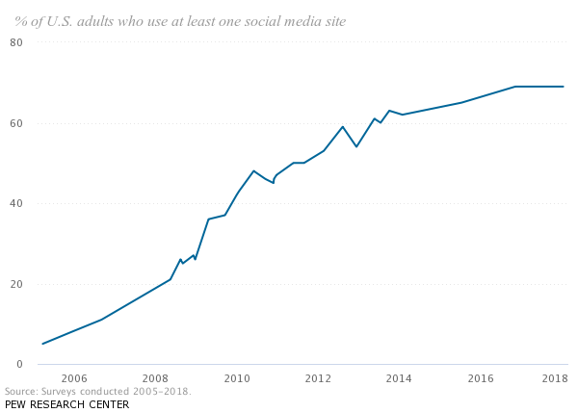
Notes:
5% in 2005 to 69% in 2018
When Pew Research Center began tracking social media adoption in 2005, just 5% of American adults used at least one of these platforms. By 2011 that share had risen to half of all Americans, and today 69% of the public uses some type of social media.
http://www.pewinternet.org/fact-sheet/social-media/

Slide 28
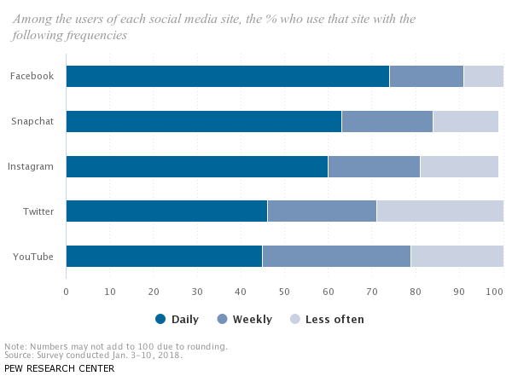
Notes:
For many users, social media is part of their daily routine. Roughly three-quarters of Facebook users – and around six-in-ten Instagram users – visit these sites at least once a day.

Slide 29
Teens & Tech Tip #6
SET A GOOD EXAMPLE
Notes:
You cannot expect your teens or other age kids to magically not use their phone 24/7 if you do! (Fitz taking a selfie example.)

Slide 30
Relationships

Slide 31

Rachel’s Sext
Notes:
https://www.youtube.com/watch?v=WfanfNc4At4

Slide 32
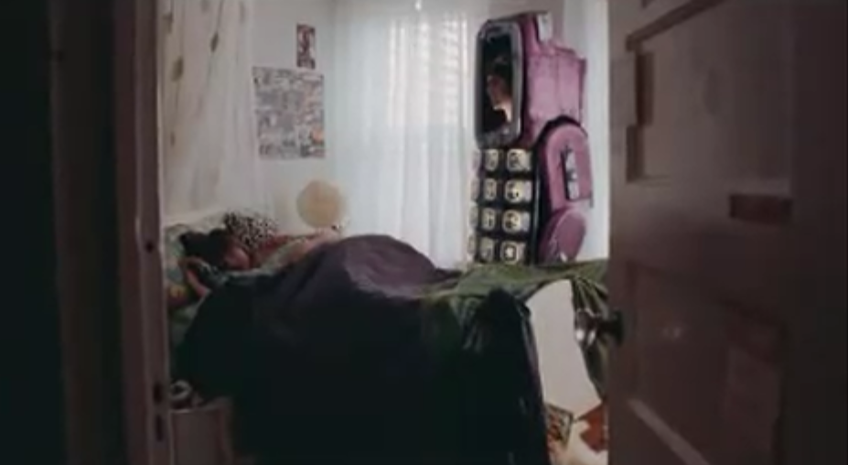
Textual Harassment
Notes:
https://www.youtube.com/watch?v=wOWSnxO5hog

Slide 33
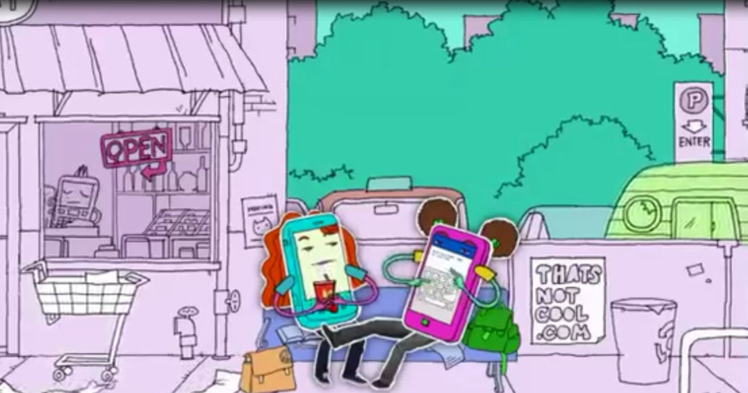
That’s Not Cool: Sharing Passwords

Slide 34

Library
Notes:
https://www.youtube.com/watch?v=KeKJpVsnV8E

Slide 35
Teens & Tech Tip #7
SET REALISTIC BOUNDARIES

Slide 36
Teens & Tech Tip #8
FOCUS ON SAFETY & VALUES

Slide 37
What they wish we knew…
“When you take away one device at night, you might not realize how many devices we still have with us.”
“Many of us have a fake Instagram account.”
“If we are passionate or angry about something, we take it to social media.”
Notes:
Social Media Wellness: Helping Tweens & Teens Thrive in an Unbalanced Digital World by Ana Homayoun
“When you take away one device at night, you might not realize how many devices we still have with us.” Access to smartphones has shifted communication for teens, and self-regulation can be difficult. The fear of missing out (FOMO) can create an overwhelming desire to be connected — in fact, according to 2015 Pew Research, 94 percent of teens go online daily, which isn’t surprising, and 24 percent of teens feel as though they are online constantly. Encouraging kids to find effective ways to self-regulate is sometimes about getting their buy-in — that is, encouraging them to reflect on the impact their daily online habits are having on their personal, academic and extracurricular goals.
“Many of us have a fake Instagram account.” A parent recently told me she had full control over her ninth-grade son’s online interactions. She explained that he didn’t even know the password for his Instagram account, and that if he wanted to post something, he had to go through her. I quietly surmised that her son might be hiding some of his online activities from her. If kids are online, parents are usually more effective acting as mentors than as micromanagers. Having open-ended conversations rather than wielding authoritative control enables kids to build the critical thinking skills needed to make smarter decisions online and in-real-life. For some kids, a finsta (“fake” Instagram) or a rinsta (“real” Instagram) might be where they feel they can share their raw, authentic feelings, even though they don’t always realize that anything shared online has the potential for a greater audience, amplified consequences or longer shelf-life. It’s up to parents to find a way in, not through coercion, but through conversation.
“If we are passionate or angry about something, we take it to social media.” Young people want their opinions to be heard. Many tweens and teens find their online communities are engaging, interactive and responsive. A message or Snapchat sent to a friend can result in an instant reply, and something posted to a group chat or online profile can create the opportunity for community-level conversation and engagement. Responses from friends and followers make kids feel heard and listened to, which is often critically important for those who simply want acknowledgment and validation (this isn’t, of course, much different for adults). At the same time, we know that teens’ and tweens’ brains are still developing and that kids often lack impulse control and the ability to understand the long-term consequences of decisions made in moments of anger and frustration. Parents who empathize with the challenges their children face can help them devise smarter, healthier ways to self-filter before posting.

Slide 38
What they wish we would do…
“Talk with us about the apps we like to use and why. Most of you have no idea about our world.”
“Help us keep an eye on who is following us.”
“Accept that there are lots of good things on social media — it is not all bad stuff.”
“Talk with us about sexting and healthy relationships in a way that isn’t awkward.”
Notes:
“Talk with us about the apps we like to use and why. Most of you have no idea about our world.” One of my students recently told me how a group of nine of her friends from school were using family tracking apps to monitor one another. When she and a few of her friends wanted to hang out or were all in the same place, there would be a continual stream of social pressure, guilt and shame from others who weren’t invited (“Why are you hanging out without us? Guess you think you’re too cool for us?”). Her parents had no idea that some of their teen daughter’s friends were essentially stalking her. Many apps have geolocation features, and parents don’t realize the new level of potential pressure (and danger) these on-all-the-time experiences can bring. Ultimately, my student removed herself from the tracking group when she decided the stress she was experiencing wasn’t worth it. A tip? Ask your kids which apps they spend the most time on (or check their phone’s data usage). Download those apps and spend time learning the ins and outs.
“Help us keep an eye on who is following us.” Even when kids keep social media accounts private or provide restricted access, anyone can request to follow or friend them and potentially have full access to their postings. In a world where likes, loves, comments and follower counts have become a barometer for popularity, teens might find it difficult to turn away potential followers, even when they should. Parents and educators should encourage teens and tweens to curate access to their accounts.
“Accept that there are lots of good things on social media — it is not all bad stuff.” Social media isn’t good or bad — it is a new form of communication and language that adults need to learn, because pretending it doesn’t exist generally isn’t a wise approach. When adults express genuine curiosity and compassion about the positive experiences associated with online interactions, kids are more likely to confide in them about the intertwining nature of their online and in-real-life experiences. Positive, supportive online communities can make a world of difference to kids who have moved to a new area, or who don’t feel particularly connected to their school community, or who aren’t able to attend school because of illness.
“Talk with us about sexting and healthy relationships in a way that isn’t awkward.” Tweens and teens who are socializing and navigating relationships online and in-real-life face challenges unheard of in previous generations. Some might mistakenly confuse the sending of explicit photos and messages with a level of intimacy that might not exist, and others might not fully understand the long-term social, emotional and legal consequences of sending, sharing and storing explicit photos (parents, check your local laws). According to the Harvard Graduate School of Education’s Making Caring Common Project, teens may benefit from conversations focused on promoting the skills needed to develop and maintain healthy relationships.

Slide 39
Teens & Tech Tips
Talk to your Teens
Try It
Keep an Open Mind
See the Good
Educate Yourself
Set a Good Example
Set Realistic Boundaries
Focus on Safety & Values
Notes:
Pair/Share turn to your friend or colleague next to you and share ONE THING you are taking away from today’s workshop

Slide 40
Resources
Common Sense Media
  17 Apps and Websites Teens are Heading to After Facebook
  Common Sense Research
It’s Complicated: The Social Lives of Networked Teens by dannah boyd
Social Media Wellness: Helping Tweens & Teens Thrive in an Unbalanced Digital World by Ana Homayoun

Slide 41
Resources
Love is Respect
  loveisrespect.org
A Thin Line
  athineline.org
That’s Not Cool
  thatsnotcool.com

Slide 42

Thank you!
k-cornelison.com
kaleigh@k-cornelison.com
Notes:
Communication
Team Building
Privilege & Bias
Facilitation Skills
Youth Development
Patient Engagement

