Slide 1

Conducting Overdose Education and Naloxone Distribution with At-risk Populations:
Training Clinicians and Front-line Service Providers

Slide 2
MO-HOPE Project
The Missouri Opioid-Heroin Overdose Prevention and Education (MO-HOPE) Project Mission: to reduce opioid overdose deaths in Missouri through expanded access to naloxone, overdose education, prevention, public awareness, assessment, and referral to treatment, for those at risk of experiencing or witnessing an overdose event

Slide 3




MO-HOPE
Topics covered today:
Opioid overdose background
Naloxone laws in Missouri
What is naloxone?
Delivering Overdose Education &
Naloxone Distribution training
MO-HOPE evaluation overview

Slide 4
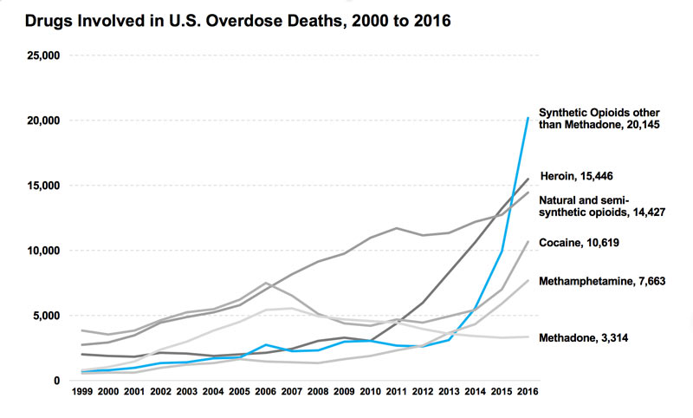

Slide 6
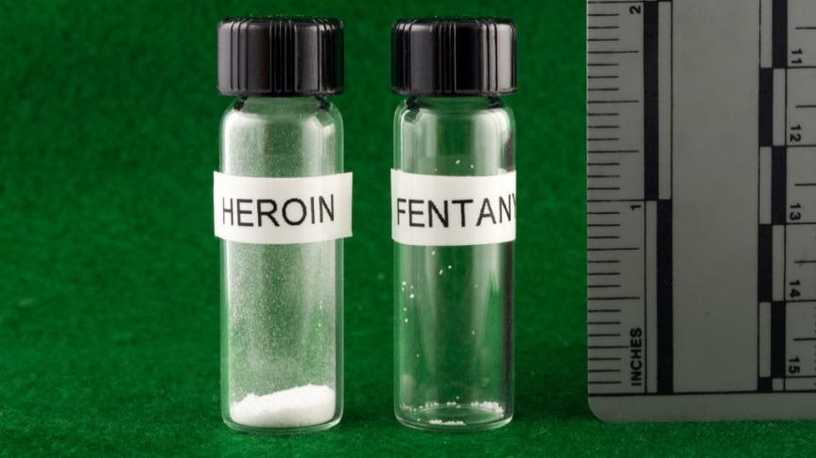
A focus on heroin and St. Louis
St. Louis has the 6th highest overdose rates of US cities
→ driven by heroin and fentanyl, not Rx drugs
In 2016, St. Louis accounted for 70% of statewide heroin-related deaths
Notes:
What is fentanyl? 50-100 times more potent than morphine
May require more naloxone
Street names for fentanyl or for fentanyl-laced heroin include Apache, China Girl, China White, Dance Fever, Friend, Goodfella, Jackpot, Murder 8, TNT, and Tango and Cash.

Slide 7
Fentanyl – Myths and Facts
MYTHS
FACTS
Coming in contact with even a small amount of fentanyl can cause an overdose.
Most commonplace contact, such as touching or being in a room with an open bag, is not enough to harm you
Powdered fentanyl does not penetrate the skin easily
There are some forms of fentanyl that are resistant to naloxone.
Naloxone counteracts the effects of all opioids, including all analogues of fentanyl. Since fentanyl is more potent than heroin, more doses of naloxone may be required
There’s no problem with first responders being overly cautious around fentanyl.
Being overly cautious can cause unnecessary delays in delivery of care to people who need immediate assistance, which can lead to death
Notes:
TC: What is the problem with first responders being overly cautious around fentanyl?
MB: We are seeing situations where some first responders won’t enter a place where they suspect people have used fentanyl until they have suited up in ultra-protective gear, obtained special gloves or masks, or called for backup. That can cause delays in delivery of care to people who have overdosed, which can lead to death. It’s similar to back in the days when people were afraid of HIV and health care providers took unnecessary precautions, resulting in harm to the patient. Anything that causes a delay in care for an overdose is a major concern.

Slide 8
Fentanyl Safety Tips
If you touch fentanyl, it can be removed from skin with soap and water
  Alcohol-based products, such as hand sanitizer or wipes, may increase fentanyl absorption
  Wash your hands soon, but not necessarily immediately
  Powdered fentanyl does not penetrate the skin very easily but avoid touching lips or eyes
Notes:
TC: What should first responders do if they are exposed to fentanyl through air?
MB: This would be an exceedingly rare occurrence- there would have to be a deliberate attempt to do so such as someone blowing powder in their face or an encounter in a drug lab where there has been a great disturbance like a raid or explosion. If the situation is a cloud of dust/material, (i.e. drug lab raid with explosions/shooting/powder everywhere) they should not go into it. The recommendations in that situation are very different and beyond what we can discuss here. For situations where there are small amounts of airborne powder (i.e. a usual user level amount of material in a small container), increase precautions including gloves, long sleeves, and pants, and a particulate [N95] mask may be considered, BUT are not always required. Again, the dose makes the toxin and simply seeing an open baggie is not a reason to increase protection beyond gloves.

Slide 9
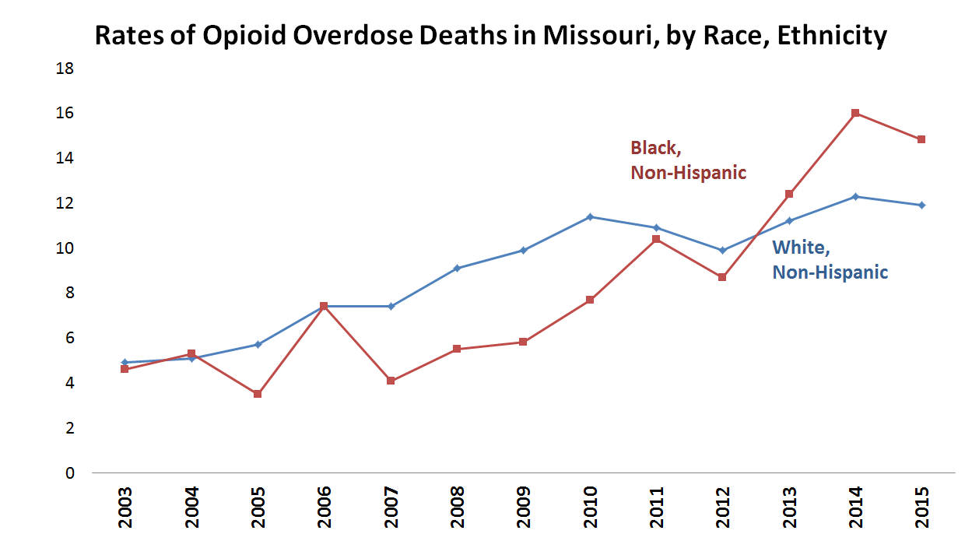

Slide 10
Naloxone laws in MO
RSMO 190.255, enacted August 28, 2014
  Distribution to first responders
  First responder administration immunity
RSMO 195.206 & RSMO 338.205, enacted August 28, 2016
  Pharmacy availability (without an outside prescription)
  Pharmacist criminal and civil immunity
  Third party access/right to possess
  Any person administering naloxone in good faith and with reasonable care has criminal and civil immunity and is immune from any disciplinary action from his/her professional licensing board
  Any person or organization acting under a standing order issued by someone who is authorized to prescribe naloxone may store and dispense naloxone if the person does not collect a fee
RSMO 195.206.2 enacted August 28, 2017
  Statewide standing order
Notes:
*CVS and Walgreens are the major pharmacy chains supplying naloxone in Missouri
Statute Section 190.255.1, HB 2040, enacted August 28th, 2015. Relevant topics covered by this bill:
Distribution to first responders
First responder administration immunity
This statute explicitly permits all first responders, including Emergency Medical Technicians (EMTs), to obtain and administer naloxone in accordance with their respective agency’s protocol and following completion of “documented training.”
House Bill No. 1568. Enacted August 28, 2016. Relevant topics covered by this bill:
Pharmacy availability (without an outside prescription)
Pharmacist criminal and civil immunity
Third party access/right to possess
Criminal and civil immunity for any person administering naloxone in good faith
Immune from disciplinary action from licensing board
Right to store and dispense for free if acting under a standing order from a health care professional
With the enactment of HB 1568 in August, 2016, Missouri joined 44 other states that had previously established similar legislation. HB 1568 covers many significant topics related to naloxone access and administration rights and immunities for individuals not previously permitted to directly purchase or administer naloxone under state law. This includes but is not limited to drug users, family members and friends of drug users, bystanders, non-profit organizations, non-paramedic first responders, and others interested in carrying naloxone due to risk of experiencing or witnessing and opioid overdose event.
Pharmacy availability. It should be noted that this law, often referred to as the “Third Party Access law,” is written somewhat differently than most other states with similar laws in place. Specifically, HB 1568 authorizes pharmacists to dispense naloxone under "physician protocol." Presumably, this essentially reflects the same practice as what other states have called a “standing order,” but the law itself doesn't create a standing order, but rather permits the practice. This means that individual pharmacies, pharmacists, or pharmacy chains are required to arrange for a physician to create and sign a protocol to establish a standing order prior to distributing naloxone without an outside prescription.
Community distribution. Also included in HB 1568 is language permitting “any person or organization acting under a standing order issued by a health care professional who is otherwise authorized to prescribe an opioid antagonist” to legally distribute naloxone, as long as they do so without requiring compensation.
Right to possess. A separate provision in HB 1568 makes it legal for "any person to possess an opioid antagonist," which presumably means that a person cannot be arrested for having naloxone even if that person does not have any form of prescription for the medication.
Prescriber and administrator immunity. Section 3 of HB1568 provides immunity both to prescribers who issue the protocol and pharmacists who dispense under it. Section 5 provides immunity to any individual who administers the medication when “acting in good faith.”

Slide 11
Missouri’s Good Samaritan Law
(RSMO 195.205) A person who, in good faith, seeks or obtains medical assistance for someone who is experiencing a drug or alcohol overdose or other medical emergency or a person experiencing a drug or alcohol overdose or other medical emergency who seeks medical assistance for himself or herself or is the subject of a good faith request shall not be
  Arrested
  Charged
  Prosecuted
  Convicted
  Have property subject to civil asset forfeiture
If the evidence … was gained as a result of seeking or obtaining medical assistance.

Slide 12
What does immunity cover?
RSMO 579.015, 579.074, 579.078, 579.105
  Possession of a controlled substance
  Possession of paraphernalia
  Keeping or maintaining a public nuisance
RSMO 311.310, 311.320, 311.325
  Alcohol sale to minor
  Possession of an altered ID
  Purchase or possession of alcohol by a minor
Violating a restraining order
Violating probation or parole

Slide 13
What is NOT covered?
Outstanding warrants
“an offense other than an offense under subsection 2 of this section, whether the offense arises from the same circumstances as the seeking of medical assistance. “

Slide 14
Let’s practice!
Landscape of the problem: addressing opioid overdose rates
A brief mentioning of fentanyl
Changing legal landscape
  Naloxone laws that provide ability to carry and immunity
  Good Samaritan law
Notes:
Pause to recap main points covered: this portion should take no more than 10 minutes. Discuss with trainees what is happening in your area, why/how people are dying, and the laws that allow them to carry naloxone.
Ask attendees to get in to pairs and each take a turn describing highlighted points to the other.
eg. Person on the left takes a minute to describe overdose rates. Person on the right then explains fentanyl. Person on the left talks about what is being done to address the issue. Person on the right discusses laws.
After about 5 minutes, stop the pairs and ask for feedback. How was this to talk about for the first time? Did you stumble over anything? Do you need more information or examples of how to explain items?
Allow for discussion so they are comfortable training others.

Slide 15
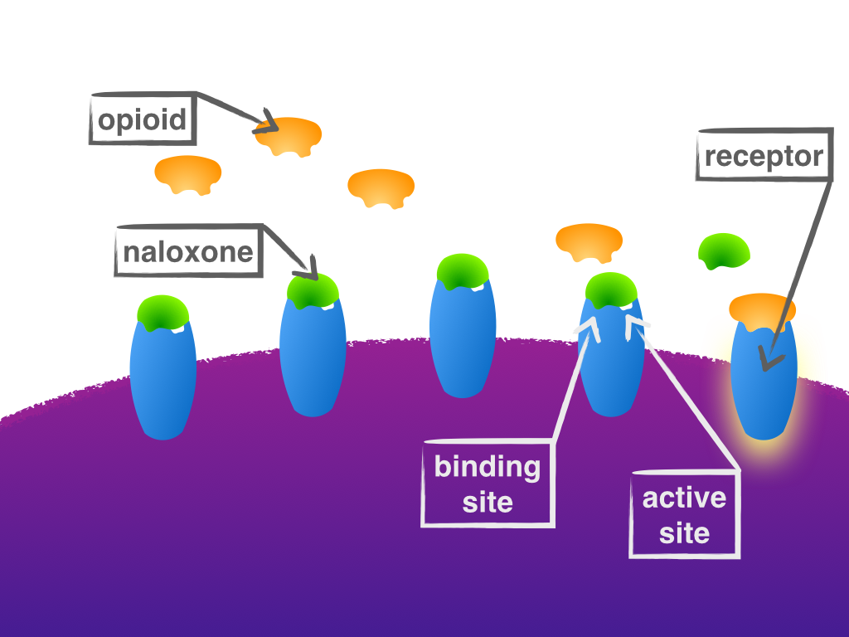
What’s naloxone?
Injectable (intramuscular or IM)
Autoinjectable
  EVZIO® is a prefilled to inject naloxone quickly into the outer thigh. Once activated, the device provides verbal instruction to the user describing how to deliver the medication like defibrillators
Prepackaged Nasal Spray
  NARCAN® Nasal Spray is a prefilled, needle-free device that requires no assembly and is sprayed into one nostril
Notes:
Naloxone is a medication that reverses the effects of an opioid overdose.
Used to only be carried in ERs, by EMTs, now law enforcement in 28 states carry it… Take home kits designed to be carried by bystanders/anyone likely to experience or witness an OD event
From 1996 – June, 2014, layperson naloxone administration has saved > 26,000 lives (CDC, 2015)
Sooner the better → not just death but permanent brain damage from lack of oxygen to brain
Different and ever evolving legal regulations by state/country. In many US states available at pharmacies (including MO as of August 28).
*** From CAPT WEBINAR- Consider adding slide if not I think at least worth mentioning the difference!
Naloxone, Narcan ®, Naltrexone, Suboxone…What’s the Difference?
Naloxone = generic name
• Narcan® = brand name of naloxone
• Suboxone® = brand name for buprenorphine +
naloxone (for treatment of opioid use disorder)
• Naloxone ≠ naltrexone (longer-acting opioid
antagonist for alcohol use disorder treatment and
relapse prevention in opioid use disorder)

Slide 16
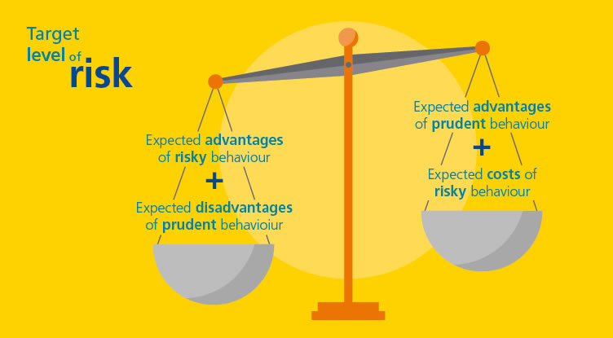
Risk Compensation
“A theory which suggests that people typically adjust their behavior in response to the perceived level of risk, becoming more careful where they sense greater risk and less careful if they feel more protected”
A familiar concern…
  safe sex ed
  HIV prophylaxis
  seatbelts
  helmets
Societal public health Cost vs. Benefit

Slide 17
Overdose Education and Naloxone Distribution (OEND)
Effectiveness
  Those who received naloxone rescue kits as part of OEND had higher rates of calling 911, administering naloxone, and staying with the victim until help arrived (Dwyer et al., 2015)
  Providers/staff has a generally positive reception of program (Samuels, 2014)
  Reduces overdose at a population level, increases preparedness to respond effectively (Walley et al., 2013), levels of use do not change (e.g., Dwyer et al., 2015)
  Reduces opioid-related ER and hospital visits, overdose events among chronic pain patients, prescribed dosage does not change (Coffin et al., 2016)
Notes:
Between ED visit and study interview: more than 1/5 reported non-fatal overdose, over ½ witnessed an overdose and there were 2 deaths reported. In the small sample, no significant differences between OE-only and OEN behavior in a witnessed overdose, reported opioid use or overdose rates. 6/19 of the OEN group who witnessed an overdose used naloxone to rescue someone and more than ½ of the OEN group still had a naloxone rescue kit Limitation: only able to reach half of participants for follow-up (Dwyer et al., 2015).
NOTE: the article does not indicate any results from the program besides provider/staff reception – the article just explains the program and goals; “In addition to decreasing deaths to overdose, our program’s ultimate is goal to help make recovery an option for anyone in RI who may need or want it. By bringing together representatives from different state departments, community organizations, and local hospitals, the OPRC designed and implemented a forward-thinking initiative to decrease opioid overdose deaths, create jobs for individuals in the recovery community, and prioritize the health and future wellbeing of people struggling with addiction or at risk for opioid overdose” (Samuels, 2014)

Slide 18

The conversation
Use the time with the patient as an opportunity to:
  Have the OEND conversation
  Acknowledge the client’s struggle with substance use
  Discuss harm reduction approach
  Highlight naloxone as a way to keep client alive to pursue treatment
  Emphasize this as standard practice; not a personal judgment
  **Educate families & friends when possible – people can’t administer Narcan to themselves!**

Slide 19
What are risk factors for an overdose?
Chronic:
Previous overdose
History of substance use or misuse
Previous suicide attempt
Access to prescription drugs
Witnessed a family member overdose
High Rx opioid dose and/or sustained action
Acute:
Period of abstinence= Decreased tolerance (Incarceration, detox, rehab, etc.)
A change in amount or purity (e.g., fentanyl)
Injecting
Mixing opioids with other substances
(CNS depressants)
Using alone
Being physically ill/respiratory disease
Homeless in the past 90 days
Notes:
Information from CAPT Webinar:
History of substance use or misuse:
“Individuals who overdose are more likely than their counterparts to have a history of substance use or misuse, such as having:
• Misused prescription drugs in the past 90 days (5)
• Misused potent opioids, such as fentanyl (6)
• Used prescription opioids and benzodiazepines (sedatives, anticonvulsants, muscle relaxers, etc.) at the same time (7)
• Used heroin in her/his lifetime (7)
• Used alcohol heavily (8)
• Used injection drugs in the past 90 days (5) “
Access to Prescription Drugs:
“Individuals who overdose are also more likely to have had access to prescription drugs, including:
• excessive exposure to prescription opioids or benzodiazepines (9)
• a maximum prescribed daily opioid dosage greater than 100 milligrams (10)
• a prescription for opioids or tranquilizers (5)
• filled prescriptions for two or more types of controlled substances (9)
• four or more filled prescriptions (9)
“Engage in doctor-shopping or pharmacy-shopping behavior” (9)
“Witnessed a family member overdose” (5)
“Been incarcerated or had a change in tolerance related to incarceration history (5)”
“Been admitted to a psychiatric hospital (8)”
“Experienced homelessness in the past 90 days (5)”
“Experienced a non-fatal overdose”
General risk factors:
- 2.8 times higher for individuals age 61-70
- 5.4 times higher for age 71-80
- 8.7 times higher for those over age 80
REFERENCES FROM CAPT WEBINAR THAT MATCH NUMBERS ABOVE:
1. NIDA (2015). Opioids. Retrieved November 1, 2016, from https://www.drugabuse.gov/drugs-abuse/opioids.
2. Rossen LM, Bastian B, Warner M, Khan D, and Chong Y. Drug poisoning mortality: United States, 1999–2014.
National Center for Health Statistics. 2016. Retrieved December 12, 2016, from https://blogs.cdc.gov/nchs-datavisualization/
drug-poisoning-mortality/.
3. CDC WONDER (2016). WONDER Online Databases. Retrieved November 1, 2016, from https://wonder.cdc.gov/.
4. Cicero TJ, Ellis MS, Surratt HL, Kurtz SP. The Changing Face of Heroin Use in the United StatesA Retrospective
Analysis of the Past 50 Years. JAMA Psychiatry.2014;71(7):821-826. doi:10.1001/jamapsychiatry.2014.366
5. Silva, K., Schrager, S. M., Kecojevic, A., & Lankenau, S. E. (2013). Factors associated with history of non-fatal
overdose among young nonmedical users of prescription drugs. Drug and Alcohol Dependence, 128(1-2), 104-110.
doi: 10.1016/j.drugalcdep.2012.08.014
6. Peterson, A. B. (2016). Increases in fentanyl-related overdose deaths—Florida and Ohio, 2013–2015. MMWR.
Morbidity and Mortality Weekly Report, 65(33), 844-849.
7. Siegler, A., Tuazon, E., Bradley O’Brien, D., & Paone, D. (2014). Unintentional opioid overdose deaths in New York
City, 2005–2010: A place-based approach to reduce risk. International Journal of Drug Policy, 25(3), 569-574. doi:
10.1016/j.drugpo.2013.10.015
8. Green, T. C., Black, R., Serrano, J. M. G., Budman, S. H., & Butler, S. F. (2011). Typologies of prescription opioid use
in a large sample of adults assessed for substance abuse treatment. PloS one, 6(11), e27244.
9. Peirce, G. L., Smith, M. J., Abate, M. A., & Halverson, J. (2012). Doctor and pharmacy shopping for controlled
substances. Medical Care, 50(6), 494–500. Retrieved from http://doi.org/10.1097/MLR.0b013e31824ebd81
10. Bohnert, A. S. B., Valenstein, M., Bair, M. J., Ganoczy, D., McCarthy, J. F., Ilgen, M. A., & Blow, F. C. (2011).
Association between opioid prescribing patterns and opioid overdose-related deaths. Journal of the American
Medical Association, 305(13), 1315–1321. Retrieved from http://doi.org/10.1001/jama.2011.370

Slide 20
How can you tell if someone’s overdosing?
Really High
Muscles become relaxed
Speech is slowed/slurred
Sleepy looking
Will respond to stimulation like yelling, sternum rub, pinching, etc.
Nodding out
Overdose
Deep snoring or gurgling (death rattle) or wheezing
Blue or grayish skin- usually lips and fingertips begin to darken first
Cold, sweaty or clammy skin
Heavy nod
Will not respond to stimulation
Breathing is very slow, irregular or has stopped/ faint pulse
Small “pinpoint” pupils
Notes:
*85% of overdoses occur in the company of others*
** Sometime people “fall out” (slang of pass out/overdose) in a position that further restricts breathing, like if their neck is crooked – something to be aware of
*** There’s a huge range in time between use and OD- sometimes it’s a minute, sometimes over 6 hours… if you come upon some who OD’s you never know how long it’s been, always give naloxone…the image od an OD being someone with a needle in their arm is inaccurate, more often than not

Slide 21
Myths – What have you heard helps stop an overdose?
  Injecting salt water into someone’s veins…
  Packing the person in a bathtub full of ice…
  Slapping/hitting the person…
  Inducing vomiting…
None of these methods are proven to be safe or effective, and they may cause further harm. The best way to reverse an opioid overdose is to administer naloxone.
Notes:
The central nervous system has already depressed breathing rates, something like an icebath would further slow the system and cause more damage!

Slide 22
What is Narcan?
Narcan® (naloxone) is a medication that reverses the effects of an opioid overdose
Onset of action: 2-3 minutes
Narcan’s effects start to wear off after ~30 minutes and are gone by ~90 minutes. Average = 60 min
  It’s possible that someone can slip back in to an overdose state – which is why it’s important to get immediate medical attention

Slide 23
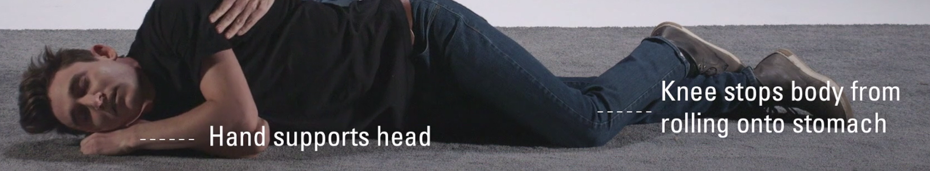
Here’s what to do if someone overdoses
  Give 1 dose of Narcan nasal spray
  Call 911
  Administer rescue breaths/put in recovery position
  Stay with the person
  Give 2nd Narcan dose after 2-3 minutes if 1st dose is not successful
Notes:
– review 911 Good Samaritan law in St Louis City
Rescue breathing – 1 breath every 7 seconds – if the brain is getting any oxygen at all then naloxone should work- even if you can get in just a little bit with your breaths this could mean life instead of death

Slide 24
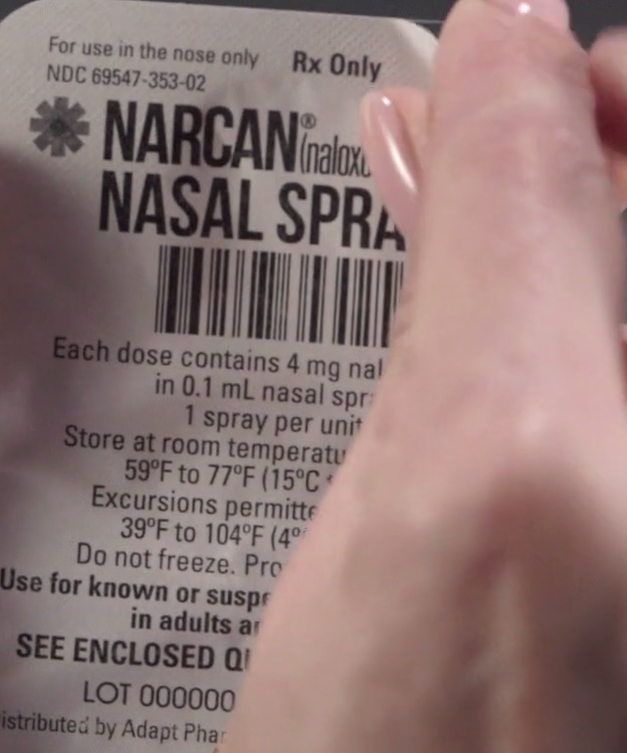
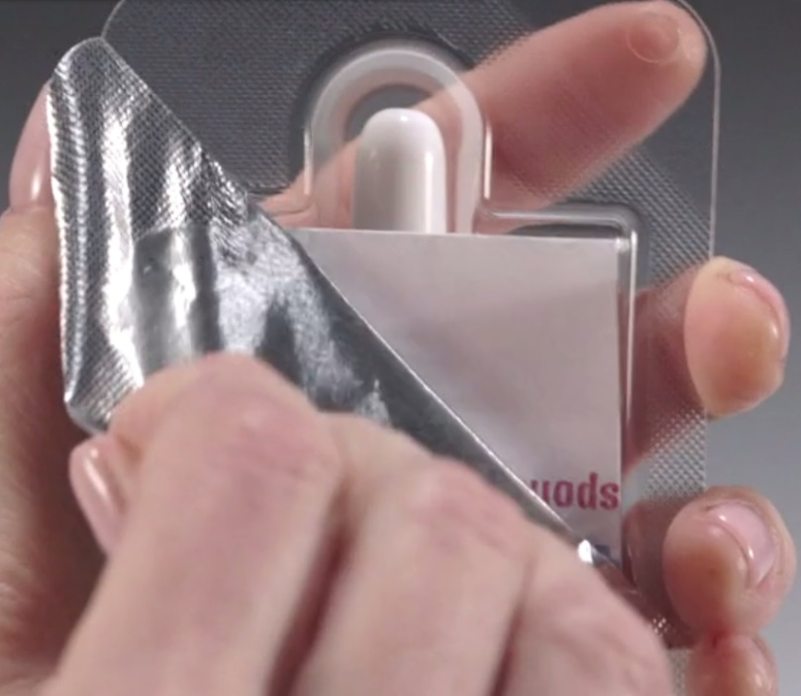
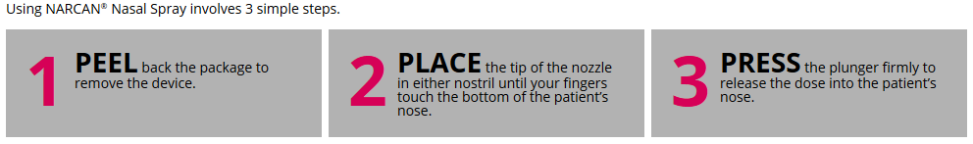
How to use Narcan

Slide 25
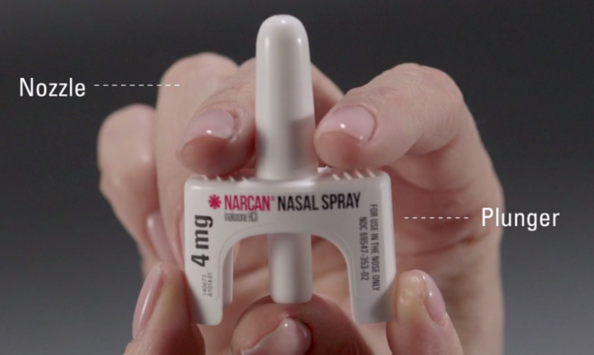
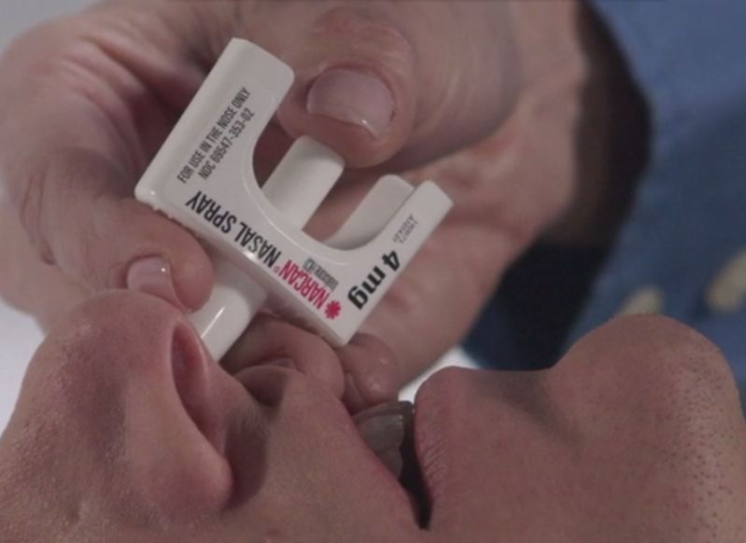
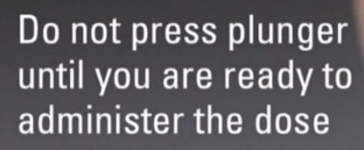
How to use Narcan

Slide 26
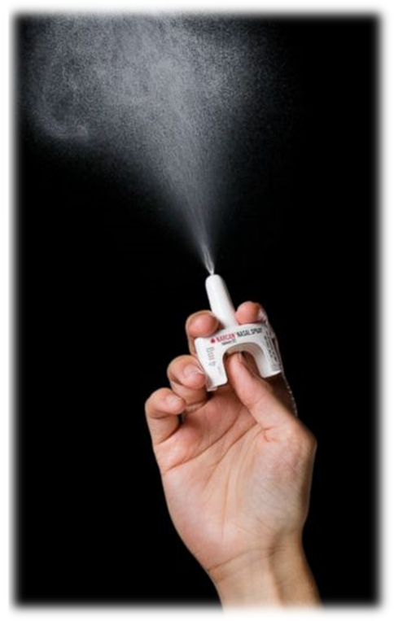
How to use Narcan

Slide 27
Why should you keep it around?
If you overdose, people around you will be able to save your life
If someone else overdoses, you’ll be able to save their life
It is not dangerous and people can’t get high from it
  No harm will be done if it’s used on someone who isn’t overdosing
Notes:
Where are you going to keep it? Who are you going to tell about it?

Slide 28
Getting and having Narcan
You can get Narcan (or naloxone) from the pharmacy
Read the instructions and go over it with family and friends who may be the ones nearby if you overdose
Keep it readily accessible and at room temperature
  Make sure others know where it is
  Don’t store it in your car
  Avoid extreme heat, cold and keep out of sunlight

Slide 29
Preventing a future overdose
Co-prescription is the “gold standard” – it doesn’t mean we don’t trust you
  You can still overdose when on medications for OUD
“If you choose to use…”
  Be around others
  Always have Narcan nearby (and someone who knows how to use it)
  Test a small amount of a new product (e.g., “taste your shot”)
  Be extra cautious after a period of abstinence/non-use - tolerance is depleted after 3-5 days
Notes:
“To help normalize conversations about overdose:
- Make it a standard practice to discuss overdose with all clients, so no one feels singled out for being more “at-risk” than others Start conversation with:
- “We can feel confident that we’ll stay abstinent, but we’ve all seen relapse happen. And with opioids, the risk of overdose is real. So we want everyone to have this information – to help yourself or maybe someone you care about.”
- “Emphasize concern for the client’s safety and survival. No slip up or relapse should be fatal.”
- “Reinforce the clients ability to help others and the community. You can help spread this
information to others or you might even be in a position to save a life.”
- “See overdose education as an opportunity to have deeper conversations about behavior
change.”
Information from: http://stopoverdose.org/section/prescribers/

Slide 30
What happens if the Narcan gets used?
If it gets used, tell someone at the treatment center
  No punishment
  Opportunity for change
  Get a new device
  Complete the MO-HOPE Overdose Field Report (if not already done by the client)
Naloxone is available at some pharmacies without an outside prescription if you or your family want additional doses
Notes:
“To help normalize conversations about overdose:
- Make it a standard practice to discuss overdose with all clients, so no one feels singled out for being more “at-risk” than others Start conversation with:
- “We can feel confident that we’ll stay abstinent, but we’ve all seen relapse happen. And with opioids, the risk of overdose is real. So we want everyone to have this information – to help yourself or maybe someone you care about.”
- “Emphasize concern for the client’s safety and survival. No slip up or relapse should be fatal.”
- “Reinforce the clients ability to help others and the community. You can help spread this
information to others or you might even be in a position to save a life.”
- “See overdose education as an opportunity to have deeper conversations about behavior
change.”
Information from: http://stopoverdose.org/section/prescribers/

Slide 31
Let’s practice!
Explain naloxone
Risk compensation
Risk factors for overdose
Symptoms of overdose
What to do if there is an overdose
Preventing future overdose
Notes:
Pause to recap main points covered: this portion should take most of your allotted training time. Discuss with trainees what naloxone is, how to use, the risk factors for overdose, how to identify an overdose and what to do in case of an overdose.
Ask attendees to get in to pairs and each take a turn describing highlighted points to the other.
eg. Person on the left takes a minute to describe naloxone. Person on the right then explains fear of risk compensation. Person on the left talks about risk factors for overdose. Person on the right lists sx of overdose. Person on left explains what to do if there is an overdose. Person on right, how to prevent overdose.
After about 5 minutes, stop the pairs and ask for feedback. How was this to talk about for the first time? Did you stumble over anything? Do you need more information or examples of how to explain items?
Allow for discussion so they are comfortable training others.

Slide 32
Your (very important) role in MO-HOPE project evaluation
Evaluation efforts led by the Missouri Institute of Mental Health (MIMH) with the University of Missouri-St. Louis

Slide 33
The rationale - Why project evaluation is important:
Evaluation efforts led by the Missouri Institute of Mental Health (MIMH) with the University of Missouri-St. Louis
Currently no centralized figures in Missouri on overdose events and reversals – who, what, where, etc.
  These figures = CRITICAL for better understanding overdose patterns and continuing to receive federal funding to provide more training and naloxone…
More knowledge in these areas = More effective training & intervention

Slide 34

The field report – what to expect:
1) Add this web link to your desktop:
mohopeproject.org/ODreport
2) After responding to an overdose, click on the
link and complete the form
Agency, Zip, Sex, Age, Drugs involved, Use of Naloxone, etc.
3) Click “submit” and data will be sent to
a secure database monitored by MIMH

Slide 35
Let’s practice
Set up the web link on your phone:
  mohopeproject.org/ODreport
Complete the Field Report for the following scenario:
  It is 01-03-17 around 2:00pm. You arrive to your home in St. Charles, MO (zip code: 63304) to find your White, non-Hispanic, 22 year-old son (PLEASE SELECT “TEST/DEMO” OPTION) in what appeared to be a heroin overdose state so you administered one dose of Narcan nasal spray that you received from Mission Recovery Community Center. He came out of the overdose and began vomiting. You call 911 and wait for EMS to arrive (they do not administer additional naloxone). Your son is then transported to a treatment facility.

Slide 36
Training how to fill out the field report tips
*Make sure to select “Test/demo” as the relationship to the person who overdosed*
  We delete all test/demo field reports – if test/demo is not selected, it will be included as data
Emphasize that no personal information is collected and any information collected is confidential
Remind that the clinician or treatment provider may fill out the field report with the client, if they prefer
A Spanish version is available
  A link at the top of the field report offers a Spanish translation or mohopeproject.org/ODreportespanol

Slide 37
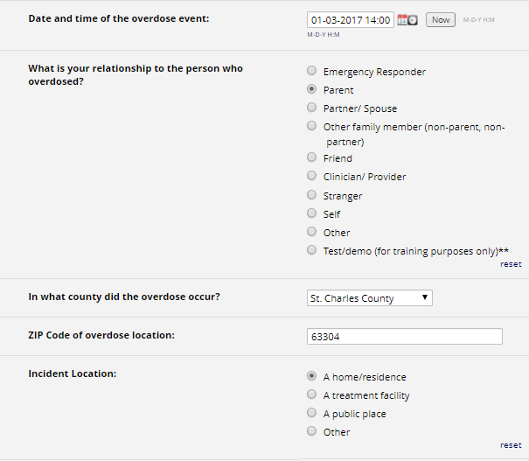

Slide 38
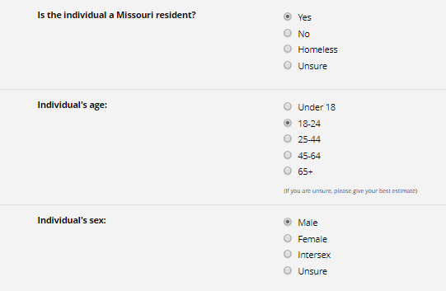

Slide 39
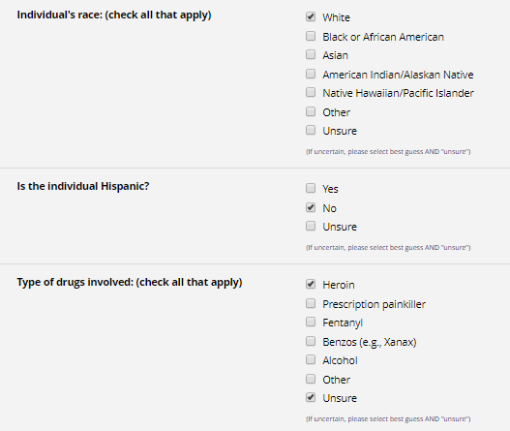

Slide 40
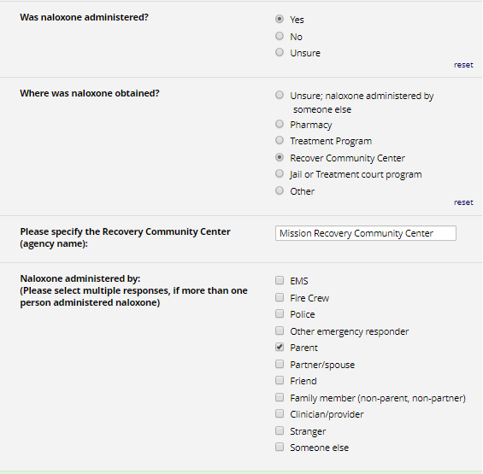

Slide 41
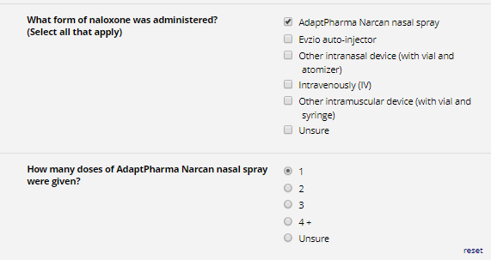

Slide 42
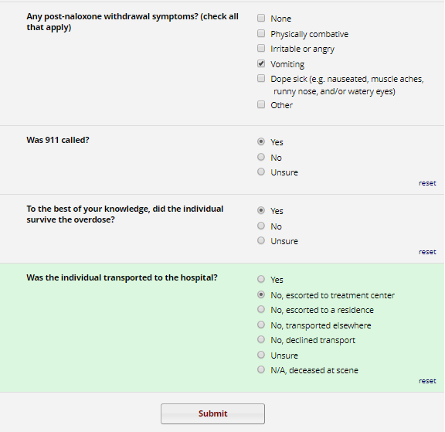

Slide 43
Questions?
Visit: www.MOHOPEproject.org
For questions about scheduling trainings, Narcan supply, or treatment resources, contact NCADA:
Brandon Costerison (trainings, supplies)
  Bcosterison@ncada-stl.org
  (314) 962-3456 xt 315
Nicole Browning, MA, LPC (treatment questions)
  Nbrowning@ncada-stl.org
  314-962-3456 xt 366
For questions about evaluation (training surveys or OD Field Reports), contact MIMH:
Sandra Mayen
  mohopeproject@mimh.edu
  (314) 516-8414

Slide 44
Thank you for attending!
Now it’s time for the post-training survey
-MO-HOPE Team
NCADA: Jenny Armbruster, Nicole Browning MA LPC, Brandon Costerison
MIMH: Kimberly Werner, PhD, Rachel Winograd, PhD, Rob Paul, PhD, Liz Sale, PhD, Claire Ward, MSW, Suzanne McCudden, MA, Kelly Gregory, Lauren Green, Sarah Phillips MA, Sandra Mayen
Missouri Department of Mental Health: Angie Stuckenschneider

