Slide 1
Family Support/peer specialist in behavioral Health and how they can help
Presented by Tanya Fongemie and Bethann Berry

Slide 2
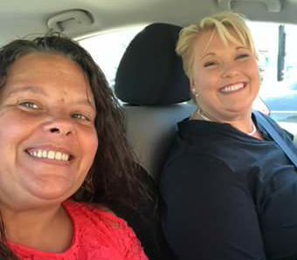
Bethann
Tanya

Slide 3
What is Peer Support and Family Support?
Peer support encompasses a range of activities and interactions between people who share similar experiences of being diagnosed with mental health conditions, substance abuse use, or both. This mutuality – often called "peerness" - between a peer support worker and person in or seeking recovery promote connection and inspires HOPE.
Family support provide services to individuals and families to improve their lives. Delivered by individuals who have common life experiences with the people they are serving. People who have children with behavioral health issues. They can help parents understand the process of the wellness as it is a family journey.

Slide 4
Peer support in behavioral health: a snapshot
Social, emotional, and practical support that is mutually offered or provided by a person with a mental health condition to another person who lives with a similar condition.
A system of giving and receiving help founded on the key principles of respect, shared responsibility, and mutual agreement on what is helpful.
People who are a bit further along in their recovery journey can offer help to those who are earlier in the process.
A way to connect with other people, peer support can help lessen isolation and possibly help a person create friendships.
*NAMI

Slide 5
What it takes to tell your story
Finding strength
Knowing your limit
Understanding others

Slide 6
warning
Parts of this story and photos may cause emotional disturbances. Feel free to take a moment to take care of yourself if it is needed.

Slide 7
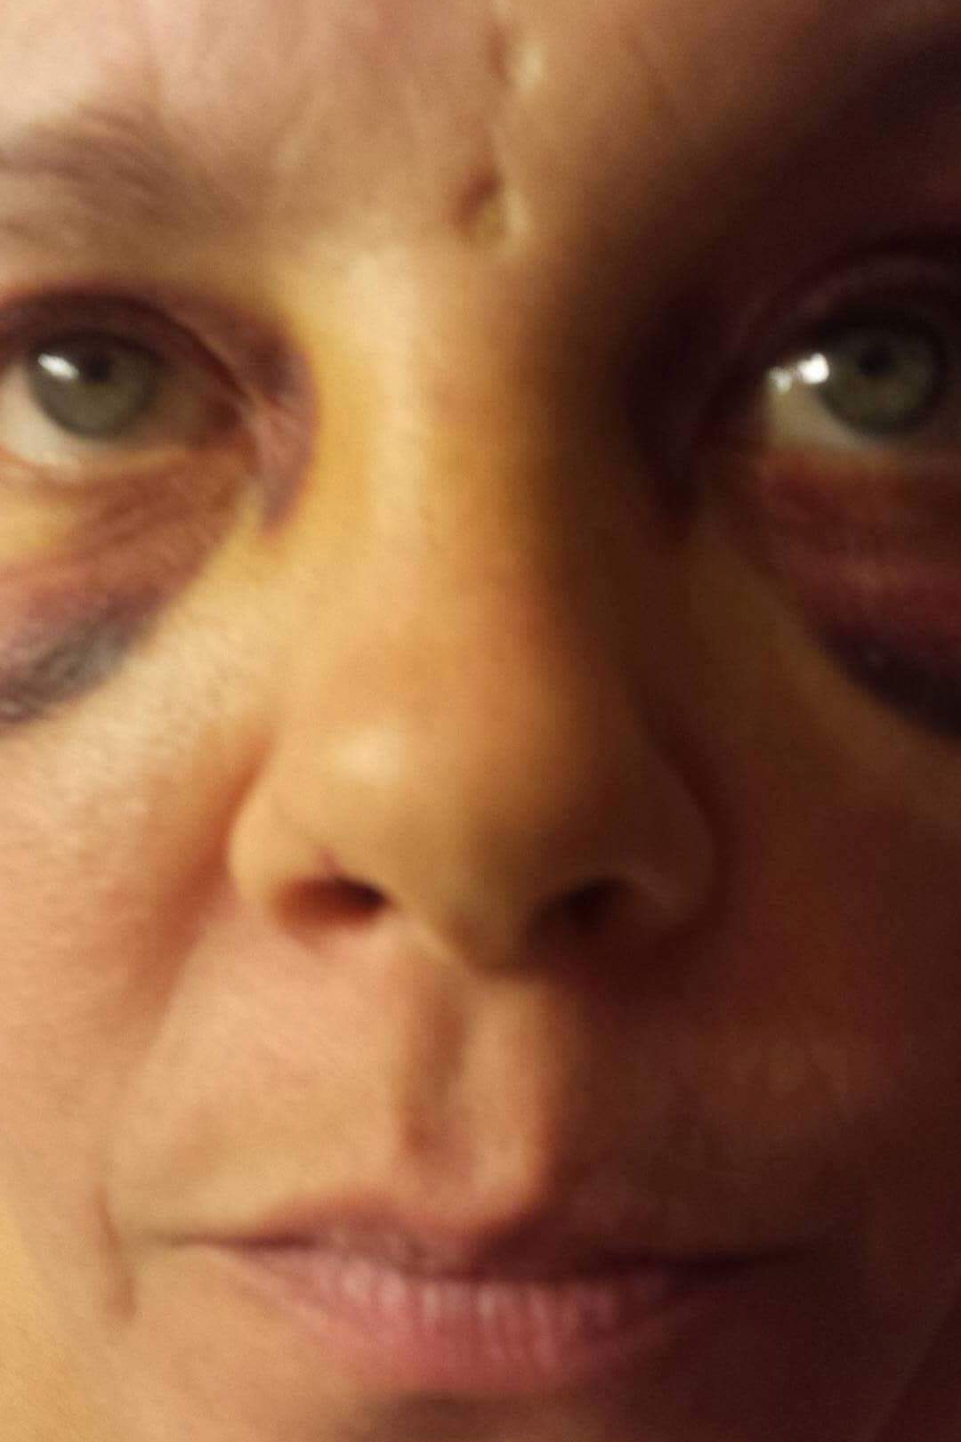
My Resiliency and recovery JOURNEY
By Tanya fongemie

Slide 8
My Story
I was only 7 years old
Not even a year later at age 8
Affidavit for molestation not rape
At 21 my body killed my daughter
Started at my early 20's with drugs
At 29 years old, my sons father got back together
Harder drugs
3 days after we were married

Slide 9
My Story
Drugs was the glue​
6 months and 2 days married​
Hospital​
6 months and 3 days I left​
Moved 500 miles away​
No one knew I was detoxing​
Meltdowns – Highs and Lows​
Late 30's​
At 40 I was physically abused again​

Slide 10
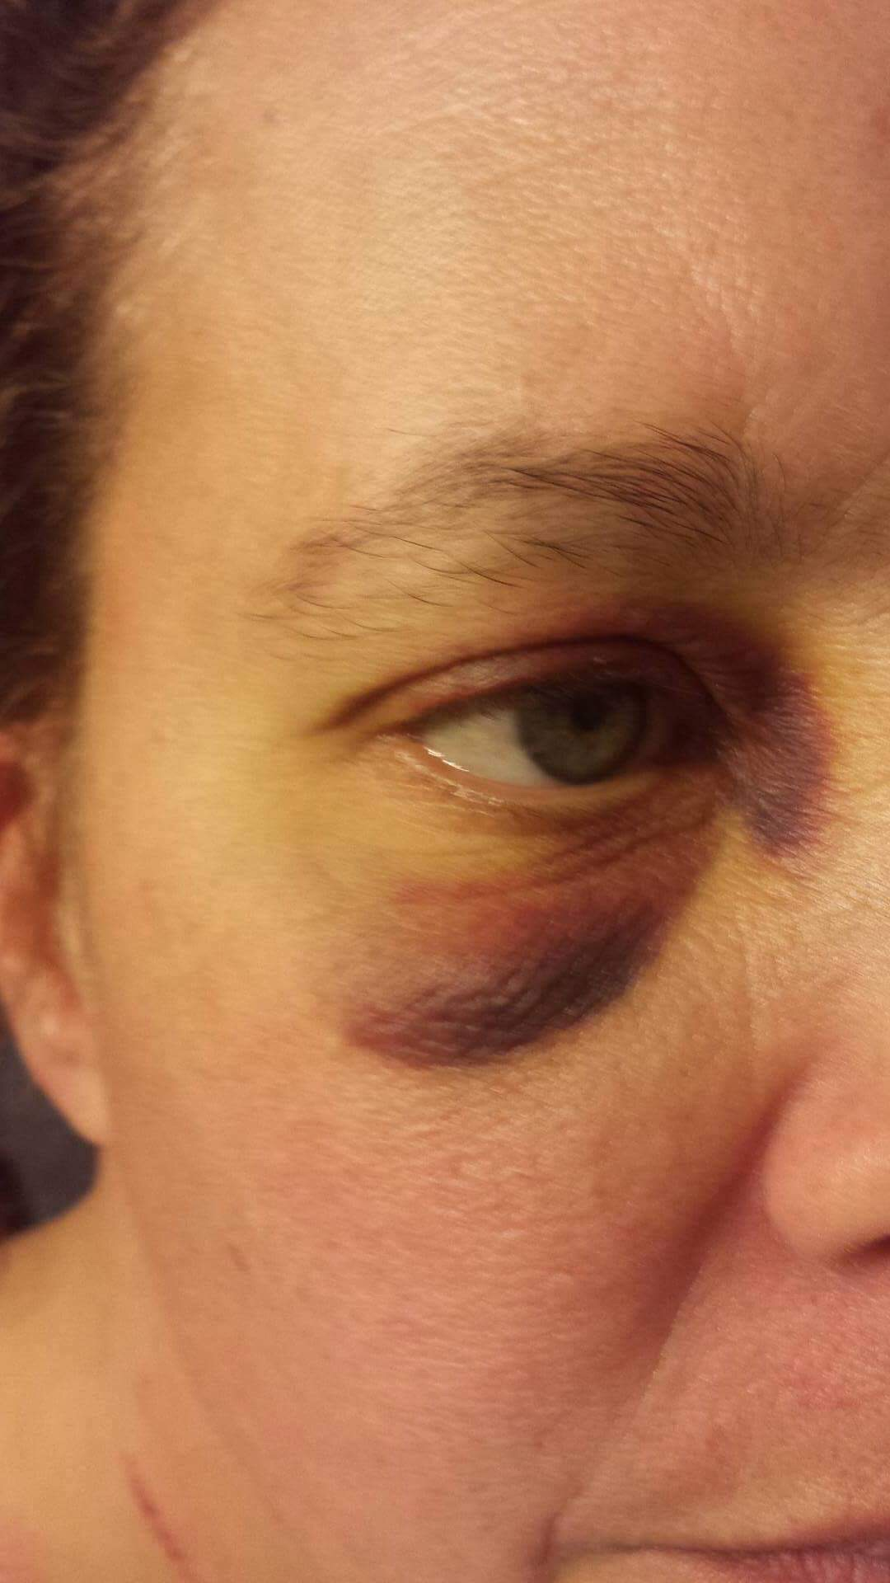
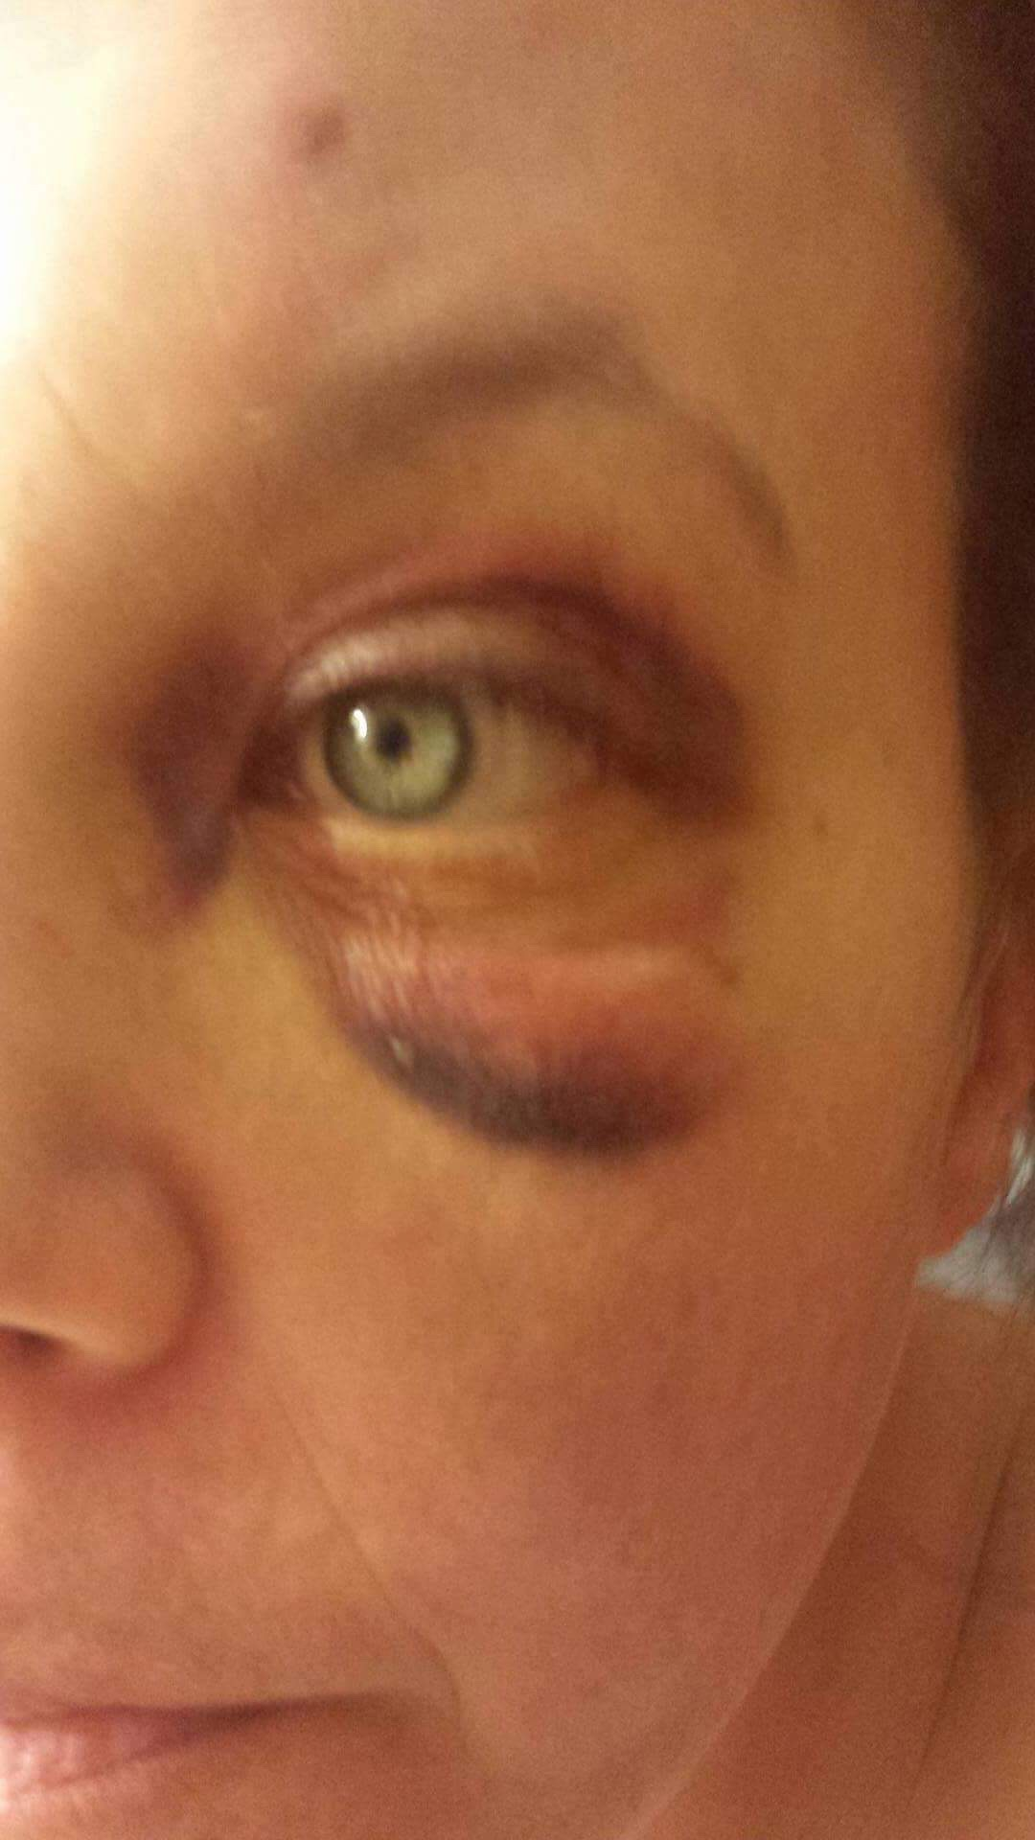
2 weeks after Valentine's Day

Slide 11
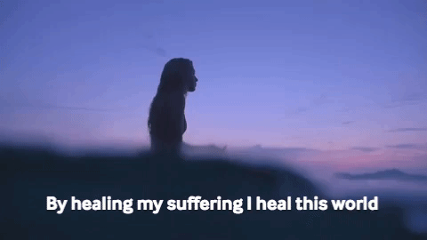
My story
Age 40 to 42
Age 42 I met my current husband
Started at FCC Behavioral Health August 15th, 2016
I thought I was done healing, I was wrong
My supervisor and I went to FSP training in Sept of 2016
I then went to CPS training in March of 2018.

Slide 12
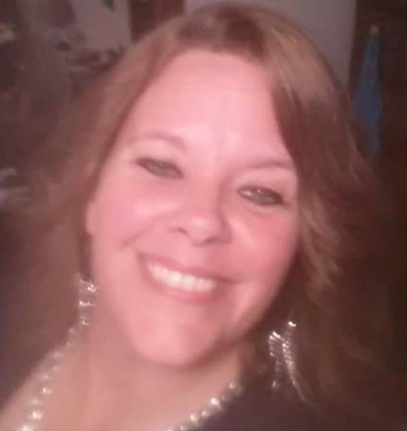
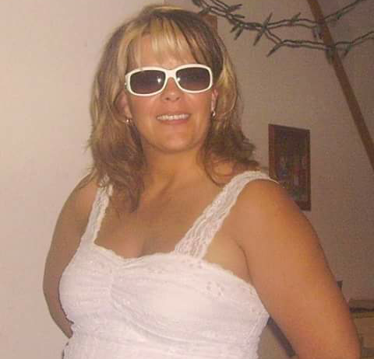
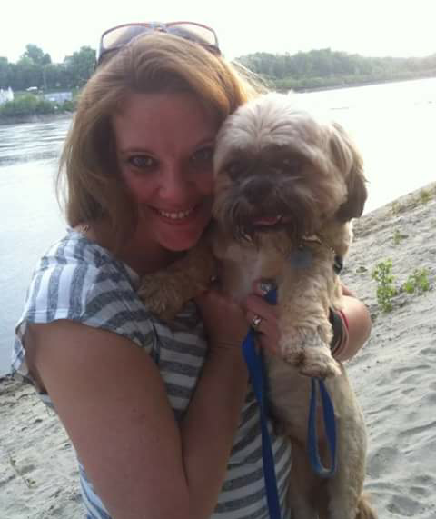

Slide 13
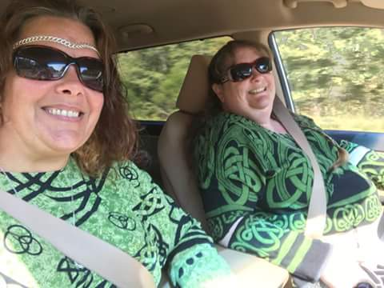
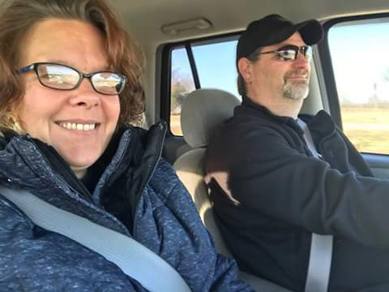
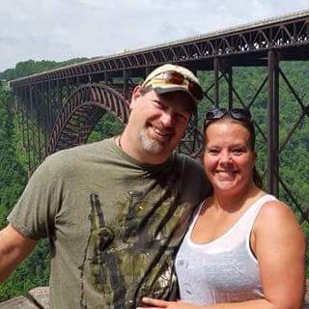
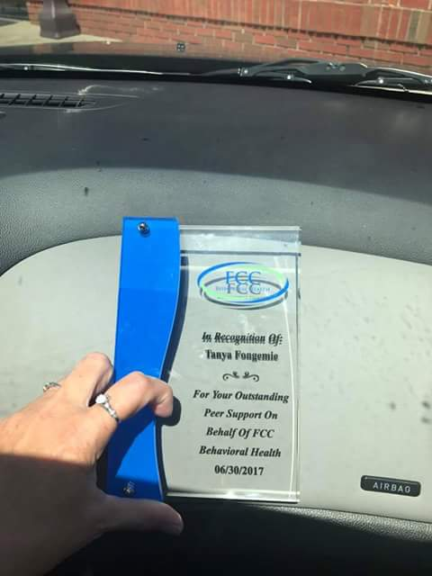
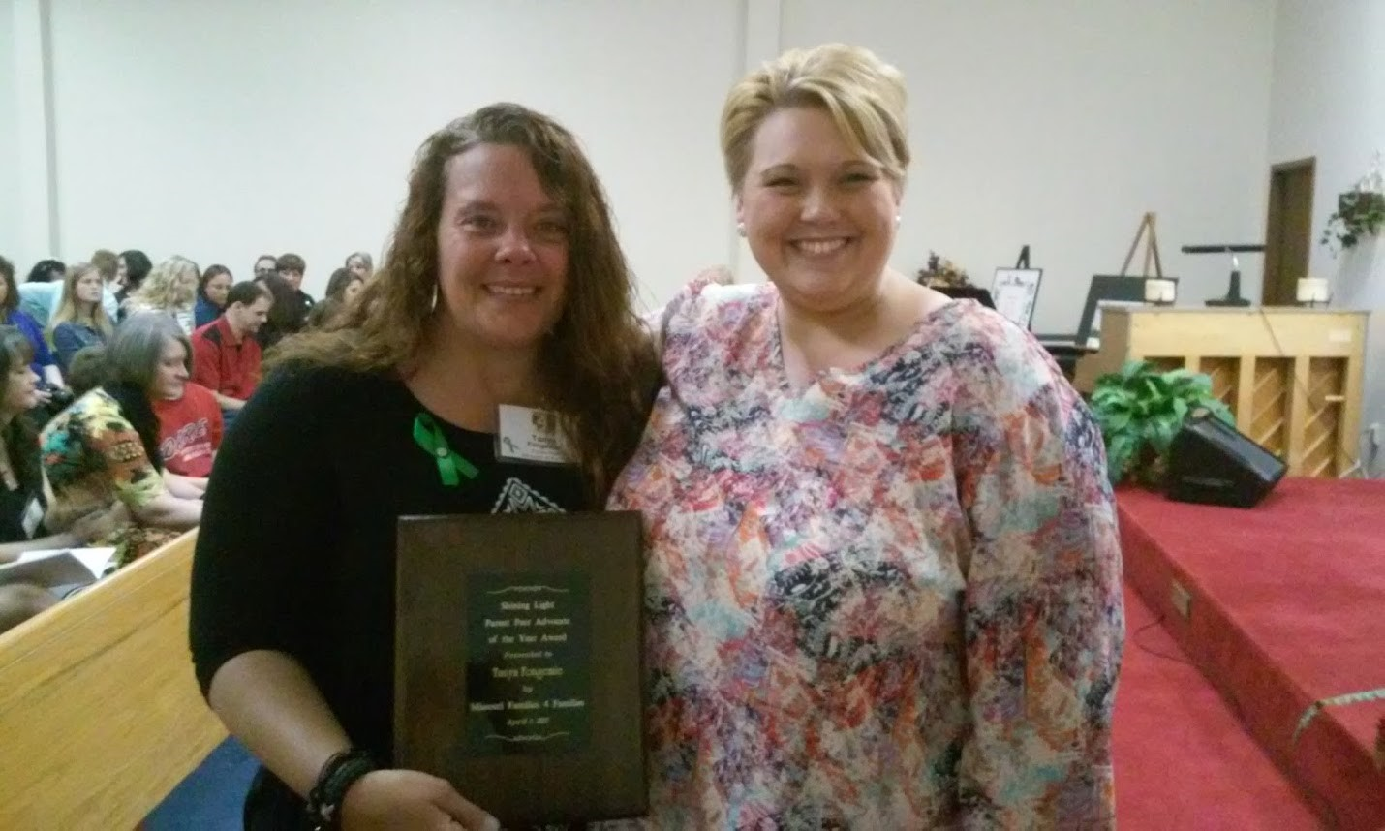

Slide 14
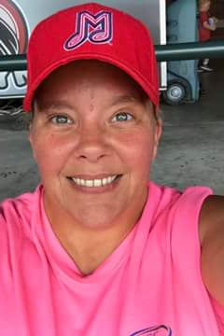
How my story can help others
I believe that telling my story allows others to have HOPE in their recovery and STRENGTH in taking care of those that need the extra support with children with behavioral health issues. I believe my own resiliency story and my recovery story proves that change is possible.

Slide 15
What does peer support do in the Behavioral health field and how is it beneficial to consumers
Job Duties
Consumer Benefits
Provide extra support to those that need the extra support or to those that don’t have the support in their life as a peer and not clinical.
Show hope, resilience, respect and trust
Showing that they are not judged for the things they have done or their wellbeing.
HOPE
TRUST
RESILIENCE
NON JUDGEMENTAL SUPPORT
ACCEPTANCE
COPING SKILLS
EDUCATION

Slide 16
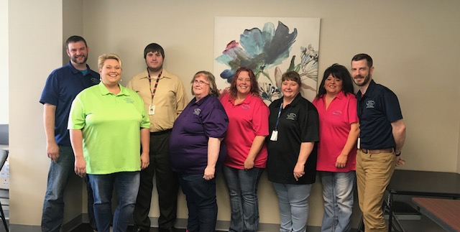
FCC ERE Family

Slide 17
How the Peer Support is viewed from co-Workers
The benefit of having a solid peer specialist on the team is heart. The two keys to a client actually changing are the desire change and the true relationship with their support team. Tanya naturally dominates the relationship portion, which allows true change to internalize within the clients. This is a service that can't be replaced, a tool that leaves a lasting impression on clients and their treatment with the ERE team.
Craig Jameson: BS ERE Intensive Care Coordinator

Slide 18
Continued
Tanya has been doing a great job on offering peer support to our consumers and is a big asset to our ERE team. She often goes above and beyond to help to meet the needs of our consumer's. Tanya brings her own experiences of recovery and mental health concerns into her work with our consumers. I have had several consumers comment on how well they like working with Tanya.
Pattie Rhine BS; ERE Care Coordinator

Slide 19
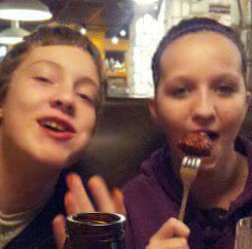
My family support journey
My beautiful daughter Brooke
My amazing son Dalton

Slide 20
Dalton
When he was younger, he struggled with anger issues. His biological father walked out of his life before birth and chose to have his party life. When the choices were presented to him, he said he didn’t want to be a father to Dalton. Dalton struggled with extreme anger. What made him the most angry was fear of turning out like his father. It took us about 10 years for him to be able to manage his own anger.
He is nothing like his father!

Slide 21
Brooke
When Brooke was 15, I confronted her about having sex after she had told me several times that she was not having sex. She finally admitted to having sex and she apologized for lying. She started cutting herself and started showing signs of depression. I couldn’t figure out why she was like that. I took her in to get on some depression meds and she started improving. Less depression and she stopped cutting herself.
Brooke finished high school a year early. On her graduation day I saw her on the field doing her walk. Her boyfriend at the time let it slip that the night that she said she had sex, she was raped. She was scared to tell me what had truly happen.
She is doing better now and I couldn’t be more proud.

Slide 22
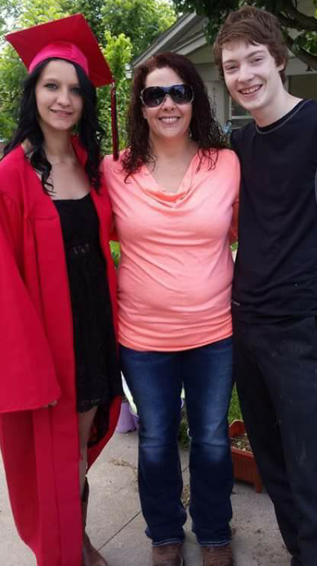
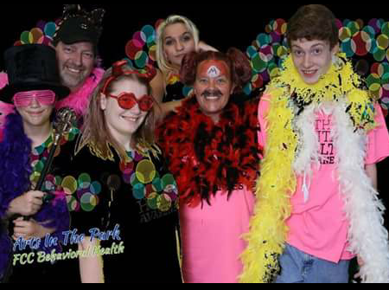

Slide 23
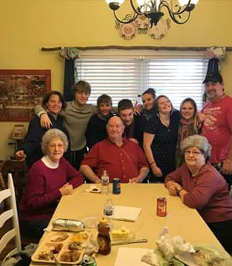
Life now and how it has helped me become what I want to be
My life now!!!! WOW!!!! I thought my life now would be impossible to have!!!!

Slide 24
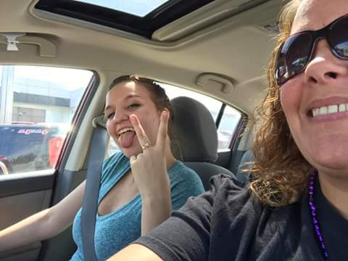
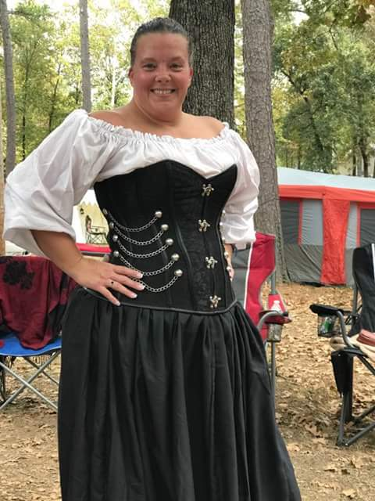
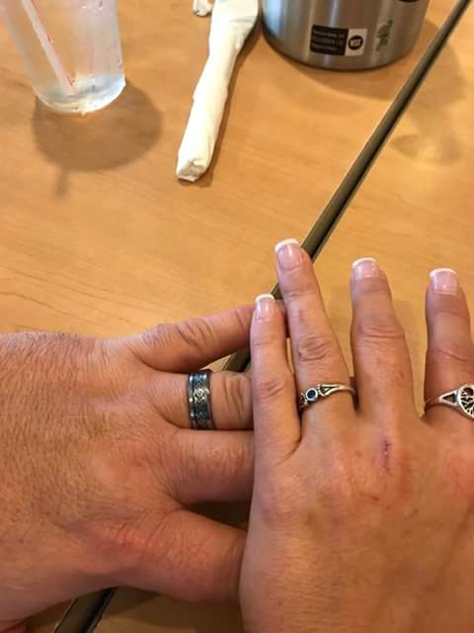
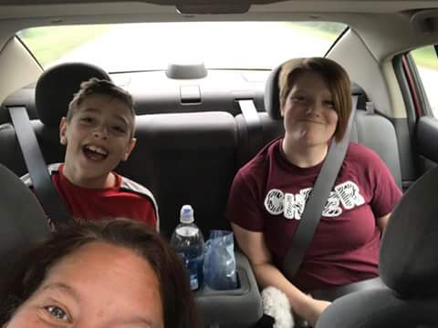
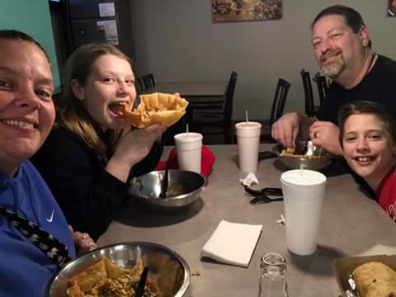

Slide 25
What does Family support do in Behavioral health for children and how is it beneficial for families
Job Duties
Benefits – Clients perspective
Help parents or care givers understand more about the child's behavioral health
Provide them advice or tell the things that have helped my children.
Provide support so they don’t have to feel the struggle alone.
Help the parents or care givers understand processes like IEP's and 504's in schools.
Helped a foster parent that lives with her adult daughters with two boys in foster care with mental health issues function better. CC received less calls about the boys.
Help get services like therapy, case management, and getting an open children's division case closed for another family where both parents are low functioning and were not aware of the problems in the home.

Slide 26
While speaking with the mother of the family she stated she feels like Tanya has been a savor in her life, she didn’t have other support systems in her life and Tanya has been helping her and her family get services for the whole family, such as therapy, case management and getting an open children's division case closed due to Tanya's constant support and availability to them. The family feels like they need this support due to the fact that they don’t feel they were wrong in their parenting ways but were just so stressed that is strained every bit of their being. They feel now they have a way to be better prepared for issues that arise due to the support system they have with Tanya.
Shining Light Awards Nomination Form
Written by Bethann Berry

Slide 27
How to integrate care
All services are voluntary and should be offered but never forced.
Allow them to go out in the community with Case Managers.
Outreach with service partners.
Allow them to volunteer to speak to clients, it should be comfortable to the peer support as well as the client.

Slide 28

Why are peer support and family support crucial to Behavioral treatment
Firsthand experience, showing others we have been there and made a change for the better.
Change is possible and it is easier with help and support.
It gives the peer or family support provider a chance to serve others in their journey
Its and opportunity to change the culture and the stigma.

Slide 29
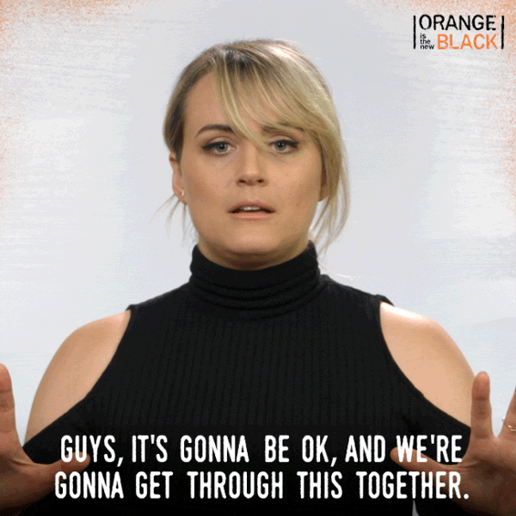
How do peer support and family support benefit programs in which they are involved
From a non-clinical view the clients that are served can have a person in which has been through ups and downs. Someone who understands the pain and struggle clients is facing. The acceptance that they may have a relapse, or slip-up. All without judgement or feeling like they have failed.

Slide 30
How to supervise family support providers
Supervisor Requirements
Supervisor's Roll for Family Support
Let families know the service is available. Never force the service of Family support to any clients family.
Give family information of the Family Support and their job within the family dynamic.
Have a family night to introduce all the services the company has. This way families can get familiar with services and faces of the company.
Offer support and guidance to employee(s).
Understand they have a different background of experience from your own.
Listen to their point of view.
Learn from them what you don’t know.
Teach them clinical skills.
Don’t judge them for their past.

Slide 31

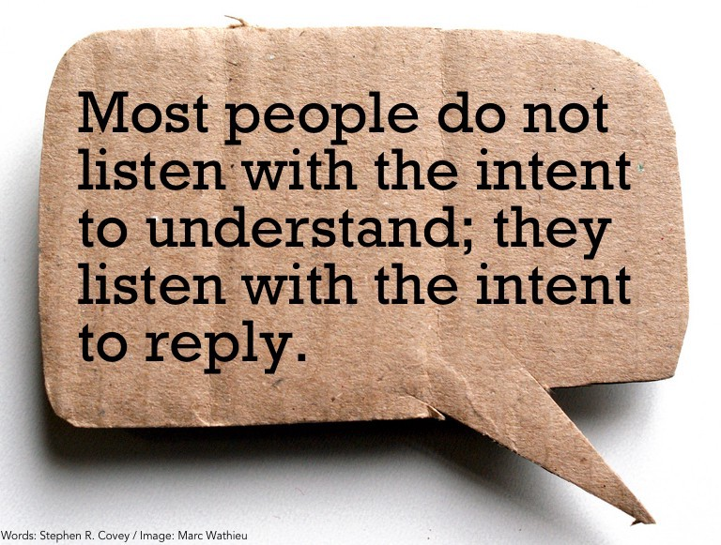

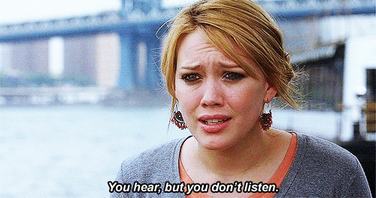
How to support your peer and family supports
Listen, Listen, Listen.....

Slide 32
Being trauma informed
What is trauma informed?
How to work with consumers in a trauma informed way.
Trauma-informed care is a strengths-based service delivery approach "that is grounded in an understanding of and responsiveness to the impact of trauma; that emphasizes physical, psychological, and emotional safety for both providers and survivors; that creates opportunities for survivors to rebuild a sense of control and empowerment." (Hopper, Bassuk, & Olivet, 2010, p.82).
Safety
Trustworthiness and Transparency
Peer Support/Family Support
Collaboration and Mutuality
Empowerment, Voice and Choice
Cultural, Historical, and Gender Issues

Slide 33

How to help Peer and Family Support deal with Compassion Fatigue
Process and talk with coworkers about situation to help get things off your chest and mind.
Preform 'reality checks"
Take time for yourself.
Enjoy the small victories.

Slide 34

What it takes to make it work
A team effort approach. Everyone has to work together.
Helps to know your personal limits and the limits of others in the team.
Having a clear cut definition of what your team members duties and positions intel .
Communication between departments, clients and all involved with clients (community partners).

Slide 35
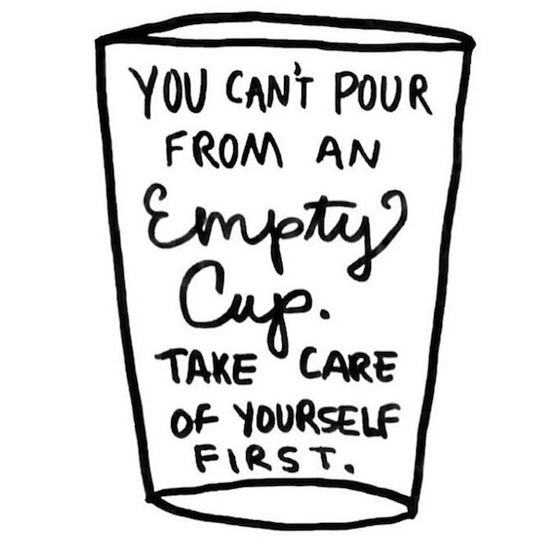
Self-care techniques for peer and family support specialist
Keeping a regular sleep schedule
Doing a hobby you enjoy
Spending time with family or friends
Mindfulness meditation
Exercise
Reflection
Remembering how far you yourself have come.
https://www.mystrength.com/ website

Slide 36
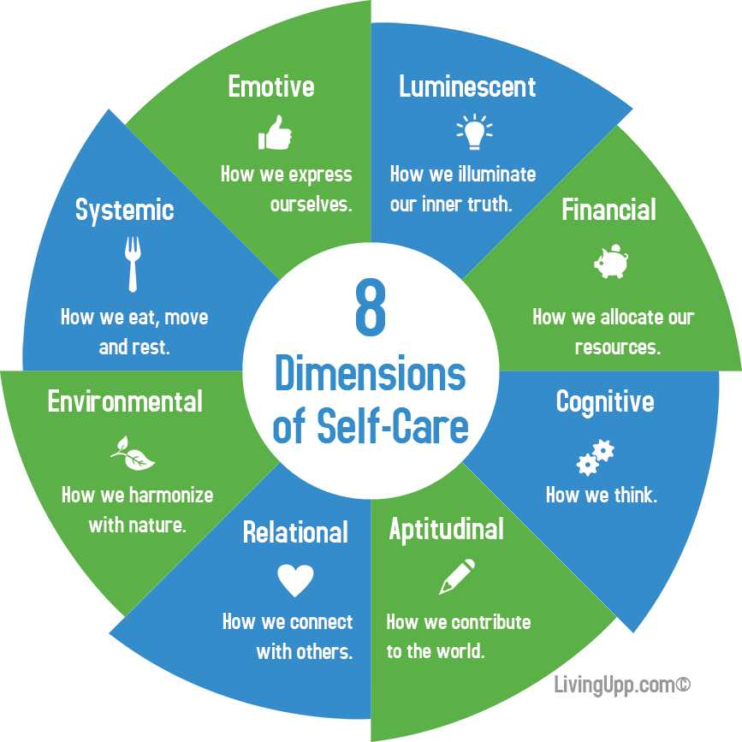

Slide 37
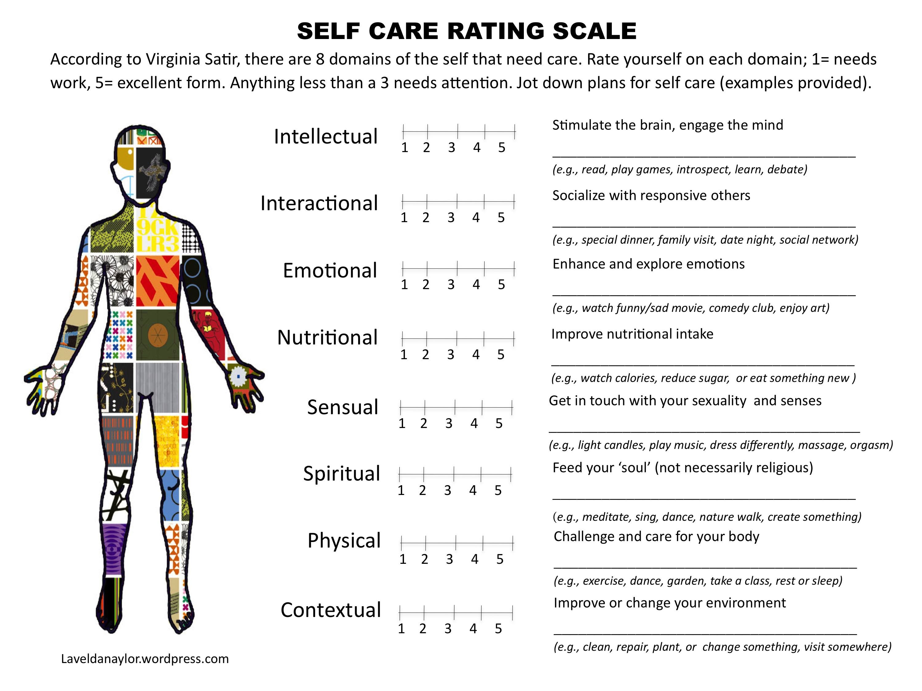

Slide 38
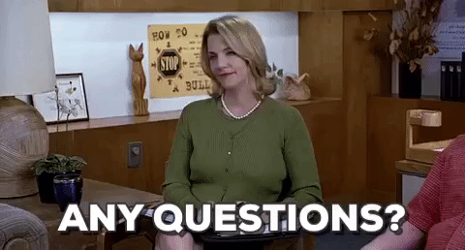

Slide 39
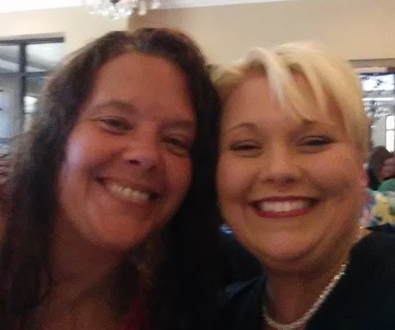
Thank you for attending
Tanya Fongemie ERE Peer Support Specialist FCC Behavioral Health
3001 Warrior Lane
Poplar Bluff MO 63901
573-686-1200 ext 3258
Tanya.fongemie@fccinc.org
Bethann Berry, MA: ERE Therapist: FCC Behavioral Health
3001 Warrior Lane
Poplar Bluff MO 63901
573-686-1200 ext 3262
Bethann.berry@fccinc.org

