Slide 1
Ethics in Mental health
Justin bennett, msw, lcsw

Slide 2
Facts about mental health
Fact 1: Approximately 20% of the world’s you have mental disorders or issues.
  About half of mental disorders begin before the age of 14.
Fact 2: Mental and substance use disorders are the leading cause of disability worldwide.
Fact 3: Approximately 800,000 people commit suicide a year.
  Suicide is the second leading cause of death for people aged 15 to 29 years old.
  There are indications that for each adult who died of suicide there may have been more than 20 others attempting suicide.
  Mental disorders and harmful use of alcohol contribute to suicides.
Fact 4: War and disasters have a large impact on mental health and psychosocial well-being.
  Rates of disorder tend to double after emergencies.
World Health Organization: Ten Facts on Mental Health

Slide 3
Facts about mental health cont.
Fact 5: Mental disorders are important risk factors for other diseases, as well as unintentional and intentional injury.
  Mental disorders increase the risk of getting ill from diseases such as HIV, cardiovascular disease, diabetes, etc.
Fact 6: Stigma and discrimination against patients and families prevent people from seeking mental health care.
  There are beliefs that people with mental illness are: untreatable; difficult; unintelligent; incapable of making decisions.
  Stigma can lead to abuse, rejection, and isolation.
  This includes interventions such as physical restraint, seclusion, denial of basic needs, invasion of privacy.
Fact 7: Human rights violations of people with mental and psychosocial disability are routinely reported in most countries.
World Health Organization: Ten Facts on Mental Health

Slide 4
Facts about mental health cont.
Fact 8: Globally, there is huge inequity in the distribution of skilled human resources for mental health.
  There are shortages in behavioral health professionals, which creates a barrier to treatment.
Fact 9: There are 5 key barriers to increasing mental health services, including:
  The absence of mental health from the public health agenda, including funding;
  The current organization of mental health services;
  Lack of integration within primary care;
  Inadequate human resources for mental health; and,
  Lack of public mental health leadership.
Fact 10: Financial resources to increase services are relatively modest.
World Health Organization: Ten Facts on Mental Health

Slide 5
Ethical decision-making
What is decision-making?
Identifying and choosing alternatives based on values and preferences
Process of sufficiently reducing uncertainty and doubt about alternatives to allow a reasonable choice to be made
How is moral decision-making different?
Process for dealing with moral uncertainties
Introduces a degree of rationality and rigor into our moral deliberations
Why do we need a model specific to ethics and mental health?
Ethical problems require examination through filters (organizational, social, personal, legal)
Mental health has unique issues (authority over others, determine social policy, legal influence)
Barrett, M.S.

Slide 6
E-T-H-I-C MODEL
Examine relevant personal, societal, agency, client professional values
Think about what ethical standards of your profession apply to the situation, as well as relevant laws, and case decisions
Hypothesize about the consequences to all of the possible solutions you can envision
Identify who will benefit and who will be harmed in view of human services’ traditional commitment to the most vulnerable people in this society
Consult with any supervisor, colleagues and other professionals who could be helpful to you in deciding what to do
Congress, E.P.

Slide 7
Steps to Ethical Decision Making
Step 1: Identify the Problem
Step 2: Identify the Potential Issues Involved
Step 3: Review Relevant Ethical Guidelines
Step 4: Know Relevant Laws and Regulations
Step 5: Obtain Consultation
Step 6: Consider Possible and Probable Courses of Action
Step 7: List the Consequences of the Probable Courses of Action
Step 8: Decide on What Appears to be the Best Course of Action
Corey, G., Corey, M.S., & Callanan, P.

Slide 8
The Five C’s of Confidentiality
(General Guidelines)
Consent – A clinician may release confidential information with the consent of the patient or a legally authorized surrogate (parent, guardian, etc.).
Court Order – A clinician may release confidential information upon the receipt of an order by a court.
Continued Treatment – A clinician may release confidential information necessary for the continued treatment of a patient (recognized by HIPAA, subject to the “minimum necessary” rule of limited disclosure).
Comply with the Law – A clinician may reveal confidential information in order to comply with mandatory reporting statutes, law enforcement or administrative agency investigations, business operations, and other such lawful purposes.
Communicate a Threat – This is the well known Tarasoff exception to confidentiality that involves the clinician’s duty to protect others from violence by a patient. Check your state law.
Meredith, P.

Slide 9
Dealing with a potential confidentiality issue
Duty – Does the clinician have a duty to maintain confidentiality in the context of a treatment relationship or for some other reason?
Exception – Does an exception exist? (Use the Five C’s as a guide)
Ask – Consider asking for help, such as a consultation from a colleague, risk manager, or attorney.
Law – Be familiar with the law of the jurisdiction and the confidentiality policy of the facility or organization.
Meredith, P.

Slide 10
Duty to warn
Prosenjit Poddar and Tatiana Tarasoff were students at UC Berkley. Poddar stated to his psychologist that he intended to kill an unnamed woman, who was identified as Tarasoff. The psychologist did not notify Tarasoff or the family, but instead notified the police. The police interviewed Poddar for commitment, but only warned him to stay away from Tarasoff. Tarasoff was murdered with a knife after she returned from a summer in Brazil, and the family sued the campus police and the university health service for negligence (Granich, 2012).
Many states modeled laws after the California Supreme Court rulings in Tarasoff v. Regents of the University of California in 1974 and 1976 (Berger & Berger, 2009, March).
  Other incidents have strengthened individual state laws, like the shooting in Aurora, CO.
Duty to warn means that the mental health coordinator must verbally tell the intended victim that there is a foreseeable danger of violence (Harvard Mental Health Letter, 2008, January).
Duty to protect implies a therapist determining that his or her patient presents a serious danger of violent to another and an obligation to use reasonable care to protect the intended victim of danger. This may entail a warning, police notifications, or other necessary steps (Ibid).
Berger, S. & Berger, S.

Slide 11
Duty to warn cont.
Since the time of Tarasoff, mental health professionals have been concerned about issues of confidentiality and the prediction of dangerousness (Applebaum, 1985).
Applebaum identifies three stages in making decisions related to Duty to Warn:
  Gather relevant data to evaluate dangerousness and make a determination based on the data.
  A course of action must be taken once the situation is determined to be dangerous.
  The therapist must implement the course of action/decision.
Borum and Reddy (2001) believe a fact-based deductive approach can be effective.
  Is the client a serious risk of violence to self or others?
  What steps are necessary to protect the intended victim?
  Has a threat been made and does the client pose a threat?
    Ask about attack-related behavior.
    Conceptualize and gauge the client’s risk to determine a dynamic pathway to action.
Berger, S. & Berger, S.

Slide 12
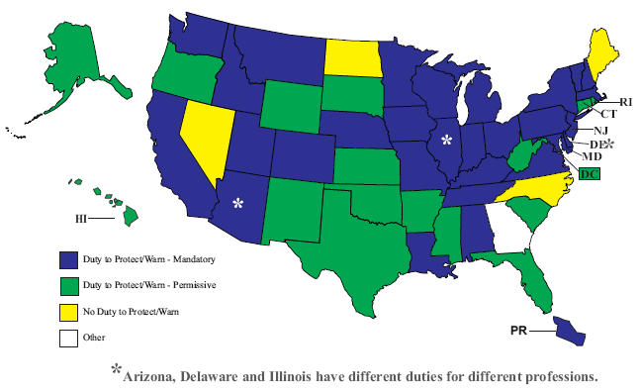
DUTY to protect/warn overview
NCSL Staff Research

Slide 13
Missouri Revised statute §632.300
632.300. Procedure when a likelihood of serious harm is alleged. — 1. When a mental health coordinator receives information alleging that a person, as the result of a mental disorder, presents a likelihood of serious harm to himself or others, he shall:
(1) Conduct an investigation;
(2) Evaluate the allegations and the data developed by investigation; and
(3) Evaluate the reliability and credibility of all sources of information.
2. If, as the result of personal observation or investigation, the mental health coordinator has reasonable cause to believe that such person is mentally disordered and, as a result, presents a likelihood of serious harm to himself or others, the mental health coordinator may file an application with the court having probate jurisdiction pursuant to the provisions of section 632.305; provided, however, that should the mental health coordinator have reasonable cause to believe, as the result of personal observation or investigation, that the likelihood of serious harm by such person to himself or others as a result of a mental disorder is imminent unless the person is immediately taken into custody, the mental health coordinator shall request a peace officer to take or cause such person to be taken into custody and transported to a mental health facility in accordance with the provisions of subsection 3 of section 632.305.
3. If the mental health coordinator determines that involuntary commitment is not appropriate, he should inform either the person, his family or friends about those public and private agencies and courts which might be of assistance.
(L. 1980 H.B. 1724, A.L. 1996 S.B. 884 & 841)

Slide 14
Missouri Revised statute §632.305
632.305. Detention for evaluation and treatment, who may request — procedure — duration — disposition after application. — 1. An application for detention for evaluation and treatment may be executed by any adult person, who need not be an attorney or represented by an attorney, including the mental health coordinator, on a form provided by the court for such purpose, and must allege under oath that the applicant has reason to believe that the respondent is suffering from a mental disorder and presents a likelihood of serious harm to himself or to others. The application must specify the factual information on which such belief is based and should contain the names and addresses of all persons known to the applicant who have knowledge of such facts through personal observation.
2. The filing of a written application in court by any adult person, who need not be an attorney or represented by an attorney, including the mental health coordinator, shall authorize the applicant to bring the matter before the court on an ex parte basis to determine whether the respondent should be taken into custody and transported to a mental health facility. The application may be filed in the court having probate jurisdiction in any county where the respondent may be found. If the court finds that there is probable cause, either upon testimony under oath or upon a review of affidavits, to believe that the respondent may be suffering from a mental disorder and presents a likelihood of serious harm to himself or others, it shall direct a peace officer to take the respondent into custody and transport him to a mental health facility for detention for evaluation and treatment for a period not to exceed ninety-six hours unless further detention and treatment is authorized pursuant to this chapter. Nothing herein shall be construed to prohibit the court, in the exercise of its discretion, from giving the respondent an opportunity to be heard.

Slide 15
Missouri Revised statute §632.305 cont.
3. A mental health coordinator may request a peace officer to take or a peace officer may take a person into custody for detention for evaluation and treatment for a period not to exceed ninety-six hours only when such mental health coordinator or peace officer has reasonable cause to believe that such person is suffering from a mental disorder and that the likelihood of serious harm by such person to himself or others is imminent unless such person is immediately taken into custody. Upon arrival at the mental health facility, the peace officer or mental health coordinator who conveyed such person or caused him to be conveyed shall either present the application for detention for evaluation and treatment upon which the court has issued a finding of probable cause and the respondent was taken into custody or complete an application for initial detention for evaluation and treatment for a period not to exceed ninety-six hours which shall be based upon his own personal observations or investigations and shall contain the information required in subsection 1 of this section.
4. If a person presents himself or is presented by others to a mental health facility and a licensed physician, a registered professional nurse or a mental health professional designated by the head of the facility and approved by the department for such purpose has reasonable cause to believe that the person is mentally disordered and presents an imminent likelihood of serious harm to himself or others unless he is accepted for detention, the licensed physician, the mental health professional or the registered professional nurse designated by the facility and approved by the department may complete an application for detention for evaluation and treatment for a period not to exceed ninety-six hours. The application shall be based on his own personal observations or investigation and shall contain the information required in subsection 1 of this section.
(L. 1980 H.B. 1724, A.L. 1996 S.B. 884 & 841)

Slide 16
Cultural Competence in Mental health
The American Psychological Association (APA), National Association of Social Workers (NASW), and National Board of Certified Counselors (NBCC) are just some of the organizations that include cultural competence and/or sensitivity in their Code of Ethics.
There is a strong mandate to remove barriers of access to care and to eliminate mental health disparities.
Michael Paasche-Orlow, MD, MPH, MA, asserts that there are three essential principles to cultural competence:
  Acknowledgement of the importance of culture in people’s lives.
  Respect for cultural differences.
  Minimization of any negative consequences of cultural differences.
Paasche-Orlow (2004)

Slide 17
Cultural Competence Definitions
Cultural Competence can be defined by three qualities:
  Cultural Sensitivity is an awareness and appreciation of human cultural diversity.
  Cultural knowledge is the factual understanding of the basic anthropological knowledge about cultural variation. It can be obtained through reading, consultation with experts, or meaningful interactions with individuals of diverse backgrounds.
  Cultural Empathy is the ability to connect emotional with the patient’s cultural perspective.
Cultural Guidance is assessing how a patient’s problems are related to cultural factors and suggesting therapeutic interventions that are based on cultural insight.
Cultural Relativism is a theory stating morality is relative to the norms of a culture.
Tseng, W.S. & Streltzer, J. (2004)

Slide 18
Ethical Dilemmas in Cultural competence
Professionals will have their own ethical commitments and ethical relativity.
What are your moral values?
How have you or will you work with a client who conflicts with your values?
How can you integrate your values with providing care?
When true ethical conflicts emerge, clinicians cannot be forced to embrace the full spectrum of cultural relativity.
  Many Western ethical norms are codified in law and standards of practice.
  Clinicians should utilize consultation in situations when ethical dilemmas surrounding cultural competence emerge.
  Clinicians can refer patient cases where they experience unavoidable conflict.
  What happens next?
Paasche-Orlow (2004)

Slide 19
American Psychological Associations Code of Ethics Regarding Cultural Competence
Principle E: Respect for People's Rights and Dignity
Psychologists respect the dignity and worth of all people, and the rights of individuals to privacy, confidentiality, and self-determination. Psychologists are aware that special safeguards may be necessary to protect the rights and welfare of persons or communities whose vulnerabilities impair autonomous decision making. Psychologists are aware of and respect cultural, individual, and role differences, including those based on age, gender, gender identity, race, ethnicity, culture, national origin, religion, sexual orientation, disability, language, and socioeconomic status, and consider these factors when working with members of such groups. Psychologists try to eliminate the effect on their work of biases based on those factors, and they do not knowingly participate in or condone activities of others based upon such prejudices.
Section 2: Competence
2.01 Boundaries of Competence: (b) Where scientific or professional knowledge in the discipline of psychology establishes that an understanding of factors associated with age, gender, gender identity, race, ethnicity, culture, national origin, religion, sexual orientation, disability, language, or socioeconomic status is essential for effective implementation of their services or research, psychologists have or obtain the training, experience, consultation, or supervision necessary to ensure the competence of their services, or they make appropriate referrals, except as provided in Standard 2.02, Providing Services in Emergencies.
American Psychological Association

Slide 20
American Psychological Associations Code of Ethics Regarding Cultural Competence cont.
Section 3: Human Relations
3.01 Unfair Discrimination: In their work-related activities, psychologists do not engage in unfair discrimination based on age, gender, gender identity, race, ethnicity, culture, national origin, religion, sexual orientation, disability, socioeconomic status, or any basis proscribed by law.
3.03 Other Harassment
Psychologists do not knowingly engage in behavior that is harassing or demeaning to persons with whom they interact in their work based on factors such as those persons' age, gender, gender identity, race, ethnicity, culture, national origin, religion, sexual orientation, disability, language, or socioeconomic status.
American Psychological Association

Slide 21
National Board for Certified Counselors (NBCC) Code of Ethics Regarding Cultural Competence cont.
Section 3: Human Relations
3.01 Unfair Discrimination: In their work-related activities, psychologists do not engage in unfair discrimination based on age, gender, gender identity, race, ethnicity, culture, national origin, religion, sexual orientation, disability, socioeconomic status, or any basis proscribed by law.
3.03 Other Harassment
Psychologists do not knowingly engage in behavior that is harassing or demeaning to persons with whom they interact in their work based on factors such as those persons' age, gender, gender identity, race, ethnicity, culture, national origin, religion, sexual orientation, disability, language, or socioeconomic status.
National Board for Certified Counselors

Slide 22
National Board for Certified Counselors (NBCC) Code of Ethics Regarding Cultural Competence cont.
NCCs take appropriate action to prevent harm.
4. NCCs shall not accept gifts from clients except in cases when it is culturally appropriate or therapeutically relevant because of the potential confusion that may arise. NCCs shall consider the value of the gift and the effect on the therapeutic relationship when contemplating acceptance. The considerations hall be documented in the client’s record.
NCCs provide only those services for which they have education and qualified experience.
26. NCCs shall demonstrate multicultural competence. NCCs shall not use counseling techniques or engage in any professional activities that discriminate against or show hostility towards individuals or groups based on gender, ethnicity, race, national origin, sexual orientation, disability, religion or any other legally prohibited basis. Techniques shall be based on established, clinically sound theory. NCCs shall discuss appropriate consideration and obtain written consent from the client(s) prior to the use of any experimental approach.
NCCs communicate truthfully.
48. NCCs shall accurately report test and assessment results and limit conclusions to those based on evidence, taking into consideration any influences that may affect results such as health, motivation and multicultural factors. NCCs shall generally avoid making decisions based on a single test or assessment result.
National Board for Certified Counselors

Slide 23
National Association of Social Workers Code of Ethics Regarding Cultural Competence
Value: Social Justice
Ethical Principle: Social workers challenge social injustice.
Social workers pursue social change, particularly with and on behalf of vulnerable and oppressed individuals and groups of people. Social workers' social change efforts are focused primarily on issues of poverty, unemployment, discrimination, and other forms of social injustice. These activities seek to promote sensitivity to and knowledge about oppression and cultural and ethnic diversity. Social workers strive to ensure access to needed information, services, and resources; equality of opportunity; and meaningful participation in decision making for all people.
Value: Dignity and Worth of the Person
Ethical Principle: Social workers respect the inherent dignity and worth of the person.
Social workers treat each person in a caring and respectful fashion, mindful of individual differences and cultural and ethnic diversity. Social workers promote clients' socially responsible self-determination. Social workers seek to enhance clients' capacity and opportunity to change and to address their own needs. Social workers are cognizant of their dual responsibility to clients and to the broader society. They seek to resolve conflicts between clients' interests and the broader society's interests in a socially responsible manner consistent with the values, ethical principles, and ethical standards of the profession.
National Association of Social Workers

Slide 24
National Association of Social Workers Code of Ethics Regarding Cultural Competence
1.05 Cultural Awareness and Social Diversity
(a) Social workers should understand culture and its function in human behavior and society, recognizing the strengths that exist in all cultures.
(b) Social workers should have a knowledge base of their clients' cultures and be able to demonstrate competence in the provision of services that are sensitive to clients' cultures and to differences among people and cultural groups.
(c) Social workers should obtain education about and seek to understand the nature of social diversity and oppression with respect to race, ethnicity, national origin, color, sex, sexual orientation, gender identity or expression, age, marital status, political belief, religion, immigration status, and mental or physical ability.
(d) Social workers who provide electronic social work services should be aware of cultural and socioeconomic differences among clients and how they may use electronic technology. Social workers should assess cultural, environmental, economic, mental or physical ability, linguistic, and other issues that may affect the delivery or use of these services.
1.06 Conflicts of Interest
(c) Social workers should not engage in dual or multiple relationships with clients or former clients in which there is a risk of exploitation or potential harm to the client. In instances when dual or multiple relationships are unavoidable, social workers should take steps to protect clients and are responsible for setting clear, appropriate, and culturally sensitive boundaries. (Dual or multiple relationships occur when social workers relate to clients in more than one relationship, whether professional, social, or business. Dual or multiple relationships can occur simultaneously or consecutively.)
National Association of Social Workers

Slide 25
National Association of Social Workers Code of Ethics Regarding Cultural Competence
1.09 Sexual Relationships
(b) Social workers should not engage in sexual activities or sexual contact with clients' relatives or other individuals with whom clients maintain a close personal relationship when there is a risk of exploitation or potential harm to the client. Sexual activity or sexual contact with clients' relatives or other individuals with whom clients maintain a personal relationship has the potential to be harmful to the client and may make it difficult for the social worker and client to maintain appropriate professional boundaries. Social workers--not their clients, their clients' relatives, or other individuals with whom the client maintains a personal relationship--assume the full burden for setting clear, appropriate, and culturally sensitive boundaries.
1.10 Physical Contact
Social workers should not engage in physical contact with clients when there is a possibility of psychological harm to the client as a result of the contact (such as cradling or caressing clients). Social workers who engage in appropriate physical contact with clients are responsible for setting clear, appropriate, and culturally sensitive boundaries that govern such physical contact.
3.01 Supervision and Consultation
(b) Social workers who provide supervision or consultation are responsible for setting clear, appropriate, and culturally sensitive boundaries.
National Association of Social Workers

Slide 26
National Association of Social Workers Code of Ethics Regarding Cultural Competence
3.02 Education and Training
(d) Social workers who function as educators or field instructors for students should not engage in any dual or multiple relationships with students in which there is a risk of exploitation or potential harm to the student, including dual relationships that may arise while using social networking sites or other electronic media. Social work educators and field instructors are responsible for setting clear, appropriate, and culturally sensitive boundaries.
6.01 Social Welfare
Social workers should promote the general welfare of society, from local to global levels, and the development of people, their communities, and their environments. Social workers should advocate for living conditions conducive to the fulfillment of basic human needs and should promote social, economic, political, and cultural values and institutions that are compatible with the realization of social justice.
6.04 Social and Political Action
(c) Social workers should promote conditions that encourage respect for cultural and social diversity within the United States and globally. Social workers should promote policies and practices that demonstrate respect for difference, support the expansion of cultural knowledge and resources, advocate for programs and institutions that demonstrate cultural competence, and promote policies that safeguard the rights of and confirm equity and social justice for all people.
National Association of Social Workers

Slide 27
Summary of rights for consumers in State-operated facilities and department of mental health consumers
Certain sections applicable to:
Consumers of Department of Mental Health Services
Consumers of psychiatric hospitals accredited by the Joint Commission
Participants of the Medicaid and Medicare programs
Note:
Some rights may be limited for safety or therapeutic reasons

Slide 28
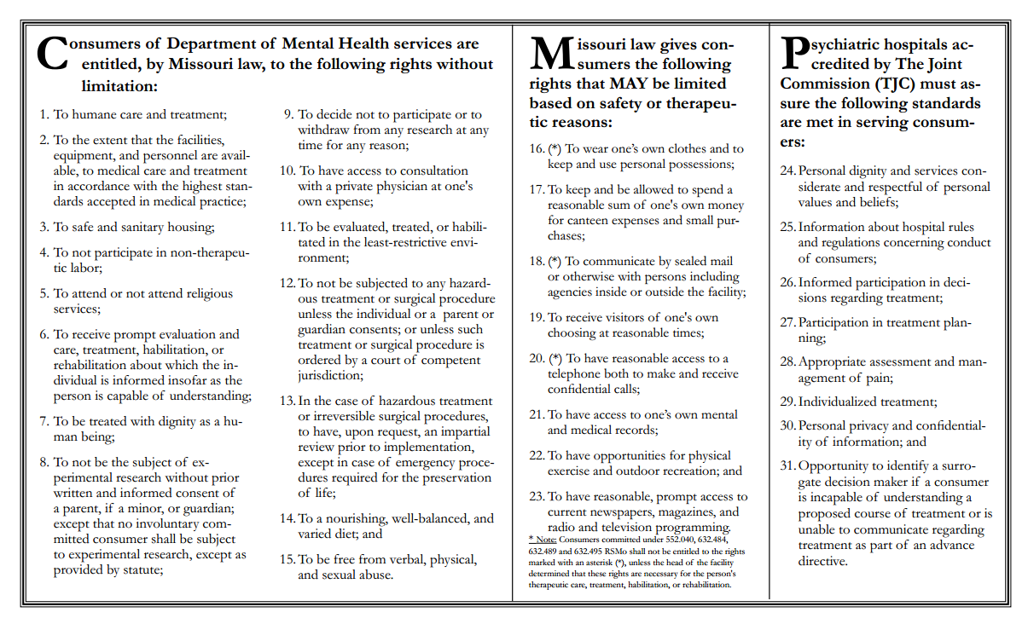

Slide 29
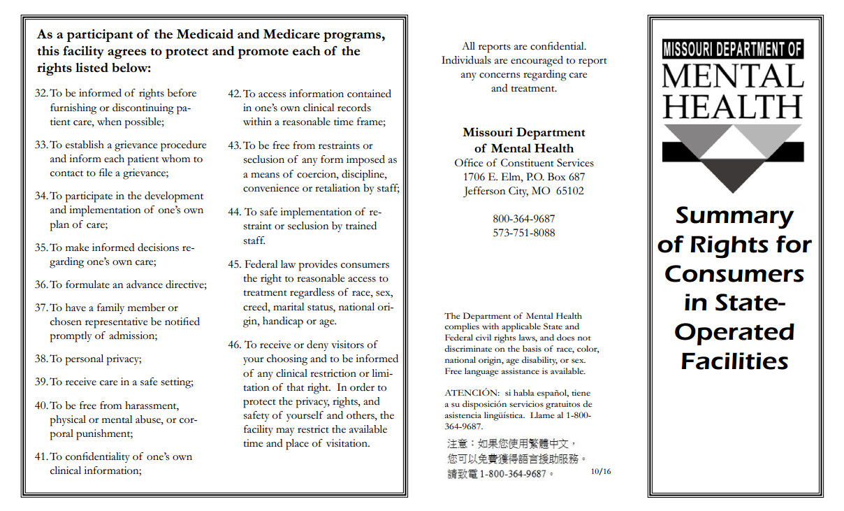

Slide 30
Ethical issues related to mental health care emergencies
Minimizing Harm:
  Individuals with mental illness may be more vulnerable to disruptions in normal routines inherent in an emergency and less likely than others to prepare or shelter themselves from significant harm.
  As care providers we should anticipate the needs and develop strategies to minimize the harm that persons with mental health disorders may face in an emergency.
Equity:
  Individuals with mental disorders are often subject to an inequitable standard of care when compared to physical impairments.
  Emergency planners and responders must sustain commitment to equity by:
    Ensuring needs of those with mental health disorders are given fair attention during emergencies.
    Engaging in effective planning and training exercises to prepare for mental health challenges.
John Hopkins Public Health Preparedness Programs

Slide 31
Ethical issues related to mental health care emergencies cont.
Effectiveness:
  Commitment to effective treatment must be sustained to the greatest degree possible.
Respecting Choice:
  Emergency mental health responders should respect the choices and preferences of those affected to the greatest degree possible.
  If any constraints on choice are necessary, they should be applied equally to the population and proportionate to the intended outcome.
  Public health officials should choose the intervention that provides the least amount of infringement to achieve the desired effect.
John Hopkins Public Health Preparedness Programs

Slide 32
Ethical issues related to mental health care emergencies cont.
Right to Privacy:
  Rights to privacy may be compromised during an emergency due to a break down in the systems to maintain confidentiality.
  PHI may need to be shared to help individuals in need.
  Public health and emergency responders should work to protect the privacy of mental health data on a “need to know” basis when possible.
Duty to Provide Care:
  Professional codes of ethics reinforce the duty to continue to provide care during an emergency.
  Individuals with mental disorders and physical disabilities may be most at risk of living in poverty and require advocacy and continued care during times of emergency.
John Hopkins Public Health Preparedness Programs

Slide 33
Ethical issues related to mental health care emergencies
Transparency:
  Responders should be transparent to the public regarding how they are prioritizing and strategizing.
  Transparency is respectful and can minimize individual and societal anxieties and other harms.
Miscellaneous:
  Individuals with pre-existing disorders are more likely to depend on a particular treatment regimen.
    The obligation to provide this treatment regimen differs from the duty to provide the safest mental health “first aid” for an individual with an acute mental disorder.
  Individuals with mental disorders should not be segregated from patients with other illnesses unless there are risks related to the individual or public safety, or their needs could be better met in a separate facility.
  Standards for evaluation, treatment, and hospitalization should be defined in emergency training manuals, including explanations of the need to provide the least restrictive care consistent with safety.
John Hopkins Public Health Preparedness Programs

Slide 34
Ethical research in mental health: Community Engaged Research
Research that does not address the knowledge or health priorities of communities may contribute to research fatigue and an unwillingness to participate in research.
Engaging communities in appropriate ways is a form of showing respect for community members as persons.
  It provides a voice to individuals who are often disenfranchised.
  The American Psychological Association has asserted that community engagement is a requirement of any ethical research with minority communities.
To be ethical, research must be scientifically valid.
  Invalid research benefits no one and wastes resources.
  Community Engaged Research can improve recruitment, retention, and the quality of participation, it can also compromise the quality of science if done poorly.
DuBois, J., Bailey-Burch, B., Bustillos, D., Campbell, J., Cottler, L., Fisher, C., … Stevenson, R.D.

Slide 35
Ethical research in mental health: Community Engaged Research cont.
Mental health service users have reported that participatory research offered them opportunities to gain knowledge and to share their unique perspectives increased self-esteem, provided an opportunity for employment, and gave them a chance to give back to society and help others.
A group of mental health professionals consumer-researchers have identified a list of requirements of appropriate involvement of consumers on the research team:
  payment for work; equal treatment; involvement in all stages of research; acknowledgement of power differentials; regular feedback on work; safe work environment, including emotional support; and sufficient training
Initially, it may be difficult to recruit diverse community members to engage researchers, but doing so will help to empower the community members and better represent the agenda of the community.
It may take time to adapt and appreciate the different values and expertise of the community members, just as it may take time for community members to understand the rules of science and research.
Community advisory boards are suggested because community members may become integrated into the research team and lose their ability to represent the community views accurately.
DuBois, J., Bailey-Burch, B., Bustillos, D., Campbell, J., Cottler, L., Fisher, C., … Stevenson, R.D.

Slide 36
Review of the Complaint and Discipline Process
A complaint is submitted to the Committee.
  The licensee has an opportunity to respond to the claim.
  The committee reviews the complaint and the licensee’s response.
  The committee may dismiss the complain or request investigation.
  The committee may refer the complaint to legal counsel seeking formal discipline.
Discipline that may be imposed by the State Committee of Social Workers:
  Letter of Concern (not formal discipline)
  Public Censure
  Probation (not to exceed five years)
  Suspension (not to exceed three years)
  Revocation (or any combination of the above)
The licensee has the ability to appeal the decision with the Administrative Hearings Commission or the Circuit Court.

Slide 37
Works Cited
American Psychological Association. (2016). Revision of ethical standard 3.04 of the “Ethical Principles of Psychologists and Code of Conduct” (2002, as amended 2010). American Psychologist, 71, 900.
Applebaum, P.S. (1985). Tarasoff and the clinician: Problems in fulfilling the duty to protect. American Journal of Psychiatry. 142, 425- 429.
Barrett, M.S. (2013). Ethical decision-making in mental health [PowerPoint Presentation]. Retrieved from http://www.dhss.delaware.gov/dsamh/files/si10_1399_presentation.pdf
Berger, S. & Berger, M. (2009). Tarasoff “duty to warn” clarified. The National Psychologist. Retrieved October 19, 2017, from https://nationalpsychologist.com/2009/03/tarasoff-%E2%80%9Cduty-to-warn%E2%80%9D-clarified/101056.html
Borum, R., & Reddy, M. (2001). Assessing violence risk in Tarasoff situations: A fact based inquiry. Behavioral Sciences and the Law, 19, 375-385.
Congress, E. P. (1999). Social work values and ethics: Identifying and resolving professional dilemmas. Belmont, CA: Wadsworth Publishing
Corey, G., Corey, M.S., & Callanan, P. (1998). Issues and ethics in the helping professions. Toronto: Brooks/Cole Publishing Company; Syracuse School of Education. (n.d.), An ethical decision making model, accessed April 17, 2018
DuBois, J., Bailey-Burch, B., Bustillos, D., Campbell, J., Cottler, L., Fisher, C., … Stevenson, R.D. (2011). Ethical issues in mental health. Curr Opin Psychiatry. 2011 May; 24(3): 208-214. doi: 10.1097/YCO.0b013e3283459422.

Slide 38
Works Cited Cont.
Granich, S. (2012). Duty to warn, duty to protect. The New Social Worker. Winter 2012; 19 (1). Retrieved October 19, 2017, from http://www.socialworker.com/feature-articles/ethics-articles/Duty_to_Warn%2C_Duty_to_Protect/
Harvard Mental Health Letter, 2008, January, 24. (7) 4-5.
John Hopkins Public Health Preparedness Programs. Frequently asked questions on ethical issues related to mental health care in emergencies. (2012, June 27). Retrieved October 19, 2017, from https://www.jhsph.edu/research/centers-and- institutes/center-for-law-and-the-publics-health/research/CDC_PERRC_Tool6.pdf
National Association of Social Workers. (2018). Preamble to the code of ethics. Retrieved April 13, 2018, from https://www.socialworkers.org/About/Ethics/Code-of-Ethics/Code-of-Ethics-English
National Board for Certified Counselors. (2016). Code of ethics. Greensboro, NC: Author.
NCSL Staff Research; Edwards, Griffin Sims. Database of State Tarasoff Laws, February 2010.
Paasche-Orlow, M. (2004). The ethics of cultural competence. Academic Medicine (pp. 347-350). 2004, April. 79 (4).
Tseng, W.S., & Streltzer, J. (2004). Introduction: Culture and psychiatry. In W.S. Tseng& J. Streltzer (Eds.), Cultural competence in clinical psychiatry (pp. 1-20). Washington, DC: American Psychiatric Publishing.
World Health Organization. Ten facts of mental health. http://www.who.int/features/factfiles/mental_health/mental_health_facts/en/index1.html. Accessed April 11, 2016.

