Slide 1
Etiologies of Addiction
John W. Airsman PsyD, LPC

Slide 2
Limitations and Clarifications
These are only suggestive assertions based on recent published literature.
Based on research utilizing a systematic review of literature, coupled with clinical experience.
Encouraging more research and speculation.
Focuses primarily on etiologies, rather than clinical implications, although there will be some discussion.
May not be applicable to every person with addictive disorders.
Addiction is complex.
Improve clinical approaches and reduce relapse rates.

Slide 3
The Problem
80% relapse rate during the first six months of treatment (Kassani, Niazi, Hassanzadeh, & Menati, 2015)
64% lapse in recovery after the first six months (Robinson, Robinson, 2014)

Slide 4
Other areas of research etiologies of addiction
Maladaptive learning
Response inhibition dysfunction
Working memory limitations
Value circuits dysregulation
The role of the insula
Sensory and motor functions related to cue induced triggers

Slide 5
Genetic Predisposition
Agrawal et al. (2013) craving is a genetic dynamic
A-synuclein in alcoholics (proteins linked to cravings)
Schuckit et al., (2012) high responders versus low responders.
Low responders require more alcohol for the desired effect.
Juli and Juli (2015) a common genetic pathway with smoking, alcohol, and opioid use disorders.

Slide 6
Popular Theories of SUD
Incentive sensitization theory
Reward deficiency syndrome
Dysregulation of stress systems

Slide 7
Incentive sensitization theory (Berridge & Robinson, 2016)
Dopaminergic system (not hedonic)
Dopamine (motivation, desire, wanting, rewards based learning)
Endogenous opioids ( hedonic, liking)

Slide 8
Incentive sensitization theory
(Berridge & Robinson, 2016)
Sensitization of the reward pathway
Incentive salience causing strong associations
Long-lasting neuroplasticity
Increases after abstinence
“incubation of craving”

Slide 9
Reward Deficiency Syndrome
(Blum, Gardner, Oscar-Berman, & Gold, 2015)
DRD2 receptor gene
Predisposed due lower amounts of dopamine
Substance seeking (regulate imbalance)
Irritability, dysthymia, and stress
Reward cascade

Slide 10
Dysregulated stress systems (Koob, 2015)
Substance abuse… activation of the hypothalamic–pituitary–adrenal (HPA) axis
Decrease in dopaminergic release, thus promoting negative affect
“it just doesn’t work anymore”
GABA and glutamate dysfunction

Slide 11
Interpersonal trauma
Multiple studies reflect well-predictable and high incidences of childhood insults predicting development of substance use disorders(Banducci, Hoffman, Lejuez, & Koenen, 2014a; Guina, Nahlas, Goldberg, & Farnsworth, 2016; Craparo, Ardino, Gori, and Caretti, 2014; Barahmand, Khazaee, and Hashjin, 2016).

Slide 12
Symptom | Sexual abuse | Physical abuse | Emotional abuse
Depression | x |  | x
Suicide ideation | x | x
Sexual Dysregulation | x
Post-traumatic stress disorder | x
Substance use disorder | x | x
Emotional dysregulation |  | x | x
Criminal behavior |  | x
Aggression |  | x
Learned helplessness |  |  | x
Low self-worth |  |  | x
Negative affect |  |  | x

Slide 13
Dopamine and dysregulation/interpersonal Trauma
Traumatizing events early in childhood may disrupt the development of the dopaminergic system (Cuevas, et al. 2014)
Impairments inabilities to connect socially (natural rewards).

Slide 14
Dopamine and dysregulation/interpersonal
Fear salience due to trauma
Abnormal development in dopamine systems and stress axis
Increasing risk for SUD
More research needed

Slide 15
Dopamine and dysregulation/interpersonal
Parental experiences dictate the development of the dopaminergic system, as well as the stress coping system. This places individuals in a highly susceptible position to develop substance use disorder due to low amounts of dopamine, inabilities to cope with stress, and difficulties connecting socially.

Slide 16
Emotional regulation
Emotional regulation (ER) is a mental strategy/process that facilitates control over affective mental conditions
Childhood developmental key stage
(Dvir, Ford, Hill, & Frazier, 2014; Tang, Tang, & Posner, 2016; Parolin et. al, 2016).

Slide 17
Emotional dysregulation
Emotional
dysregulation
Substance
use disorder
Significant overlay in neurological mechanisms

Slide 18
Emotional dysregulation
Attachment issues
Intergenerational transmission
Interpersonal integrity
Alexithymia

Slide 19
Underreported interpersonal dysfunction
Trauma versus interpersonal dysfunction
Intergenerational transmission (minimizing or unaware)
Alexithymia (inability to report)
Low motivation (noncompliance)

Slide 20
Interpersonal trauma
Developmental trauma
Trauma or lack of attunement exposure leads to dysregulation of stress system
Symptoms of dysphoria and negative affect
Substance use to mitigate the symptoms

Slide 21
Alexithymia
45% to 67% present with (SUD)alexithymia
Difficulties identifying and describing emotions
Extrinsic focus to regulate
Similar to disassociation
Complications in treatment

Slide 22
Attachment issues (Fletcher, Nutton, Brend, 2014)
Addiction as an attachment disorder
Suggested an association between addiction and insecure attachment
Fearful avoidant attachment
Substance acts as a substitutionary object
Isolation exacerbates dysregulation

Slide 23
Intergenerational transmission
Transmission of parental neurology
In utero and/or environmentally
Transference of trauma and interpersonal issues
Holocaust exposure studies (Yehuda, 2015)
Hyperactive stress systems

Slide 24
Treatment for emotional dysregulation
More research on which one of these domain is more critical in addiction/relapse
Healthy emotional regulation is contingent on the functionality on all five domains.
Treatment modalities focusing on all the next effectiveness of treatment.

Slide 25
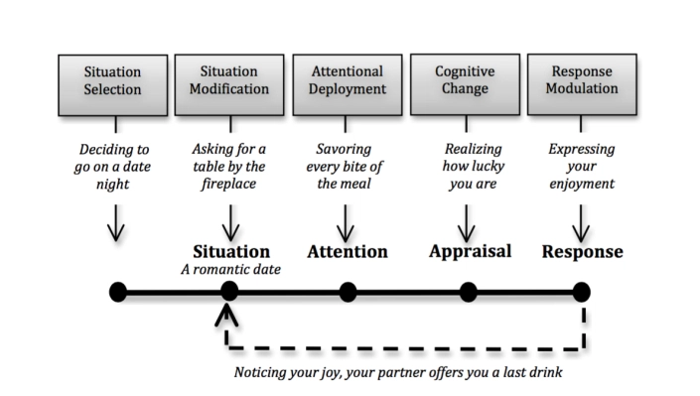
Emotional regulation

Slide 26
Emotional regulation
Situation selection involves making a choice anticipating the probability of or absence of an emotional response. The nature of the response can be positive or negative.

Slide 27
Emotional regulation
Situational modification is also based off the choice. The choice is a matter of altering the situation to affect the emotional consequences.

Slide 28
Emotional regulation
Attention deployment is the directing or redirecting of attention anticipating a shift in affect for more desirable conditions.

Slide 29
Emotional regulation
Cognitive change (CBT) involves modulation or governing the evaluation of the situation. The therapeutic reframe is an accurate description of this domain.
Research suggests SSRIs may improve this phase

Slide 30
Emotional regulation
Response modulation is essentially the reaction or response. This includes extrinsic coping mechanisms.

Slide 31
Emotional dysregulation
Recognition and description of affect(alexithymia)
Difficulties in regulating negative affect
Low motivation to endure uncomfortable feelings
Poor choices in response(Spence and Courbasson, 2012)

Slide 33
Clinical implications
The nebulous role of alexithymia
Attunement and Mindsight ( Clinical tools)
Targeting emotional regulation dysfunctional domains
Underreported interpersonal trauma, due to alexithymia
Underreported interpersonal issues, due to intergenerational transmission

Slide 34
Alexithymia
Asking a client “how do you feel”?
45% to 67% present with (SUD)alexithymia
Difficulties identifying and describing emotions

Slide 35
Psycho-Drama Therapy
Psychodrama as an affective means of bypassing cognitive defenses to access the right prefrontal cortex, anterior cingulate cortex, and insula. This could be a possible means overcoming the alexithymic condition.

Slide 36
Dream analysis
By-passing defensives and alexithymia

Slide 37
Social engagement
12 step communities
Refuge Recovery and Smart Recovery
Mitigating isolation
Unconditional positive regard
Ventromedial PFC (atunement)

Slide 38
Speculations and questions
Is CBT and DBT fully sufficient for treatment of substance use disorder related to interpersonal trauma and alexithymia?
Creative ways to improve working memory and engage the ventromedial prefrontal cortex and insula.

